Slide 1
A Child-Centered AT Plan: A Process for Including Assistive Technology (AT)
Training materials created by the Technology to Improve Kids’ Educational Success (TIKES) Project, a project of PACER Center (PACER.org/stc/tikes)
Notes:
Slide 1: Title Slide

Slide 2
A Child-Centered AT Plan: A Process for Including Assistive Technology (AT) Training materials created by PACER Center for the Technology to Improve Kids’ Educational Success (TIKES) Project
Paula Goldberg, PACER Center Executive Director
Bridget Gilormini, Director PACER’s Simon Technology Center
Notes:
Slide 2: Workshop Information
Presenter Notes:
Workshop presenters may wish to insert location, date, and name of presenters on this slide.

Slide 3
Federally funded Early Childhood and Assistive Technology Grants
The TIKES Project is an education priority that is based on research that shows assistive technology is very underutilized by children with disabilities ages birth to 5
The TIKES Project is one of three grants awarded in the country by the U.S. Department of Education’s Office of Special Education Programs (OSEP)
You play an important role in equipping and supporting not only yourselves but future early intervention and early childhood providers, teachers and parents across the U.S.A. about AT
Notes:
Slide 3: About TIKES
Presenter Notes:
TIKES, or Technology to Improve Kids’ Educational Success, is one of three early childhood and assistive technology model demonstration grants awarded nationally. This education grant is based on a priority to improve outcomes for children with disabilities ages birth to 5 by leveraging the use of assistive technology to bridge developmental and achievement gaps. Research shows that assistive technology is underutilized and underdocumented for children with disabilities ages birth to 5. The majority of families do not learn about assistive technology from their teachers or providers but from other families. This grant is about developing a model of training materials to equip and support educators and families by increasing their knowledge and awareness of assistive technology, and helping them identify appropriate technology solutions for their children or students.

Slide 4
PACER Center
An established national parent center providing important information to parents and educators for more than 35 years
More than 30 programs
PACER.org
952-838-9000
Notes:
Slide 4: About PACER Center
Presenter Notes:
PACER Center is a parent center built on the model of parents helping parents. For more than 35 years, PACER has been helping families advocate for the educational rights of their children. PACER also works closely with schools and school districts, educators, and providers to help them understand the parent perspective, provide valuable staff training resources, and offer resources from more than 30 different programs that include transition, bullying prevention, early childhood, racially and culturally diverse projects, state personnel development grants, and more.

Slide 5
Simon Technology Center
Celebrating over 29 years of assistive technology services and projects
Dedicated to making the benefits of technology more accessible
PACER.org/stc
952-838-9000
Notes:
Slide 5: About the Simon Technology Center
Presenter Notes:
For over 29 years, the knowledgeable staff of the Simon Technology Center have been making the benefits of assistive technology accessible to families, educators, and individuals. The STC does this through a variety of core services and assistive technology projects, including free assistive technology consultations with families and their children, information and referral services, workshops, and a vast AT lending library to support the exploration of assistive technology.

Slide 6
Session Agenda
Reviewing legal requirements of consideration
2. Three tools for including AT
3. Using the consideration tools
4. Items for discussion
5. Closing thoughts, questions, & evaluations
Notes:
Slide 6: Session Agenda
Presenter Notes:
“The Child-Centered AT Plan: A Process for Including Assistive Technology (AT)” is a workshop designed to help educators and families learn about three tools to help Individual Family Service Plan (or IFSP) and Individualized Education Program (or IEP) teams consider assistive technology for children ages birth to 5. Including AT in the the IFSP or IEP, or “Consideration of AT,” is a legal requirement as part of the Individuals with Disabilities Education Act (IDEA).
This presentation will review the legal requirements for consideration, introduce three easy-to-use and helpful documents, review how to use these documents, and discuss some commonly asked questions.
NOTE TO PRESENTERS: If you are an early intervention provider only working with children with disabilities ages birth to 3 you can hide slides 31-44 (Using the Consideration Tools: IEP). If you are an early childhood education provider only working with children with disabilities ages 3 to 5, you can hide slides 16-30 (Using the Consideration Tools: IFSP).

Slide 7
Reviewing Legal Requirements
Page 7
Notes:
Slide 7: Reviewing Legal Requirements
(Transition slide leading into the review of legal requirements for considering assistive technology in the Individual Family Service Plan (IFSP) and the Individualized Education Program (IEP).)

Slide 8
Individuals with Disabilities Education Act (IDEA)
IDEA requires that assistive technology be CONSIDERED for all students with a disability who have an IFSP or IEP.
Notes:
Slide 8: Individuals with Disabilities Education Act (IDEA)
Presenter Notes:
Let’s review. In a previous workshop, “Including Assistive Technology (AT) in the Individual Family Service Plan (IFSP) and Individualized Education Program (IEP),” we introduced the process for considering assistive technology. The Individuals with Disabilities Education Act, or IDEA, is the federal special education law that addresses services for children with disabilities. It was signed into law in 1975. This law requires schools to provide necessary assistive technology devices and services to help children with disabilities receive an appropriate education. Simply said, for every child with an IFSP or IEP, assistive technology must be considered.

Slide 9
Individuals with Disabilities Education Act (IDEA)
The law tells us to consider assistive technology.
It doesn’t tell us what this process looks like.
Notes:
Slide 9: Individuals with Disabilities Education Act (IDEA)
Presenter Notes:
The law tells us to consider assistive technology, but it does not tell us how to consider assistive technology. Although it does not outline this process for us, it is important to consider assistive technology and to document this consideration process.
Ask your administrator about the district’s guidelines for documenting the consideration of AT. Documenting gives clear evidence that you have indeed considered assistive technology and clearly communicates with all team members, including the family, what AT is being tried or used with a child.

Slide 10
Best Practices
Quality Indicators for Assistive Technology (QIAT) (QIAT.org)
Notes:
Slide 10: Best Practices
Presenter Notes:
The Quality Indicators of Assistive Technology (QIAT) is a grassroots movement of leaders in assistive technology that has helped establish guidance in best practices for assistive technology. Most of the work you see today about the language of consideration, including the SETT (Student, Environment, Tasks, Tools) framework and more can be traced back to Joy Zabala and the QIAT Leadership Team. While the plans we are going to share with you today were not created by QIAT, they have certainly been influenced by the work of QIAT. There are many resources available on the QIAT website as well as an active community of professionals, parents, and vendors around the country who communicate via the QIAT List about many topics of assistive technology including the legal process of consideration.

Slide 11
Three Tools for Including AT
Page 11
Notes:
Slide 11: Three Tools for Including AT
(Transition slide leading into the introduction of three consideration tools and the history behind their development.)

Slide 12
Developing Useful Tools
To help IFSP and IEP teams consider the use of assistive technology for children ages birth to 5, the TIKES Project has developed simple documents that are easy to use.
Notes:
Slide 12: Developing Useful Tools
Presenter Notes:
The SETT framework (Student, Environment, Task, and Tools) is frequently used in K-12 settings, but was not written for a birth to age 5 audience. This is likely due in part to the many different ways early intervention and early childhood services are delivered around the country. In the initial stages of our project, we developed a Child-Centered AT Plan. Over the years of the project, the TIKES team has received feedback from participating providers as they used the plan. This helped the TIKES team in designing simple and useful tools.

Slide 13
Barriers to Consideration
Lack of knowledge
of the law
of AT or what is considered AT
of the consideration process
Lack of clear direction about how and where to document
Lack of time
Notes:
Slide 13: Barriers to Consideration
Presenter Notes:
In our development process we looked at some of the barriers to consideration. We wanted the products we developed through the TIKES Project to address these barriers and be high-quality tools that teachers would find useful. In addition, we conducted a random sampling of IFSP and IEP documents. This random review yielded some valuable information about how and where IFSP and IEP providers document assistive technology.

Slide 14
IFSP/IEP Sampling: Trends
Very low percentage of evidence of consideration in IFSPs
Higher percentage of evidence of consideration in IEPs when AT has a specific place in the IEP
Many items commonly considered AT were not identified as AT.
Notes:
Slide 14: IFSP/IEP Sampling: Trends
Presenter Notes:
We know that research shows underutilization of assistive technology for children with disabilities ages birth to 5. In our work with TIKES, while analyzing IFSP and IEP documents from our partner districts, we found evidence of the use of assistive technology, but the teams did not label it as assistive technology. For example, a provider may have listed under “Accommodations” that a child used a visual schedule and picture communication book, but also documented that “AT was considered and is not needed at this time.” Overall, we found a high incidence of documenting visual strategies and supports, supports for sensory needs, and supports for challenging behaviors, all of which may be considered assistive technology.
The first thing we analyzed in this group of random samples was quantity. IFSP and IEP software programs and documents differ by district, but do have some common elements. In districts where IEPs have a specific place to document assistive technology, the quantity of documentation was higher. The second aspect we analyzed was quality of documentation. We looked at consistency, contradicting statements, etc. As in the previous example, there were many documents that stated that AT had been considered but was not needed, while AT use was mentioned throughout the document. This random sample of IEPs and IFSPs, and all of our experiences in education, led to the development of tools that are simple, easy to use, and will intentionally guide teachers, professionals, and families through the process of considering AT.

Slide 15
Three Planning Documents
AT Consideration Flowchart
Visual planning guide
Child-Centered AT Plan
Documentation guide
Expanded Child-Centered AT Plan
Comprehensive documentation guide
Notes:
Slide 15: Three Planning Documents
Presenter Notes:
As we discussed our experiences, the research on AT use, and what would be useful to IFSP and IEP teams, we created a plan that would be easy to use. We wanted a design that would not add paperwork to a provider’s workload, but would help them be intentional about the legal requirement to consider assistive technology. We created an AT Consideration Flowchart designed to function as a visual planning guide of the possible outcomes of consideration. We developed the Child-Centered AT Plan, a two-page documentation guide that systematically helps you to an outcome based on the child or student with whom you are working. We also created an Expanded Child-Centered AT Plan that could or could not be used with every child. It would function as a tool to help with more complex cases.

Slide 16
Using the Consideration Tools: IFSP
Page 16
Notes:
Slide 16: Using the Consideration Tools: IFSP
(Transition slide leading into how to use each of the tools in the early intervention process.)

Slide 17
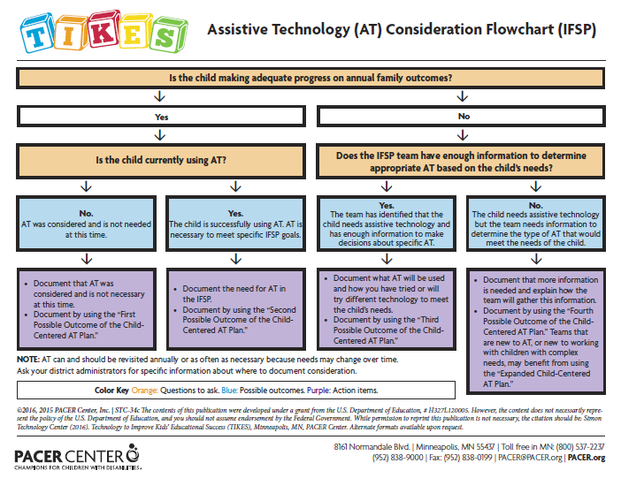
TIKES’ AT Consideration Flowchart (IFSP)
Visual reminder
Color coded
Includes
Key questions
Possible outcomes
Action items
Notes:
Slide 17: TIKES’ AT Consideration Flowchart (IFSP)
Presenter Notes:
The first tool we want to talk about is the AT Consideration Flowchart. The purpose of this tool is to function as a visual guide for the possible outcomes of consideration. For each student, there will be one outcome of consideration. The flowchart includes key questions in orange, possible outcomes in blue, and action items in purple. The TIKES’ AT Consideration Flowchart can serve as a reminder for people who are considering AT.

Slide 18
TIKES’ AT Consideration Flowchart (IFSP)
Follow the flowchart
Is the child making adequate progress on annual family outcomes?
Either a yes or no answer leads you to another question that will help guide the process.
Notes:
Slide 18: TIKES’ AT Consideration Flowchart (IFSP)
Presenter Notes:
As we follow the key questions in orange, they will lead you to four possible outcomes of consideration in blue, followed by an action item in purple that will lead to the use of the TIKES’ Child-Centered AT Plan. Follow the flowchart and look at the possible outcomes of consideration. The first question, listed in orange, is: “Is the child making adequate progress on annual family outcomes?” Either a “yes” or “no” answer leads you to another question that will continue to guide the process.

Slide 19
TIKES’ AT Consideration Flowchart (IFSP)
Yes, the child is making progress.
Is the child currently using AT?
A yes or no answer leads you to an outcome and an action item.
Notes:
Slide 19: TIKES’ AT Consideration Flowchart (IFSP)
Presenter Notes:
The first question the consideration flowchart asks is: “Is the child making adequate progress on annual family outcomes?” The team determines, yes, the child is making progress. This leads to the second question (in orange), “Is the child currently using AT?” A yes or no answer here leads to an outcome (in blue) and an action item (in purple), and guides the team to the Child-Centered AT Plan.

Slide 20
TIKES’ AT Consideration Flowchart (IFSP)
No, the child is not currently using AT.
Outcome 1: AT was considered by the team and is not needed at this time.
Action Item 1: Document that AT was considered and is not necessary at this time. Use the “First Possible Outcome of the Child-Centered AT Plan.”
Notes:
Slide 20: TIKES’ AT Consideration Flowchart: IFSP
Presenter Notes:
The second question asked is: “Is the child currently using AT?” This time the answer is, “No, the child is not currently using AT.” The child is making progress, is not using, and does not need assistive technology. This leads to the first possible outcome, “AT was considered and is not needed at this time.” There is also an action item to document the consideration of AT using the first possible outcome of the Child-Centered AT Plan (1. Including AT — First Possible Outcome: AT was considered and is not needed at this time.)

Slide 21
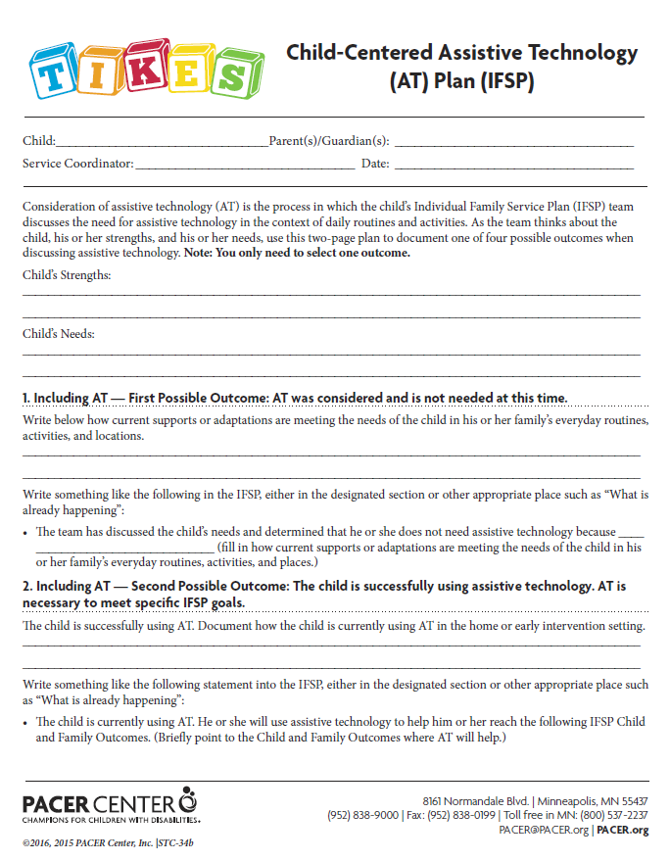
TIKES’ Child-Centered AT Plan: Four Different Possible Outcomes
Start by filling in basic information.
Note the child’s strengths and needs.
Important: Only choose one of four possible outcomes.
Notes:
Slide 21: TIKES’ Child-Centered AT Plan: Four Different Possible Outcomes
Presenter Notes:
Following the flowchart to the first possible outcome, the team is now working in the two-page TIKES’ Child-Centered AT Plan. Start by filling in the basic information: Child’s name, service coordinator, parents’ name(s), and date. There are also fields to note a child’s strengths and needs. Knowing these help teams make decisions about the appropriate technology for a child.
It should be noted that not all of the four possible outcomes need to be filled out; just the outcome that is appropriate for the child for which the team is writing the plan. The section the team fills out in the TIKES’ Child-Centered AT Plan will correspond with the outcome the team determined using the flow chart. The team will only fill out one section of the TIKES’ Child-Centered AT Plan for each child. Now the team has finished the TIKES’ Child-Centered AT Plan. This is a conversation and a process completed annually, generally during the annual IFSP meeting. However, the team, which includes the parents, can revisit the process any time the needs of the child change or the team feels he or she might benefit from assistive technology.

Slide 22
TIKES’ Child-Centered AT Plan: First Possible Outcome
Document how current supports or adaptations are meeting the child’s needs.
Action Item gives guidance about where to document and possible language to use.
Notes:
Slide 22: TIKES’ Child-Centered AT Plan: First Possible Outcome
Presenter Notes:
Next, there is space to document how current supports or adaptations are meeting the needs of the child in everyday routines, activities, and locations. The last step is to document it in the IFSP. The TIKES’ Child-Centered AT Plan suggests writing, “The team has discussed the child’s needs and determined that he or she does not need assistive technology because [fill in how current supports or adaptations are meeting the needs of the child in his or her family’s everyday routines, activities, and places]” in “What is Already Happening.” Following these steps provides clear documentation of the team’s process of consideration and communicates with all team members the decision the team reached.
For this example, we are finished with the TIKES’ Child-Centered AT Plan.

Slide 23
TIKES’ AT Consideration Flowchart (IFSP)
Yes, the child is currently using AT.
Outcome 2: The child is successfully using AT. AT is necessary to meet specific IFSP goals.
Action Item 2: Document the need for AT in the IFSP by using the “Second Possible Outcome of the Child-Centered AT Plan.”
Notes:
Slide 23: TIKES’ AT Consideration Flowchart (IFSP)
Presenter Notes:
The team can then answer the second question, “Is the child currently using AT?” with a yes. This means the child is making progress and is currently using assistive technology to meet his or her needs. This leads to the second possible outcome, “The child is successfully using AT. AT is necessary to meet specific IFSP goals.” We also have an action item, which leads the team to document the consideration of AT using the second possible outcome of the TIKES’ Child-Centered AT Plan.

Slide 24
TIKES’ Child-Centered AT Plan: Second Possible Outcome
Start by filling in basic information.
Note the child’s strengths and needs.
Document AT the child is using, and how the child is using it at home or in the early intervention setting.
Action Item gives guidance about where to document and possible language to use.
Notes:
Slide 24: TIKES’ Child-Centered AT Plan: Second Possible Outcome
Presenter Notes:
Following the flowchart, the team now has the second possible outcome and are again working in the two-page TIKES’ Child-Centered AT Plan. Always start by filling in the basic information: child’s name, service coordinator, parents’ name(s), and date. The fields to note a child’s strengths and needs are important for every child. Next, there is space to document information about assistive technology the child is currently using to meet their needs. The last step is to document the AT in the IFSP. The TIKES’ Child-Centered AT Plan suggests writing, “The child is currently using AT. He or she will use assistive technology to help him or her reach the following IFSP Child and Family Outcomes” in “What is Already Happening.” Again, the team has clear documentation of the consideration process and good communication with IFSP team members.
Remember, this is a conversation and a process done annually — generally during the annual IFSP meeting. However, the team can revisit the process any time the needs of the child change and the team feels the assistive technology he is using no longer works, or there is new technology available that might better meet his needs.
For this example, we are finished with the TIKES’ Child-Centered AT Plan.

Slide 25
TIKES’ AT Consideration Flowchart (IFSP)
No, the child is not making adequate progress and may benefit from AT.
Does the IFSP team have enough information to determine appropriate AT based on the child’s needs?
A yes or no answer here leads to an outcome and an action item.
Notes:
Slide 25: TIKES’ AT Consideration Flowchart (IFSP)
Presenter Notes:
Going back to the first question (in orange), “Is the child making adequate progress on annual family outcomes?” the team would now answer, “No, the child is not making adequate progress and may benefit from AT.” This leads to a new question (in orange), “Does the IFSP team have enough information to determine appropriate AT based on the child’s needs?” A yes or no answer here each leads to an outcome and an action item.

Slide 26
TIKES’ AT Consideration Flowchart (IFSP)
Yes, the team has enough information to determine appropriate AT.
Outcome 3: The team has identified that the child needs assistive technology and has enough information to make decisions about specific AT.
Action Item 3: Document the need for AT in the IFSP by using the “Third Possible Outcome of the Child-Centered AT Plan.”
Notes:
Slide 26: TIKES’ AT Consideration Flowchart (IFSP)
Presenter Notes:
The team answers this question with, “Yes, the team has enough information to make decisions about appropriate AT to meet the child’s needs.” This leads to the third possible outcome (in blue), “The team has identified that the child needs assistive technology and has enough information to make decisions about specific AT.” The team also has an action item (in purple) to document the consideration of AT using the third possible outcome of the Child-Centered AT Plan.

Slide 27
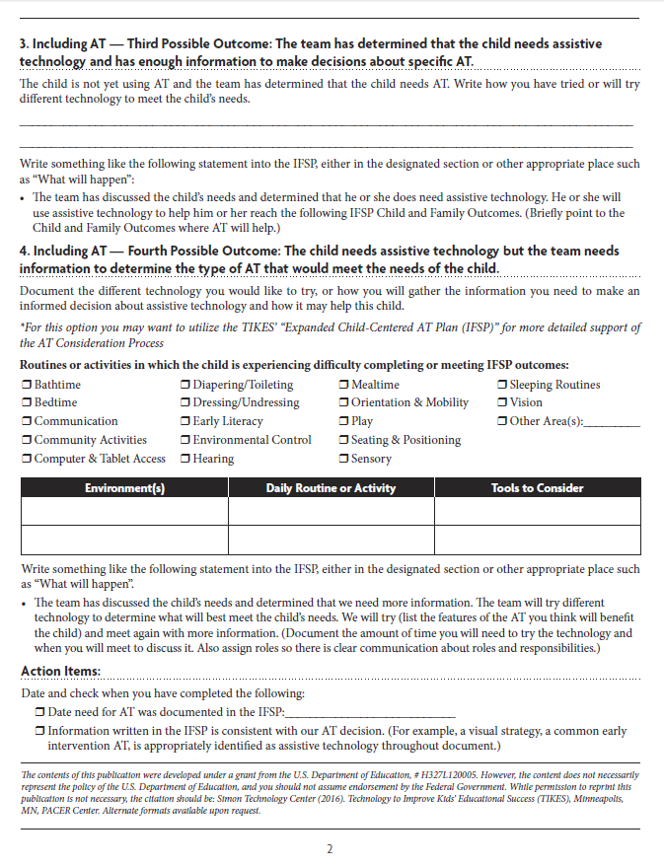
TIKES’ Child-Centered AT Plan: Third Possible Outcome
Start by filling in basic information.
Note the child’s strengths and needs.
Document how the team has tried or will try different AT to meet the child’s needs.
Action Item gives guidance about where to document and possible language to use.
Notes:
Slide 27: TIKES’ Child-Centered AT Plan: Third Possible Outcome
Presenter Notes:
Following the flowchart, the team now comes to the third possible outcome and are again working in the two-page Child-Centered AT Plan. Always start by filling in the basic information: child’s name, service coordinator, parents’ name(s), and date, and the fields to note a child’s strengths and needs. Under Outcome 3, there is space to document information about the assistive technology the team has tried or will try to meet the needs of the child. In the third outcome, the team members feel confident in their understanding and use of assistive technology, and the needs of the child, and can move forward with that knowledge. The last step is to document this in the IFSP. The TIKES’ Child-Centered AT Plan suggests writing, “The team has discussed the child’s needs and determined that he or she does need assistive technology. He or she will use assistive technology to help him or her reach the following IFSP Child and Family Outcomes” in “What Will Happen.” It would be best practice and good communication to also document how long any trials using AT will go and what standard will be used to measure success.
For this example, we are finished with the TIKES’ Child-Centered AT Plan.

Slide 28
TIKES’ AT Consideration Flowchart (IFSP)
No, the team does not have enough information.
Outcome 4: The child needs assistive technology but the team needs information to determine the type of AT that would meet the needs of the child.
Action Item 4: Document the need for AT in the IFSP by using the “Fourth Possible Outcome of the Child-Centered AT Plan.”
Notes:
Slide 28: TIKES’ AT Consideration Flowchart: IFSP
Presenter Notes:
Now the team takes the last path going down the flowchart and answers the second question with, “No, the team does not have enough information to determine appropriate AT based on the needs of the child.” With this option, the team knows that the child is not making progress and the team needs more information. The team may need more information about the child and his needs, or they may need more information about the technology that would be appropriate to meet the child’s needs. This leads to the fourth possible outcome, “The child needs assistive technology but the team needs information to determine the type of AT that would meet the needs of the child.” There is also an action item to document the process of consideration using the fourth possible outcome of the TIKES’ Child-Centered AT Plan.

Slide 29
TIKES’ Child-Centered AT Plan: Fourth Possible Outcome
Start by filling in basic information.
Note the child’s strengths and needs.
Document how you have tried or will try different AT to meet the child’s needs.
Action Item gives guidance about where to document and possible language to use.
Notes:
Slide 29: TIKES’ Child-Centered AT Plan: Fourth Possible Outcome
Presenter Notes:
Following the flowchart, the team comes to the fourth and last possible outcome and are again working in the two-page TIKES’ Child-Centered AT Plan. Always start by filling in the basic information: child’s name, service coordinator, parents’ name(s), and date. Also complete the fields to note a child’s strengths and needs. There are additional supports under the fourth outcome to support a team’s process in gathering more information. They can document the different technology they would like to try, or indicate how they will gather the needed information to help make informed decisions about what AT will help meet the needs of this child. The last step is to document the process of consideration in the IFSP. The TIKES’ Child-Centered AT Plan suggests writing, “The team has discussed the child’s needs and determined that we need more information. We will try different technology to determine what will best meet the child’s needs. We will try [list the features of the AT you think will benefit the child] and meet again with more information” in “What Will Happen.” It would be best practice and good communication to also document how long any trials with AT will go and what standard will be used to measure success. Teams may also want to consider using the TIKES’ Expanded Child-Centered AT Plan if they need to bring in a district or outside consultant, or need more help in determining the AT needs of the child.
For this example, we are finished with the TIKES’ Child-Centered AT Plan.

Slide 30
TIKES’ Child-Centered AT Plan: Action Items
Inclusion of Action Items is to promote consistency and quality of documentation.
Check each box when Action Item is completed.
Notes:
Slide 30: TIKES’ Child-Centered AT Plan: Action Items
Presenter Notes:
When the team is finished documenting the possible outcome for the child, the last step is to follow up on the Action Items. The Action Items were built into the TIKES’ Child-Centered AT Plan to promote consistency and quality of documentation for including AT in the IFSP. Check each box and then the Action Item will be complete. The first Action Item, “Date need for AT was documented in the IFSP” is to record when the team followed up on the outcome action item and documented the process of considering AT in the IFSP. The second Action Item, “Information written in the IFSP is consistent with our AT decision. (For example, a visual strategy, a common early intervention AT, is appropriately identified as assistive technology throughout the document.)” is a quality check to ensure that the AT documentation is consistent throughout the plan.

Slide 31
Using the Consideration Tools: IEP
Page 31
Notes:
Slide 31: Using the Consideration Tools: IEP
(Transition slide leading into how to use each of the tools in early childhood education.)

Slide 32
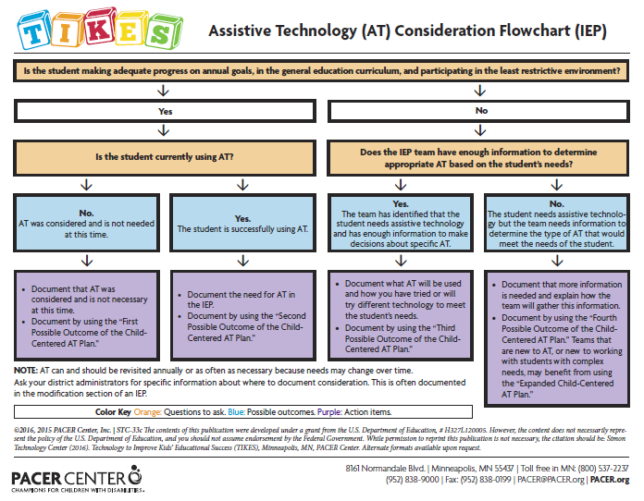
TIKES’ AT Consideration Flowchart (IEP)
Follow the flowchart.
Is the student making adequate progress on annual goals, in the general education curriculum, and participating in the least restrictive environment?
Either a yes or no answer leads to another question that helps to guide the process.
Notes:
Slide 32: TIKES’ AT Consideration Flowchart (IEP)
Presenter Notes:
Following the key questions in orange leads the team to four possible outcomes of consideration in blue, followed by an action item in purple that will lead to use of the TIKES’ Child-Centered AT Plan. Follow the flowchart and look at the possible outcomes of consideration. The first question (in orange), “Is the student making adequate progress on annual goals, in the general education curriculum, and participating in the least restrictive environment?” leads to another question with either a yes or no answer. This next question continues to guide our process.

Slide 33
TIKES’ AT Consideration Flowchart (IEP)
Yes, the student is making progress.
Is the student currently using AT?
A yes or no answer leads to an outcome and an action item.
Notes:
Slide 33: TIKES’ AT Consideration Flowchart (IEP)
Presenter Notes:
The first question (in orange) asks, “Is the student making adequate progress on annual goals, in the general education curriculum, and participating in the least restrictive environment?” First, answer, “Yes, the student is making progress.” This leads to the second question (also in orange), “Is the student currently using AT?” Either a yes or no answer here leads to an outcome and an action item, and guides you to the TIKES’ Child-Centered AT Plan.

Slide 34
TIKES’ AT Consideration Flowchart (IEP)
No, the student is not currently using AT.
Outcome 1: AT was considered and is not needed at this time.
Action Item 1: Document that AT was considered and is not necessary at this time by using the “First Possible Outcome of the Child-Centered AT Plan.”
Notes:
Slide 34: TIKES’ AT Consideration Flowchart (IEP)
Presenter Notes:
Let’s answer the second question, “Is the student currently using AT?” by saying “No, the student is not currently using AT.” The child is making progress, is not using AT, and does not need assistive technology. This leads to the first possible outcome, “AT was considered and is not needed at this time.” The team also has an action item to document the process of considering AT using the first possible outcome of the TIKES’ Child-Centered AT Plan.

Slide 35
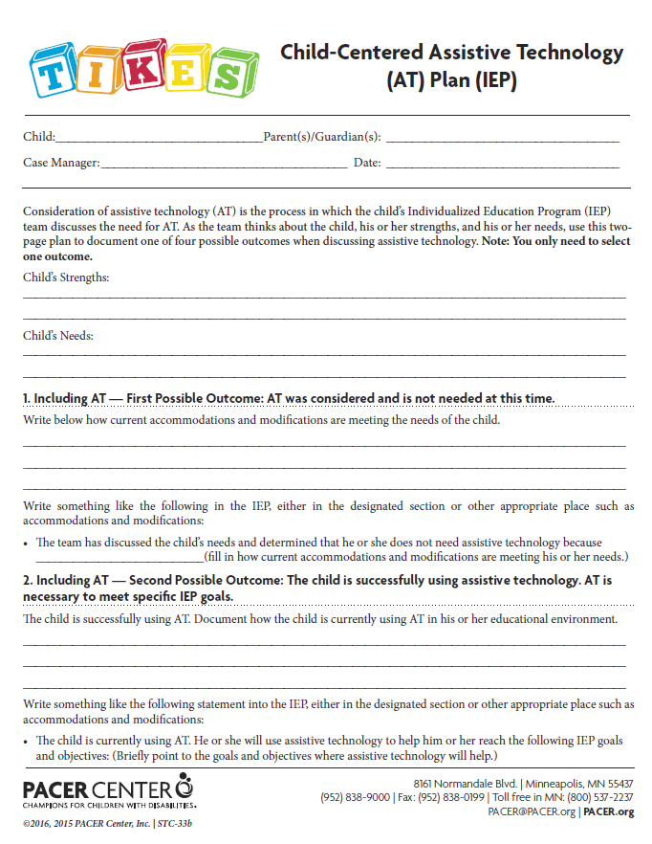
TIKES’ Child-Centered AT Plan: Four Different Possible Outcomes
Start by filling in basic information.
Note the child’s strengths and needs.
Important: Only choose one of four possible outcomes.
Notes:
Slide 35: TIKES’ Child-Centered AT Plan: Four Different Possible Outcomes
Presenter Notes:
Following the flowchart to the first possible outcome, the team is now working in the two-page TIKES’ Child-Centered AT Plan. Start by filling in the basic information: child’s name, case manager, parents’ name(s), and date. There are also fields to note a child’s strengths and needs, which will help teams make decisions about the appropriate technology for a child.
It should be noted that not all of the four possible outcomes need to be filled out; just the outcome that is appropriate for the child for which the team is writing the plan. The section the team fills out in the TIKES’ Child-Centered AT Plan will correspond with the outcome the team determined using the flow chart, and the team will only fill out one section of the TIKES’ Child-Centered AT Plan for each child. Now the team has finished the TIKES’ Child-Centered AT Plan. This is a conversation and a process completed annually, generally during the annual IEP meeting. However, the team, which includes the parents, can revisit the process any time the needs of the child change or the team feels he or she might benefit from assistive technology.

Slide 36
TIKES’ Child-Centered AT Plan: First Possible Outcome
Document how current accommodations and modifications are meeting the child’s needs.
Action Item gives guidance about where to document and possible language to use.
Notes:
Slide 36: TIKES’ Child-Centered AT Plan: First Possible Outcome
Presenter Notes:
Next, there is space to document how current accommodations and modifications are meeting the needs of the child. The last step is to document the process of AT consideration in the IEP. The TIKES’ Child-Centered AT Plan suggests writing this in the designated “Assistive Technology” section: “The team has discussed the child’s needs and determined that he or she does not need assistive technology because [fill in how current accommodations and modifications are meeting his or her needs].” If the IEP document doesn’t contain a section to document Assistive Technology, use another appropriate place such as “Accommodations and Modifications.” Following these steps provides clear documentation of the process of considering AT and communicates with all team members about the decision the team reached.
For this example, we are finished with the TIKES’ Child-Centered AT Plan.

Slide 37
TIKES’ AT Consideration Flowchart (IEP)
Yes, the student is currently using AT.
Outcome 2: The student is successfully using AT.
Action Item 2: Document the need for AT in the IEP by using the “Second Possible Outcome of the Child-Centered AT Plan.”
Notes:
Slide 37: TIKES’ AT Consideration Flowchart (IEP)
Presenter Notes:
View the flowchart and answer the second question, “Is the student currently using AT?” with a yes. This means the child is making progress and is currently using assistive technology to meet his or her needs. This leads to the second possible outcome, “The student is successfully using assistive technology.” The team also has an action item, which leads to documenting the consideration of AT using the second possible outcome of the TIKES’ Child-Centered AT Plan.

Slide 38
TIKES’ Child-Centered AT Plan: Second Possible Outcome
Start by filling in basic information.
Note the child’s strengths and needs.
Document the AT the child is using and how the child is using it in his educational environment.
Action Item gives guidance about where to document and possible language to use.
Notes:
Slide 38: TIKES’ Child-Centered AT Plan: Second Possible Outcome
Presenter Notes:
Following the flowchart, the team looks at the second possible outcome and is again working in the two-page TIKES’ Child-Centered AT Plan. Always start by filling in the basic information: child’s name, case manager, parents’ name(s), and date. The fields to note a child’s strengths and needs are important for every child. Next, there is space to document information about the assistive technology the child is currently using to meet his or her needs. The last step is to document it in the IEP. The TIKES’ Child-Centered AT Plan suggests writing, “The child is currently using AT. He or she will use assistive technology to help him or her reach the following IEP goals and objectives” in an appropriate place in the IEP such as “Accommodations and Modifications.” Again the team has clear documentation of the consideration process and good communication with IEP team members.
Remember, this is a process done annually, usually during the annual IEP meeting. However, the team can revisit the process any time the needs of the child change and the team feels the assistive technology he or she is using no longer works, or there is new technology available that might better meet his or her needs.
For this example, we are finished with the TIKES’ Child-Centered AT Plan.

Slide 39
TIKES’ AT Consideration Flowchart (IEP)
No, the child is not making adequate progress and may benefit from AT.
Does the IEP team have enough information to determine appropriate AT based on the child’s needs?
A yes or no answer leads to an outcome and action item.
Notes:
Slide 39: TIKES’ AT Consideration Flowchart (IEP)
Presenter Notes:
Going back to the first question (in orange), “Is the student making adequate progress on annual goals, in the general education curriculum, and participating in the least restrictive environment?” the team will now answer, “No, the child is not making adequate progress and may benefit from AT.” This leads to a new question (in orange), “Does the IEP team have enough information to determine appropriate AT based on the student’s needs?” A yes or no answer here each leads to an outcome and an action item.

Slide 40
TIKES’ AT Consideration Flowchart (IEP)
Yes, the team has enough information to determine appropriate AT.
Outcome 3: The team has identified that the student needs assistive technology and has enough information to make decisions about specific AT.
Action Item 3: Document the need for AT in the IEP by using the “Third Possible Outcome of the Child-Centered AT Plan.”
Notes:
Slide 40: TIKES’ AT Consideration Flowchart (IFSP)
Presenter Notes:
The team answers this question with, “Yes, the team has enough information to make decisions about appropriate AT to meet the student’s needs.” This leads to the third possible outcome (in blue), “The team has identified that the student needs assistive technology and has enough information to make decisions about specific AT.” The team also has an action item (in purple) to document the consideration of AT using the third possible outcome of the TIKES’ Child-Centered AT Plan.

Slide 41
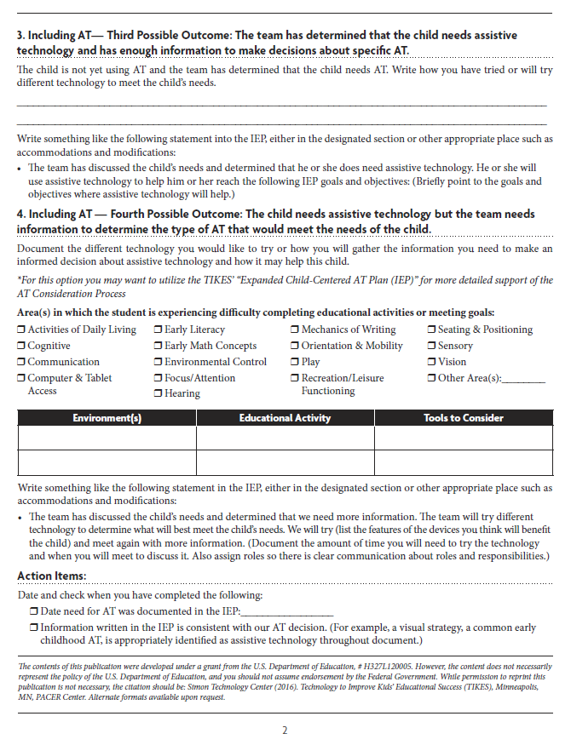
TIKES’ Child-Centered AT Plan: Third Possible Outcome
Start by filling in basic information.
Note the child’s strengths and needs.
Document how the team has tried or will try different AT to meet the child’s needs.
Action Item gives guidance about where to document and possible language to use.
Notes:
Slide 41: TIKES’ Child-Centered AT Plan: Third Possible Outcome
Presenter Notes:
Following the flowchart, the team now comes to the third possible outcome and is again working in the two-page TIKES’ Child-Centered AT Plan. Always start by filling in the basic information: child’s name, case manager, parents’ name(s), and date, and the fields to note a child’s strengths and needs. Under Outcome 3, there is space to document information about the assistive technology the team has tried or will try to meet the needs of the child. In the third outcome, the team feels confident in their understanding and use of assistive technology, and the child’s needs, and can move forward with that knowledge. The last step is to document this in the IEP. The TIKES’ Child-Centered AT Plan suggests writing, “The team has discussed the child’s needs and determined that he or she does need assistive technology. He or she will use assistive technology to help him or her reach the following IEP goals and objectives” in an appropriate place in the IEP, such as the designated place to document AT or in “Accommodations and Modifications.” It is helpful to also document how long any AT trials will take and what standard the team will use to measure success.
For this example, we are finished with the TIKES’ Child-Centered AT Plan.

Slide 42
TIKES’ AT Consideration Flowchart (IEP)
No, the team does not have enough information.
Outcome 4: The student needs assistive technology, but the team needs information to determine the type of AT that would meet the needs of the student.
Action Item 4: Document the need for AT in the IEP by using the “Fourth Possible Outcome of the Child-Centered AT Plan.”
Notes:
Slide 42: TIKES’ AT Consideration Flowchart (IEP)
Presenter Notes:
Now, using the flowchart, answer the second question with, “No, the team does not have enough information to determine appropriate AT based on the student’s needs.” With this option, the team knows that the child is not making progress and the team needs more information. The team may need more information about the child and his or her needs, or they may need more information about the technology that would be appropriate to meet the child’s needs. This leads to the fourth possible outcome, “The student needs assistive technology, but the team needs information to determine the type of AT that would meet the needs of the student.” AT is necessary to meet specific IEP goals and objectives. The team also has an action item to document the consideration of AT using the fourth possible outcome of the TIKES’ Child-Centered AT Plan.

Slide 43
TIKES’ Child-Centered AT Plan: Fourth Possible Outcome
Start by filling in basic information.
Note the child’s strengths and needs.
Document how the team has tried or will try different AT to meet the child’s needs.
Action Item gives guidance about where to document and possible language to use.
Notes:
Slide 43: TIKES’ Child-Centered AT Plan: Fourth Possible Outcome
Presenter Notes:
Following the flowchart, it is now the fourth and final possible outcome and the team is again working in the two-page TIKES’ Child-Centered AT Plan. Always start by filling in the basic information: child’s name, case manager, parents’ name(s), and date. Also complete the fields to note a child’s strengths and needs. There are additional supports under the fourth outcome to support a team’s process for gathering more information. They can document the different technology they would like to try, or indicate how they will gather the needed information to help make informed decisions about AT and what AT will help meet the needs of this child. The last step is to document the process in the IEP. The TIKES’ Child-Centered AT Plan suggests writing, “The team has discussed the child’s needs and determined that we need more information. The team will try different technology to determine what will best meet the child’s needs. We will try [list the features of the devices you think will benefit the child] and meet again with more information” in an appropriate place in the IEP, such as a designated place for assistive technology or in “Accommodations and Modifications.” It is best practice to also document how long any trials will take and what standard will be used to measure success. Teams may also want to consider using the TIKES’ Expanded Child-Centered AT Plan if they need to bring in a district or outside consultant, or need more help in determining the AT needs of the child.
For this example, we are finished with the TIKES’ Child-Centered AT Plan.

Slide 44
TIKES’ Child-Centered AT Plan: Action Items
Inclusion of Action Items is to promote consistency and quality of documentation.
Check each box when Action Item is completed.
Notes:
Slide 44: TIKES’ Child-Centered AT Plan: Action Items
Presenter Notes:
When the team is finished documenting the possible outcome for the child, the last step is to follow up on the Action Items. The Action Items were built into the TIKES’ Child-Centered AT Plan to promote consistency and quality of documentation for including AT in the IEP. Check each box. Then the Action Item is complete. The first Action Item, “Date need for AT was documented in the IEP” is to record when the team followed up on the outcome action item and documented the process of considering AT in the IEP. The second Action Item, “Information written in the IEP is consistent with our AT decision. (For example, a visual strategy, a common early intervention AT, is appropriately identified as assistive technology throughout the document.)” is a quality check to ensure that the AT documentation is consistent throughout the IEP.

Slide 45
TIKES’ Expanded Child-Centered AT Plan
Page 45
Notes:
Slide 45: TIKES’ Expanded Child-Centered AT Plan
(Transition slide leading into discussion of the TIKES’ Expanded Child-Centered AT Plan and when it might be appropriate to use.)

Slide 46
The TIKES’ Expanded Child-Centered AT Plan (IFSP/IEP)
Current AT use
Areas of need
Trying AT
Training
Set-up and maintenance
Back-up plan
AT roles
Documenting AT decisions
Action items
Notes:
Slide 46: The TIKES’ Expanded Child-Centered AT Plan (IFSP/IEP)
Presenter Notes:
The TIKES’ Expanded Child-Centered AT Plan is a longer planning tool to help both IFSP and IEP teams determine what AT will meet the needs of an individual child. The team has used the flowchart and two-page plan, and decided on the fourth possible outcome, “The child needs assistive technology, but the team needs more information to determine the type of AT that would meet the needs of the child.” The supports for the fourth possible outcome in the two-page plan aren’t enough to guide the decision-making process of the team. The expanded plan provides more room and topic headers to discuss AT and the needs of the child in greater depth. The documents differ slightly in their language based on settings, and a home versus educational focus. The expanded plan includes space to discuss current AT use (if any), areas of need, trying AT, identifying any training needs, device or system set-up and maintenance, establishing a back-up plan, assigning AT roles, documenting the AT decisions in the IFSP or IEP, and Action Items that have been included for the purpose of improving quantity and quality of AT documentation.

Slide 47
Items for Discussion
Page 47
Notes:
Slide 47: Items for Discussion
(Transition slide leading into discussion of some common issues or questions when considering AT.)

Slide 48
Considering New Technology
New technology is always being developed and could help your child or the child you work with.
Notes:
Slide 48: Considering New Technology
Presenter Notes:
New technology is constantly being developed. A specific technology may be released after you’ve already made decisions about AT that could help the learning of a child with whom you are working. As with all assistive technology, the team should consider the potential benefits and whether a child needs it to make progress on IFSP outcomes, or IEP goals and objectives. The increase in the use of tablets is a good example of the impact new technology can have on teacher and parent requests for AT for a child. Still, the team needs to consider the benefits of the technology and establish a need.

Slide 49
Consideration vs. Assessment
Consideration and assessment are not the same thing
Consideration is a team conversation and decision about the need for AT
Assessment is a systematic process to test the effectiveness of AT
Notes:
Slide 49: Consideration vs. Assessment
Presenter Notes:
Sometimes the process of considering AT is referred to as an assessment, but the consideration of AT and an AT assessment are not the same thing. In the process of considering assistive technology, a team will sometimes decide that more information is needed, and they’ll use a systematic formal assessment of AT to determine the technology that will meet a child’s needs. An assessment is not required to consider AT, to make AT decisions, or before writing AT into a child’s IFSP or IEP.

Slide 50
Assistive Technology Assessment
What is an AT assessment?
Assessment or evaluation is a more formal process of determining what AT devices and services will help the student meet educational goals.
Who conducts an AT assessment?
Individuals with knowledge of the student and types of AT to meet identified needs:
Schools
Fee-based organizations
Outside consultants
Notes:
Slide 50: Assistive Technology Assessment
Presenter Notes:
An assistive technology evaluation is different from a disability evaluation. The AT evaluation may be needed in addition to the disability evaluation that is required for the child to receive special education services. A formal assistive technology evaluation is used to determine whether a child could benefit from the use of assistive technology devices. If an assistive technology evaluation is needed, it follows the same IFSP/IEP evaluation timetables. For children ages birth to 3, the team has 45 calendar days to complete the evaluation, meet, and write the IFSP. For children ages 3 to 21, the team has 30 school days from the date of signing consent to completion of the assessment. The AT assessment is usually conducted by school personnel who have expertise with assistive technology and should be done in the child’s customary environment. It is possible that much of the information for the assistive technology assessment can be taken from general assessment and intervention information already available.
Many schools, districts, or co-ops have assistive technology specialists or teams with skills and knowledge to assist the IFSP/IEP team in conducting an appropriate evaluation. Schools are generally the first resource in providing AT evaluations. If schools do not have the resources, there are fee-based, comprehensive, formal AT assessments offered elsewhere, and outside consultants with expertise in assistive technology are sometimes called in to conduct an evaluation.

Slide 51
An AT Assessment is Needed…
When the parent or student (if older than 18) requests an evaluation in writing
If the team cannot identify devices or strategies to help the student meet educational goals
If equipment trials are inconclusive
Notes:
Slide 51: Assistive Technology Assessment is Needed. . .
Presenter Notes:
An evaluation for assistive technology can be requested at any time by a parent or a student older than 18. It should be put into writing by the parent or student, and presented to the school. A formal assistive technology assessment is useful when the IFSP or IEP team has not identified appropriate and useful assistive technology tools that may help the child or student meet their IFSP family outcomes, or IEP goals and objectives. It is the school’s responsibility to provide and pay for this AT evaluation.

Slide 52
Funding Assistive Technology
Who pays for AT?
Schools
Third-party billing
How do families acquire needed AT and other useful technology?
AT reuse programs
Micro loans
Do-it-yourself (DIY)
Long-term loan programs
Crowdfunding
Notes:
Slide 52: Funding Assistive Technology
Presenter Notes:
A common question in this process is, “Who pays for the assistive technology?” Schools are required to provide evaluations and assistive technology devices and services included in the IFSP and IEP. If an assistive technology device is included in the IFSP or IEP, the school is legally obligated to purchase it. If the team has performed its due diligence and identified a device to meet the needs of a child, they need to write it into the IFSP or IEP.
If the school pays for the device, it owns the device. If any part of the device is paid for by the parent or their insurance company, the family owns the device.
Another question is, “Where can schools and families go to acquire identified AT, or AT that is not listed as a need?” We’ll talk more in depth about funding options in another training, but here are some options that schools and families could explore:
AT reuse is the concept of giving life to assistive technology after it is no longer needed by the person for whom it was originally purchased. Schools generally don’t have an official reuse program, but they do reassign assistive technology to other students when it is no longer needed.
Micro loans are small loans that some agencies provide when other funding options are not available. These are generally in small amounts and with low interest rates.
Do-it-yourself, or DIY, is the concept of making things that are similar to items that can be purchased. They can often be made for a fraction of the cost.
Long-term loan programs are similar to technology lending libraries, but also loan equipment with an extended or open-ended due date.
Crowdfunding is the concept of using web-based tools to tap into social networks and interested audiences to raise the funds needed to purchase the technology.

Slide 53
District AT Policies and Procedures
TIKES consideration tools were developed based on best practices
Check with your district administrators about AT policies and procedures
Avoid yes/no check boxes
Advocate for AT policies if there are none
Include IDEA law on AT in your policies
Notes:
Slide 53: District AT Policies and Procedures
Presenter Notes:
The TIKES materials we have discussed today were all developed from evidence-based practice and research, and in accordance with AT laws and guidance in IDEA and from the Federal Office of Special Education Programs (OSEP). The primary goal of the TIKES team in developing these materials is to provide you with clear guidance on how to best consider, implement, and document the use of AT. It is also important to be aware of your district’s specific AT policies and procedures. If you don’t know your district’s policies, ask! If your district doesn’t have AT policies yet, advocate to have these created. TIKES has developed a series of handouts specifically to support school administrators on AT policy.

Slide 54
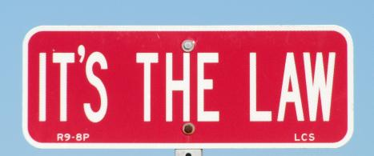
Closing Thoughts
Considering AT is a requirement for every student with an IFSP or IEP.
Notes:
Slide 54: Closing Thoughts
Presenter Notes:
Considering AT is a legal requirement for every student with an IFSP or IEP.
The IEP team must… (v) consider whether the child needs assistive technology devices and services.
[Authority: 20 U.S.C. 1412(a)(1), 1412(a)(12)(A)(i), 1414(d)(3), (4)(B), and (7); and 1414(e)]
Early intervention services include… (xiii) assistive technology services and assistive technology devices.
[Authority: 20 U.S.C. 1400 et seq]

Slide 55
Closing Thoughts
It is important to consider assistive technology and to document your consideration.
Notes:
Slide 55: Closing Thoughts
Presenter Notes:
It is important to consider assistive technology and to document your consideration. Write it down. Others will not know you have gone through the process of consideration unless you document it in the child’s IFSP or IEP.

Slide 56
Questions?
Notes:
Slide 56: Questions
Presenter Notes:
Thank you for letting us share this very important topic with you. Please take a minute to complete the TIKES workshop evaluation. We appreciate your feedback and comments very much.

Slide 57
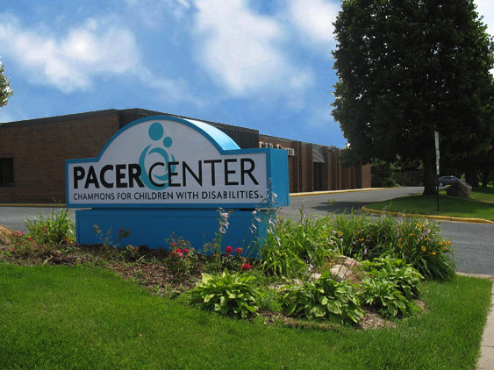
Contact Information
Technology to Improve Kids’ Educational Success (TIKES)
PACER.org/stc/tikes
952-838-9000
Funded by the U.S. Department of Education, Office of Special Education Programs (OSEP)
TIKES is a project of
PACER Center
PACER.org | 952-838-9000 | 888-248-0822
Notes:
Slide 57: Contact Information
Presenter Notes:
For information about this or other training materials available through the TIKES Project, please use the above contact information.

Slide 58
Funding Statement
The contents of this publication were developed under a grant from the U.S. Department of Education, # H327L120005. However, the content does not necessarily represent the policy of the U.S. Department of Education, and you should not assume endorsement by the Federal Government.
While permission to reprint this publication is not necessary, the citation should be: Simon Technology Center (2016). Technology to Improve Kids’ Educational Success (TIKES), Minneapolis, MN, PACER Center.
Alternate formats available upon request.
Notes:
Slide 58: Funding Statement
Presenter Notes:
The contents of this publication were developed under a grant from the U.S. Department of Education, # H327L120005. However, the content does not necessarily represent the policy of the U.S. Department of Education, and you should not assume endorsement by the Federal Government.
While permission to reprint this publication is not necessary, the citation should be: Simon Technology Center (2016). Technology to Improve Kids’ Educational Success (TIKES), Minneapolis, MN, PACER Center.
Alternate formats available upon request.

