Slide 1
Bullying Prevention 101
A guide for elementary school students
Notes:
Slide title: Title page
Objective: Slide to show onscreen pre-presentation
PACER’s National Bullying Prevention Center
Is a program of PACER Center
8161 Normandale Blvd. | Bloomington, MN 55437
952.838.9000
bullying411@PACER.org
PACER.org/Bullying
Founded in 2006, PACER’s National Bullying Prevention Center actively leads social change, so that bullying is no longer considered an accepted childhood rite of passage. PACER provides innovative resources for students, parents, educators, and others, and recognizes bullying as a serious community issue that impacts education, physical and emotional health, and the safety and well-being of students.
PACER.org/Bullying: This is the portal page for parents and educators to access bullying resources, which include educational toolkits, awareness toolkits, contest ideas, promotional products and more.
PACERTeensAgainstBullying: Created by and for teens, this website is a place for middle and high school students to find ways to address bullying, to take action, to be heard, and to own an important social cause.
PACERKidsAgainstBullying: A creative, innovative and educational website designed for elementary school students to learn about bullying prevention, engage in activities and be inspired to take action

Slide 2
Things you should know about bullying
Section One

Slide 3
Take the Quiz
How many students are bullied?
1 in 2
1 in 3
1 in 5
1 in 10
1 in 20

Slide 4
What is Bullying?
Bullying is when someone is being hurt either by words or actions on purpose, by someone with more “power”, usually more than once, feels bad because of it, and has a hard time stopping what is happening to them.

Slide 5
How is Someone Bullied?
Bullying can be:
  Physical: hitting, kicking, damaging another’s stuff
  Verbal: teasing, name calling, gossiping, laughing at someone’s differences,
  Emotional: leaving someone out on purpose, manipulating someone to do something
  Cyber: mean comments through text, email, on social media or in games, sending pictures that are not yours to share

Slide 6
What is “Cyber” Bullying
Cyberbullying is a form of bullying using technology – internet, email, cell phones, games, social media, pictures – to hurt or harm someone who cannot stand up for himself or herself easily.

Slide 7
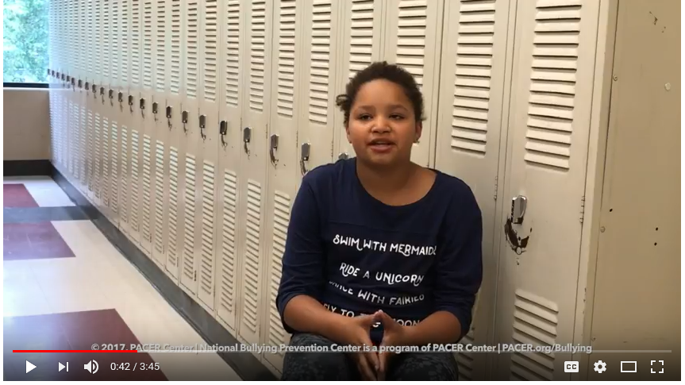
Video:
Does cyberbullying only start at age 13?
Answers by kids!

Slide 8
Conflict vs. Bullying:
What’s the Difference?
Conflict is a disagreement or argument in which both sides express their views.
Bullying is behavior with intention to hurt and the other person often doesn’t feel safe or like they can make it stop.
Conflict is a disagreement or argument in which both sides express their views.
Bullying is behavior with intention to hurt and the other person often doesn’t feel safe or like they can make it stop.

Slide 9

Video:
Conflict vs. Bullying

Slide 10
Opinion Poll:
Which type of bullying happens most often?
Physical
Verbal
Emotional
Cyberbullying

Slide 11
Who Is Involved?
Everyone!
TARGET = The person targeted by the bullying behavior.
PERSON WHO BULLIES = The person(s) directing the behavior toward the target
WITNESS OR BYSTANDERS = Those witnessing the behavior

Slide 12
Checklist:
Are you a target?
Read each of the questions on your handout and check the box next to anything that you may have experienced or felt.
These items apply to what happens at school and online such as text messages, gaming, or social media posts.

Slide 13
Checklist:
Do You Bully?
Read each of the questions on the checklist and check the box next to anything that you may have done or felt.
These items apply to what happens at school and online, such as text messages, gaming, or social media posts.

Slide 14
Did you know?
Read the handout with interesting facts about bullying.
Some that maybe you already know, along with some that will definitely be new and informative!

