Slide 1
Bullying Prevention 101
A guide for elementary school students
Notes:
Slide title: Title page
Objective: Slide to show onscreen pre-presentation
PACER’s National Bullying Prevention Center
Is a program of PACER Center
8161 Normandale Blvd. | Bloomington, MN 55437
952.838.9000
bullying411@PACER.org
PACER.org/Bullying
Founded in 2006, PACER’s National Bullying Prevention Center actively leads social change, so that bullying is no longer considered an accepted childhood rite of passage. PACER provides innovative resources for students, parents, educators, and others, and recognizes bullying as a serious community issue that impacts education, physical and emotional health, and the safety and well-being of students.
PACER.org/Bullying: This is the portal page for parents and educators to access bullying resources, which include educational toolkits, awareness toolkits, contest ideas, promotional products and more.
PACERTeensAgainstBullying: Created by and for teens, this website is a place for middle and high school students to find ways to address bullying, to take action, to be heard, and to own an important social cause.
PACERKidsAgainstBullying: A creative, innovative and educational website designed for elementary school students to learn about bullying prevention, engage in activities and be inspired to take action

Slide 2
Judgement Free Generation
Section Three
Advocacy and self advocacy in action:
Bringing kindness, acceptance, and inclusion into your school and community each day

Slide 3
Opinion Poll:
When you see bullying, how does it make you feel?
Sad
Scared
Angry
Disappointed
Frustrated
Confused

Slide 4
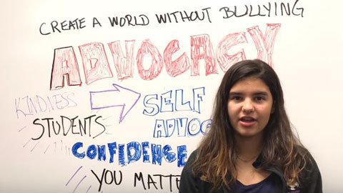
Video:
What Should You Do?
Peer Advocacy

Slide 5
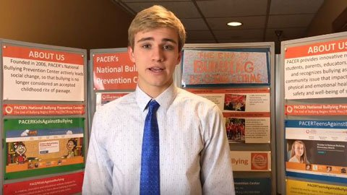
Video:
What Should You Do?
Ways to Be There

Slide 6
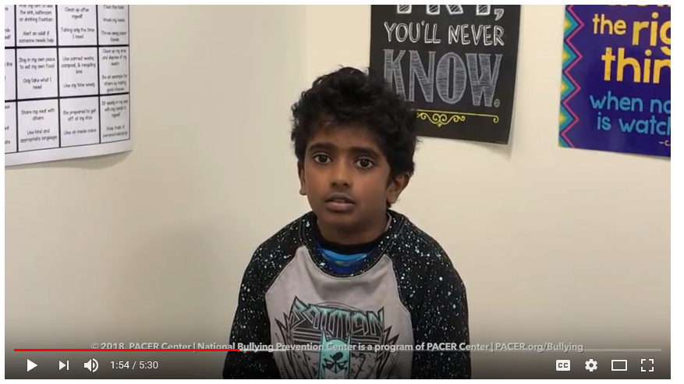
Video:
What Should You Do?
Inclusion!

Slide 7
Handout:
Kindness Conversations
Now its your turn to talk through “what should you do” in these real-life situations.
Note Passing Gone Wrong
In science class, you see a student write something on a piece of paper and pass it to another student. When the student gets the note, they read it and write more down on the note. That student then passes it to a different student who reads it, laughs, writes something down, and passes it on again. This happens several times until finally someone passes the note to you.
When you open the note, you see at the top of the note, “Reasons why Taylor shouldn’t be at this school,” with a list of hurtful comments written about Taylor, who is in science class with you. Taylor is sometimes made fun of by others because some kids decided they didn’t like her. What should you do?

Slide 8
Handout:
Kindness Conversations
Now its your turn to talk through “what should you do” in these real-life situations.
Laughing when it’s not funny
There’s a girl in your class named Maria. It’s not always easy to understand what Maria says. Whenever she talks in class, another student named Luke makes fun of her. During class today, Maria was sharing her favorite part of the book your class just read. Luke started to repeat what she said in an exaggerated way for the whole class to hear and many students laughed, including some of your friends. You see that Maria was not sure why some people were laughing and you feel upset about what’s happened. What should you do?

