Slide 1
Bullying Prevention 101
A guide for middle and high school students
Notes:
Slide title: Title page
Objective: Slide to show onscreen pre-presentation
PACER’s National Bullying Prevention Center
Is a program of PACER Center
8161 Normandale Blvd. | Bloomington, MN 55437
952.838.9000
bullying411@PACER.org
PACER.org/Bullying
Founded in 2006, PACER’s National Bullying Prevention Center actively leads social change, so that bullying is no longer considered an accepted childhood rite of passage. PACER provides innovative resources for students, parents, educators, and others, and recognizes bullying as a serious community issue that impacts education, physical and emotional health, and the safety and well-being of students.
PACER.org/Bullying: This is the portal page for parents and educators to access bullying resources, which include educational toolkits, awareness toolkits, contest ideas, promotional products and more.
PACERTeensAgainstBullying: Created by and for teens, this website is a place for middle and high school students to find ways to address bullying, to take action, to be heard, and to own an important social cause.
PACERKidsAgainstBullying: A creative, innovative and educational website designed for elementary school students to learn about bullying prevention, engage in activities and be inspired to take action

Slide 2
Judgement Free Generation
Section Three
Advocacy and self advocacy in action: Bringing kindness, acceptance, and inclusion into your school and community each day

Slide 3
“Did You Know?”
How often will a bullying situation end when a peer intervenes?
78%
57%
23%
12%

Slide 4

Video:
What’s Inclusion and Why Does It Matter?

Slide 5
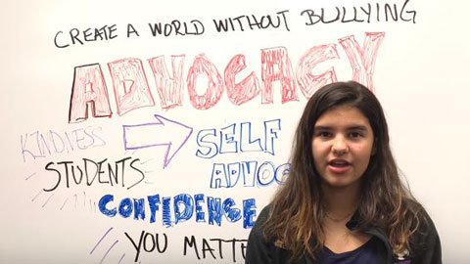
Video:
What Should You Do? Peer Advocacy

Slide 6
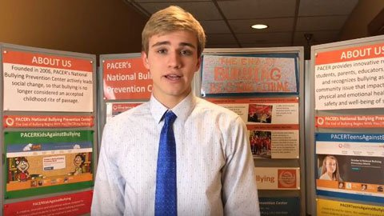
Video:
What Should You Do? Ways to Be There

Slide 7
Handout:
Kindness Conversations
Conversation One: Being Bullied
You are in class one day and the teacher asks a question. You raise your hand to answer the question, but your answer isn’t correct. Another student that sits behind you laughs and says, “That was such an easy question.” The comment makes you feel bad, but you don’t say anything back.
Later that day during lunch, the same student and their friends are laughing and pointing at your direction. They walk by your table and say, “Don’t raise your hand in class anymore. You just waste everyone’s time.”

Slide 8
Handout:
Kindness Conversations
Conversation Two: Witnessing a Fight
You’re walking to the bus one day after school. You see a crowd of students and walk over to see what’s happening. As you get closer, you realize that a group of students are threatening to beat up a younger student at school.
All of a sudden, the group of students starts shoving and punching the younger student. Many other students are watching and cheering it on.

Slide 9
Handout:
Kindness Conversations
Conversation Three: Meeting New Students
It’s the start of a new school year and you’re excited to see all of your friends again. In your first class, the students introduce themselves. There’s a student who says he was homeschooled and this is the first time being in classes with other students.
After several days, you start noticing that the new student is having a hard time making friends. You see him being left out on purpose – one day, he sat at a table and everyone nearby got up and left. You’ve heard other students say they don’t like the new student because he just doesn’t fit in. You feel bad for the new student, but you’re afraid of what others will think.

