Slide 1
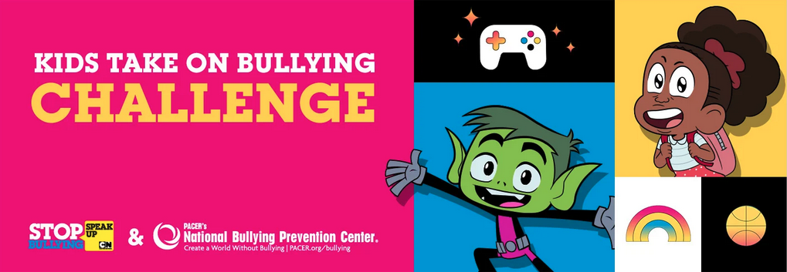
Kids Take On Bullying
Webinar Series
Session 1

Slide 2
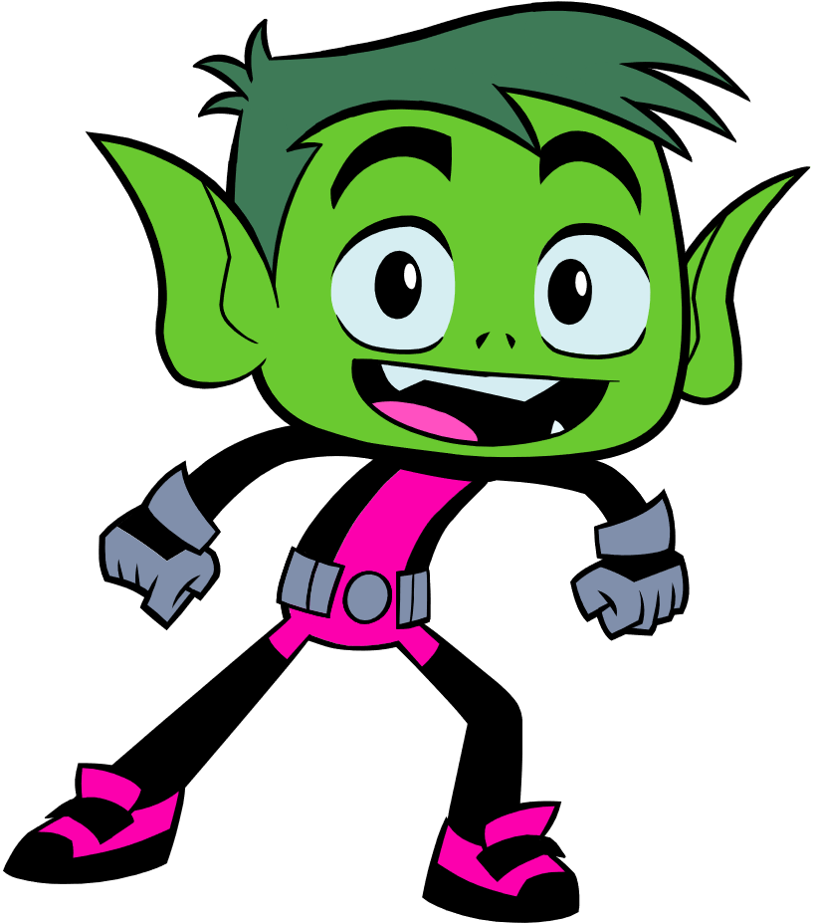
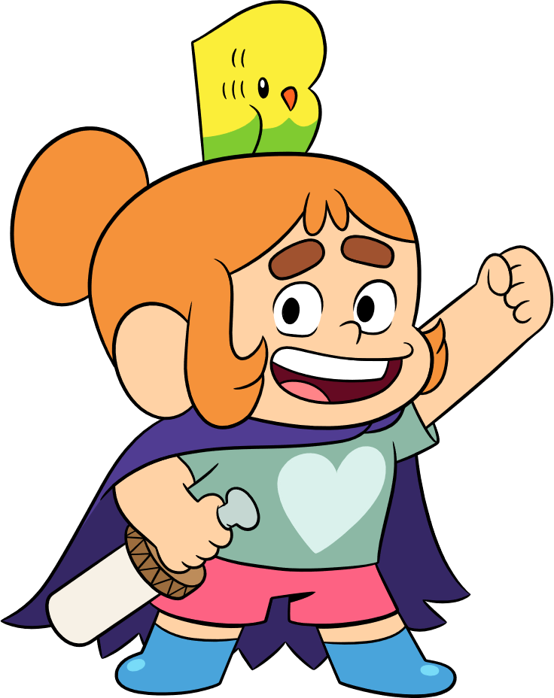
What is the Kids Take On Bullying Challenge?
Partnership between PACER’s National Bullying Prevention Center and Cartoon Network’s Stop Bullying: Speak Up
This challenge is all about empowering kids to take on bullying wherever they see it – at school, in their community or online.

Slide 3
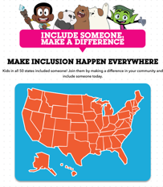
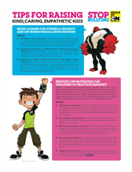
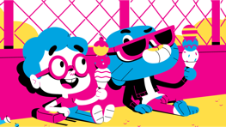
Cartoon Network’s Stop Bullying: Speak Up
Kids told us they felt bullying was an issue they could change if given the right tools
2010
Stop Bullying: Speak Up is Cartoon Network’s commitment to address bullying among kids. We do this by empowering our audience to speak up safely and effectively in the face of bullying, while helping kids develop greater kindness, compassion, and empathy skills that stop bullying before it starts.

Slide 4
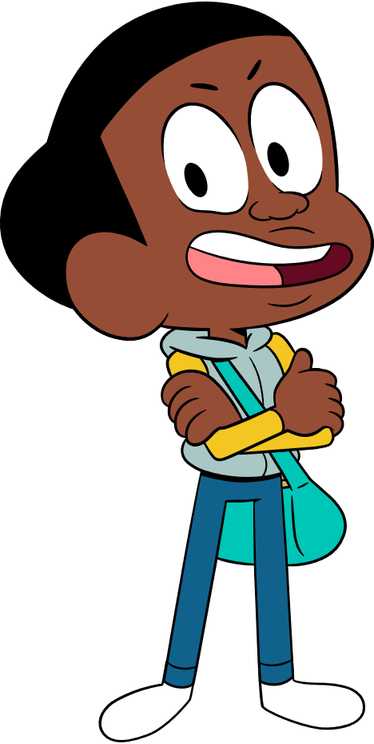
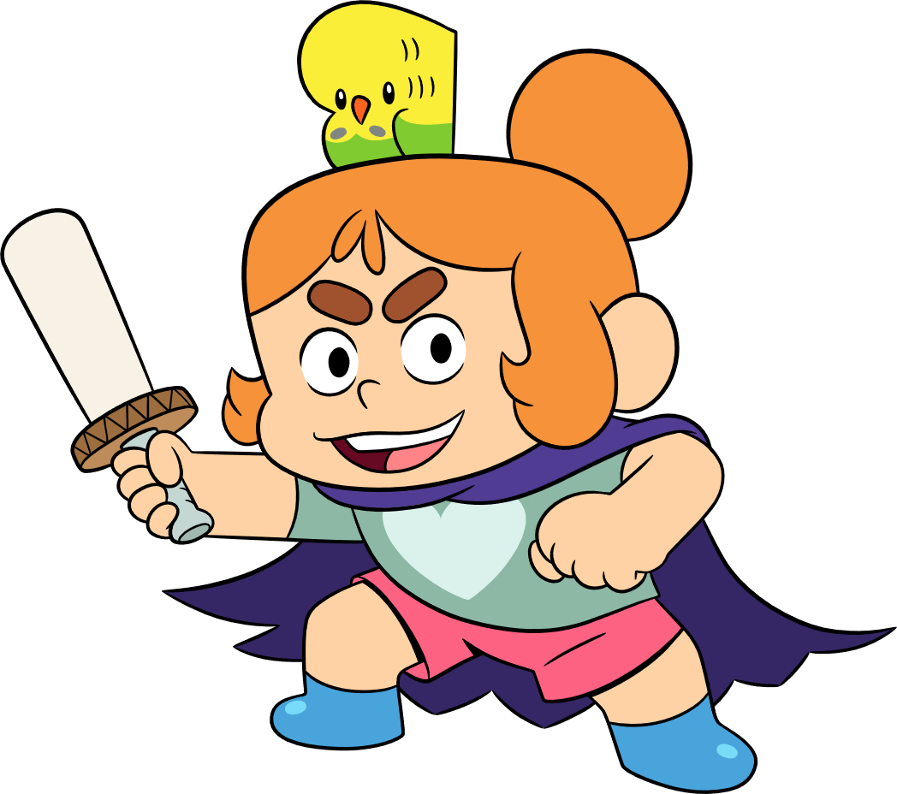
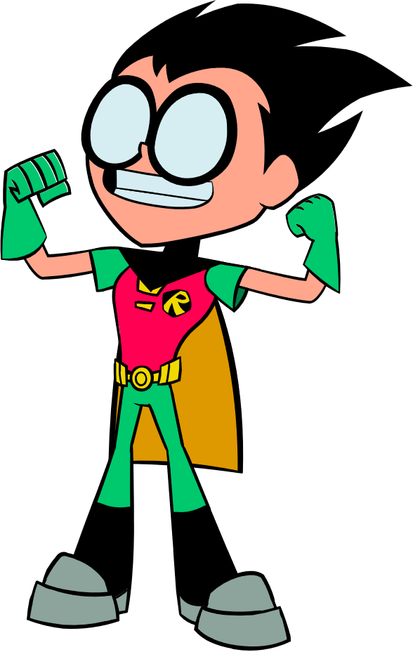
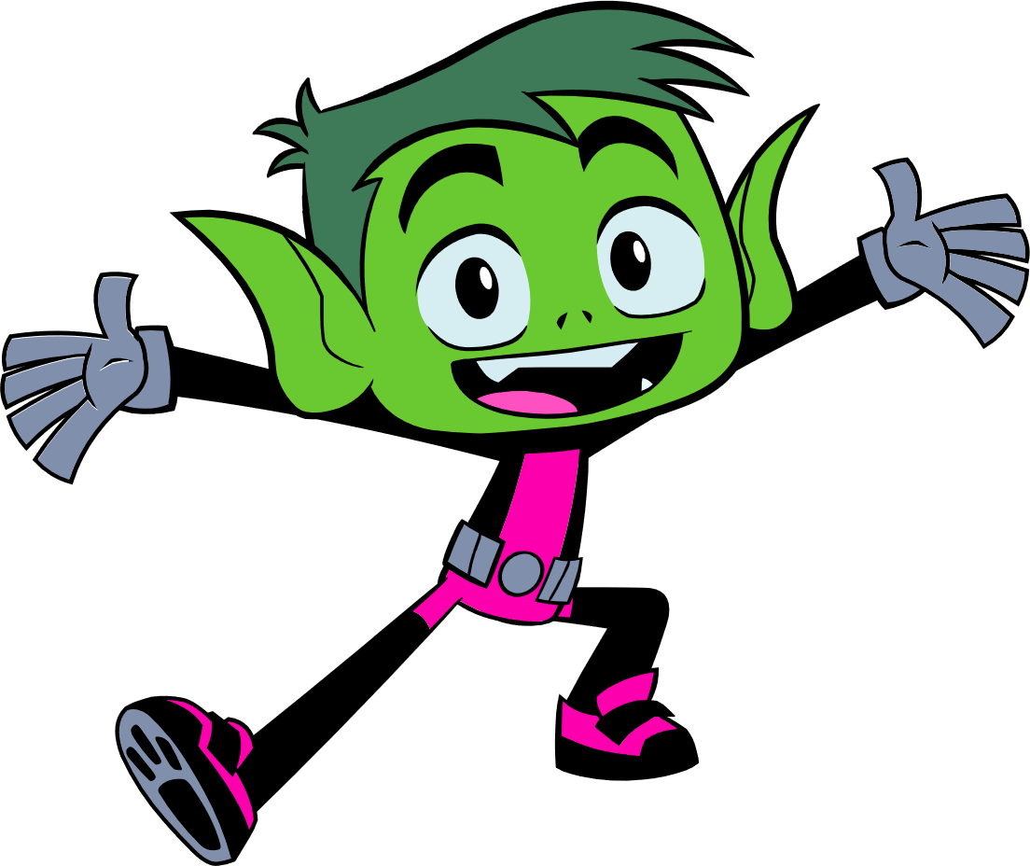
It Takes All of Us to Take on Bullying!
More than 130 entries to the Kids Take On Bullying Challenge
Students from across the country participated, including California, Rhode Island, New Mexico, Florida, Washington, Wyoming, and more!
Kids from 1st grade to 12th grade all had great ideas to share

Slide 5
What will the webinar series include?
We will be meeting for 6 weeks, on Thursdays at 2:30 – 3:15 pm CST
Note: We are skipping the week of March 14 – 18th for Spring Break.
Each session will be recorded & available to watch if you aren’t able to make a session. These will be posted on KidsTakeOnBullying.org the following day.
February 17
February 24
March 3
March 10
March 24
March 31

Slide 6
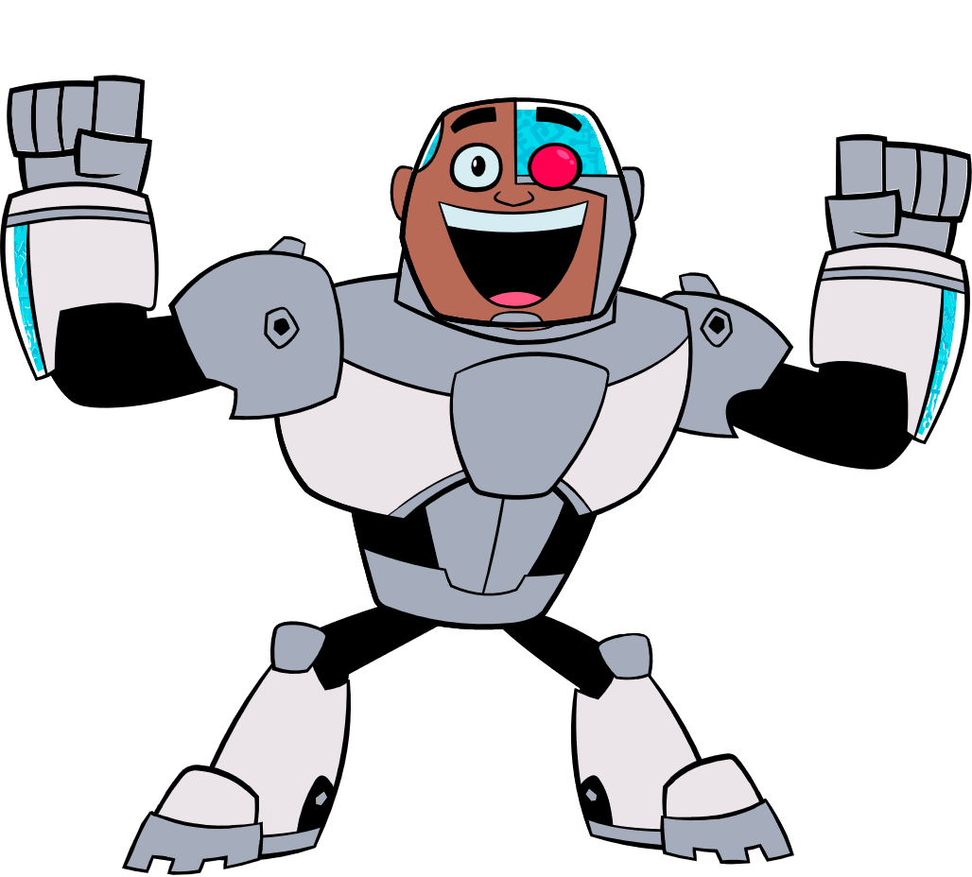
What will the webinar series include?
Each session will be 45 minutes and will feature:
Session welcome and ice breaker
Education
Interaction
At the end of each session, we will stay on the webinar to answer any specific questions you have or topics you want to talk about! This portion will NOT be recorded or shared.

Slide 7
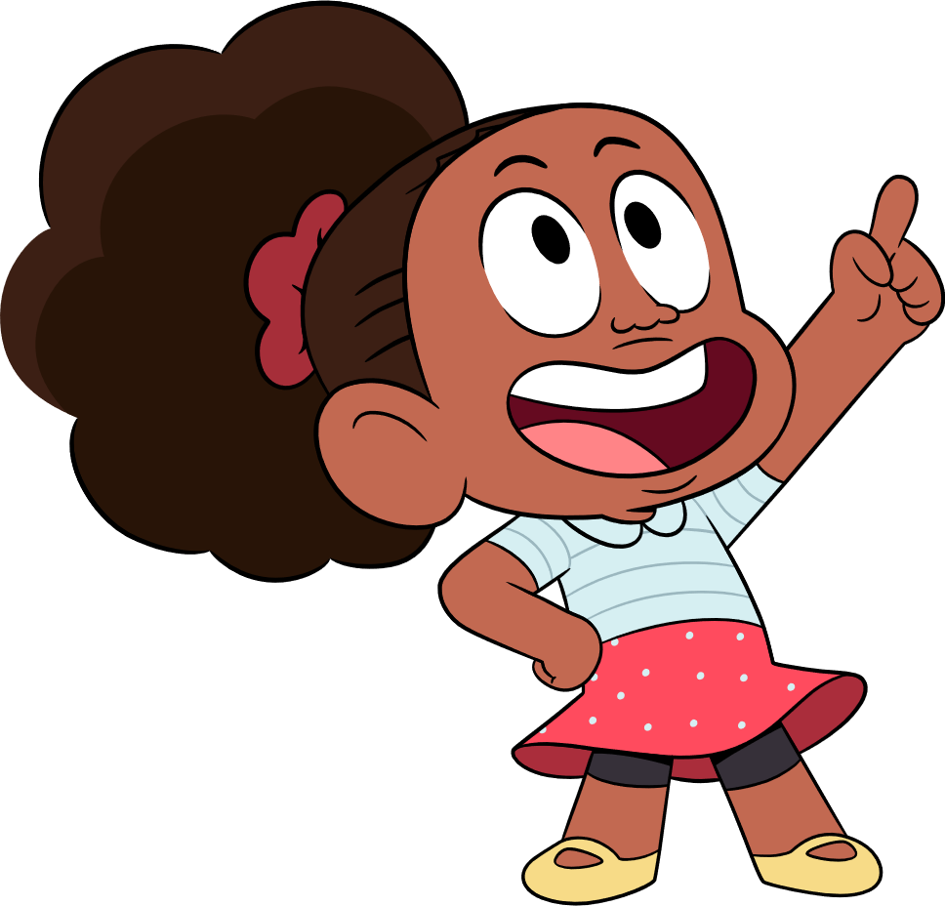
Get To Know You!
1) Are you in elementary school, middle school or high school?
2) Where in the US are you located? East coast, west coast, or midwest?
3) Have you been involved with bullying prevention before?

Slide 8
Why Does Bullying Prevention Matter?
More than 1 of 5 five students report being bullied. This means they might be scared to go to school or it can make it hard to concentrate because they’re afraid of being bullied.
Bullying can lower self-esteem and self-confidence. It can make students feel all alone and like no one cares.
It’s not just targets of bullying who are hurt by. Bullying hurts everyone involved.
We can all play a role in preventing bullying and creating a world without bullying!

Slide 9
What is Bullying?
A lot of kids describe bullying as “When someone tries make you feel bad about yourself.”
It’s bullying if:
Someone is being hurt or harmed by words or actions.
The person being hurt has a hard time making it stop.
The behavior usually happens more than once
The kids who are doing it have more power.
What does it mean to have more power?
Power can mean the person bullying is older, bigger, more popular, or there is a group of kids bullying one person.

Slide 10
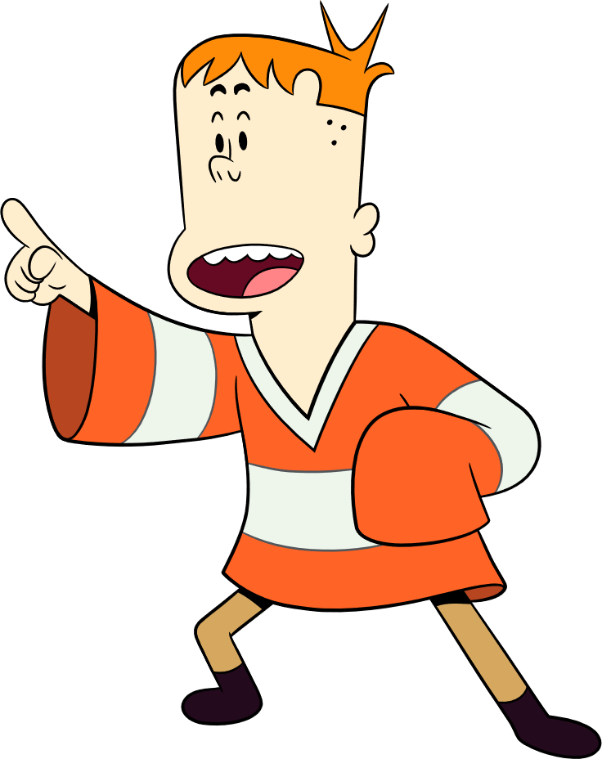
Types of Bullying
Physical: Pushing, shoving, hitting, kicking, damaging someone else’s things.
Verbal: Teasing, name calling, threats, mean jokes, rumors, gossip, saying things about someone that aren’t true.
Emotional: Leaving someone out on purpose, telling lies about someone, embarrassing someone publicly.
Cyberbullying: Sending mean text messages, posting videos or photos to make fun of someone, spreading rumors online.

Slide 11
Impact of Bullying
School – When students experience bullying, it can make it hard to focus or be interested in learning .
Feelings – When kids are worried about bullying, it can lead to low self-esteem and self- confidence. It can also lead to feeling sad, angry or lonely.
Interests – Bullying can lead kids to lose interest in activities they use to enjoy, like after school clubs or sports.
Bullying can make you feel alone and like no ones cares.

Slide 12
Who Is Involved?
Who Is Involved?
TARGET →
STUDENT WHO →
BULLIES
WITNESS OR → BYSTANDER
Person who is being bullied
Person whose actions cause hurt or harm
Person who sees or knows of the behavior

Slide 13
Important Things To Remember
Important Things To Remember
And to add to it all, the role that any students play in a bullying situation can change.
Somebody who was bullied one day might make fun of a younger kid the next day.
That’s why it’s important not to label other kids as a “bully”. When someone is labeled this way, everyone starts to think of them that way and that nothing can change.
Again, bullying is about behavior. And behavior CAN change!

Slide 14
Important Things To Remember
Bullying is all about behavior.
Bullying could be directed at anyone & it can also be shown by anyone. It’s not defined by appearance.
The one sure thing is that no one EVER deserves to be bullied and everyone has the RIGHT to be safe.

Slide 15
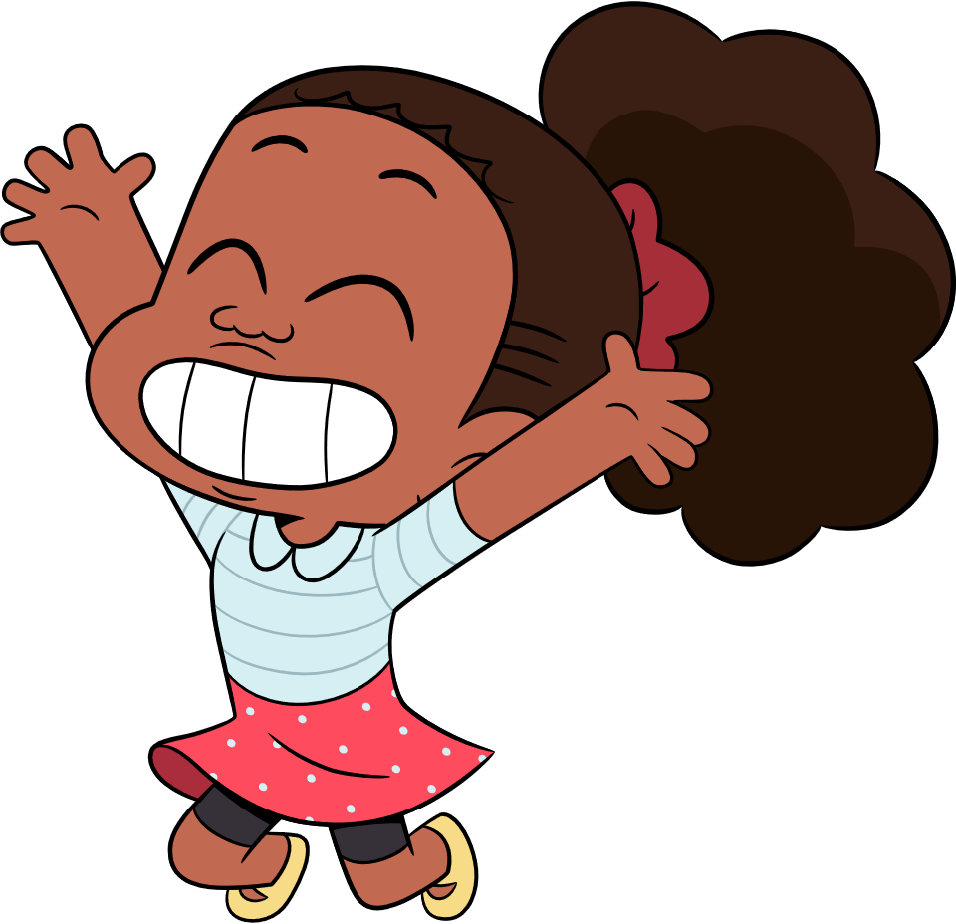
Did You Know?
Let’s start thinking more about bullying and its impact. This will give us time to start thinking about what bullying looks like at your school or in your community – and how this might impact your amazing idea!
Read the question on the slides – and talk about it if you are watching as a group. We will have about 1 minute per each question for responses and will then find out the answer and talk about it!

Slide 16
Did You Know?
What is bullying?
Accidentally running into someone in the hallway and apologizing
When a group of kids purposely excludes the new kid from recess
Taking the last dessert at lunch
When two kids disagree about the music they like.

Slide 17
Did You Know?
Is bullying the
same as conflict?
YES NO
they are the same they are different
Notes:
Bullying is different from conflict.
Conflict is a disagreement or argument in which both sides express their views.
Bullying is negative behavior directed by someone exerting power and control over another person.
Conflict is when there is a disagreement, with both kids expressing their views, and no feels unsafe. Bullying is behavior with intention to hurt or harm.
Bullying is done with a goal to hurt or harm someone. With bullying, there is often a power imbalance between those involved.
In normal conflict, kids often know if they’ve crossed the line and realize if they hurt someone and want to stop that behavior. However with bullying, kids continue their behavior even when they know it’s hurting someone.

Slide 18
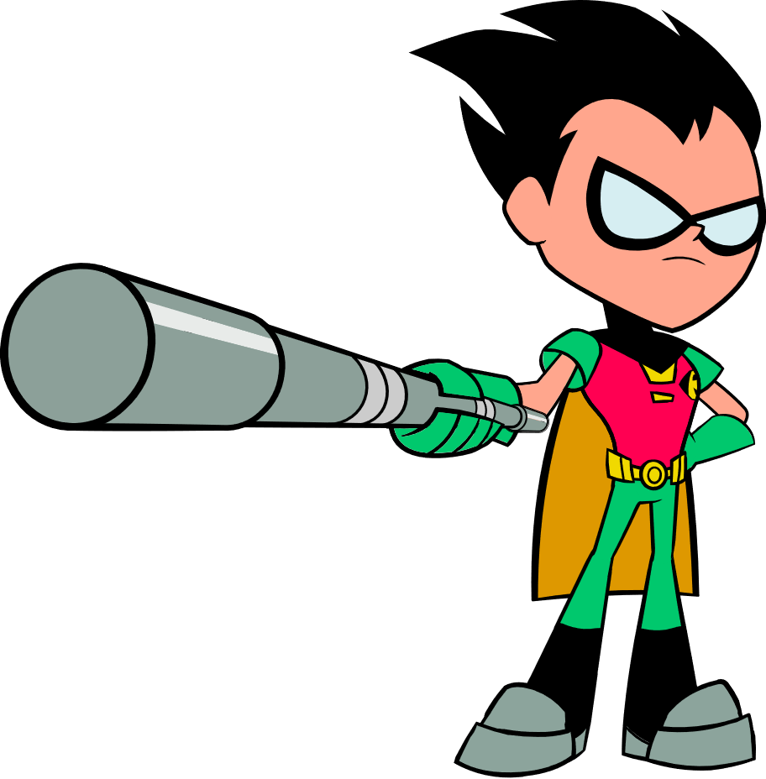
Did You Know?
If you tell an adult about bullying, it’s considered tattling or “snitching”
YES NO
Notes:
A lot of kids say that they don’t want to tell an adult about bullying because they don’t want to be called a tattle-tale.
Telling is done to keep yourself or someone else safe – its done when someone is being hurt or in andger– help from an adult is needed. Tattling is done to get someone in trouble – about a situation that can usually be worked out without an adult – might be about a behavior that is done on accident where no one got hurt or is in danger.

Slide 19
Did You Know?
Can someone who you thought was a friend be bullying you?
YES NO
Notes:
Friends will sometimes disagree. Friends will sometimes hurt each other's feelings, have an argument, or simply need time away from one another. This is normal and can happen in any friendship, no matter how close.
If you are experiencing treatment from a friend that hurts you and you have asked that friend to stop, but it still continues, then that is not friendship. That behavior could be bullying.
Friendship behaviors do not include hurting someone on purpose or continually being mean even when asked to stop. A friend will change or be remorseful for her behavior if they find out they are hurting you. If you aren't certain if what is happening is part of a normal friendship or if it is bullying, talk to an adult you trust and get help sorting out the relationship.

Slide 20
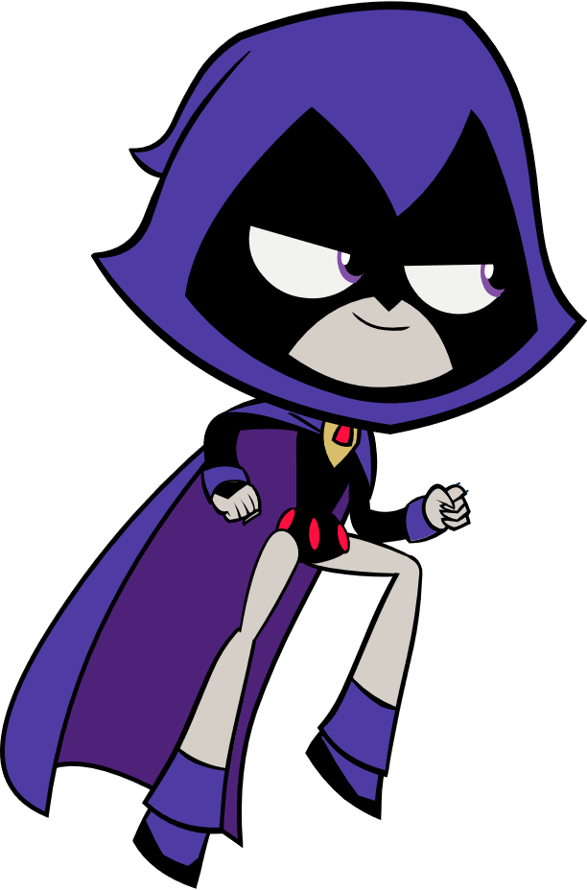
Did You Know?
Who is affected by bullying?
Those who are bullied
Those who bully
Those who see it
All of the above

Slide 21
Did You Know?
Do most schools have bullying prevention policies?
YES NO

Slide 22
Did You Know?
What should you do if you’re being bullied?
A) Speak up
B) Tell an adult
C) Know you have the right to be safe
D) All of the above
Notes:
No one EVER deserves to be bullied. If you are being bullied, it’s important for you to say something, especially to tell an adult, so they can help you resolve the situation

Slide 23
Did You Know?
Why does it matter if we have bullying at school?
A) It doesn’t – it’s just a part of growing up
B) So students learn which of their peers are in charge
C) Because it negatively impacts everyone
D) Because some students deserve it
Notes:
Every state in the nation has a law that prevents bullying in schools, and often includes your school posting and sharing its policy. If you don’t know yours, ask your teacher about it.

Slide 24
Reflection Questions
What is one thing
everyone should know
about bullying?

Slide 25
Reflection Questions
Why is it important
for students
to take on bullying?

Slide 26
What To Expect Next Week
NEXT SESSION: Thursday, February 24th at 2:30 pm CST
WHAT TO EXPECT:
Roles Student Play In Bullying
Diving Deeper – What does bullying look like in your school, community, or online space?
REMINDERS:
This webinar will be archived and posted at KidsTakeOnBullying.org
We will be available for the next 15 – 20 minutes if you have any questions!

