Slide 1
Kids Take On Bullying
Webinar Series
Session 2

Slide 2
What will the webinar series include?
We will be meeting for 6 weeks, on Thursdays at 2:30 – 3:15 pm CST. Remaining dates include:
Note: We are skipping the week of March 14 – 18th for Spring Break.
Each session will be recorded & available to watch if you aren’t able to make a session. These will be posted on KidsTakeOnBullying.org the following day.
March 3
March 10
March 24
March 31

Slide 3
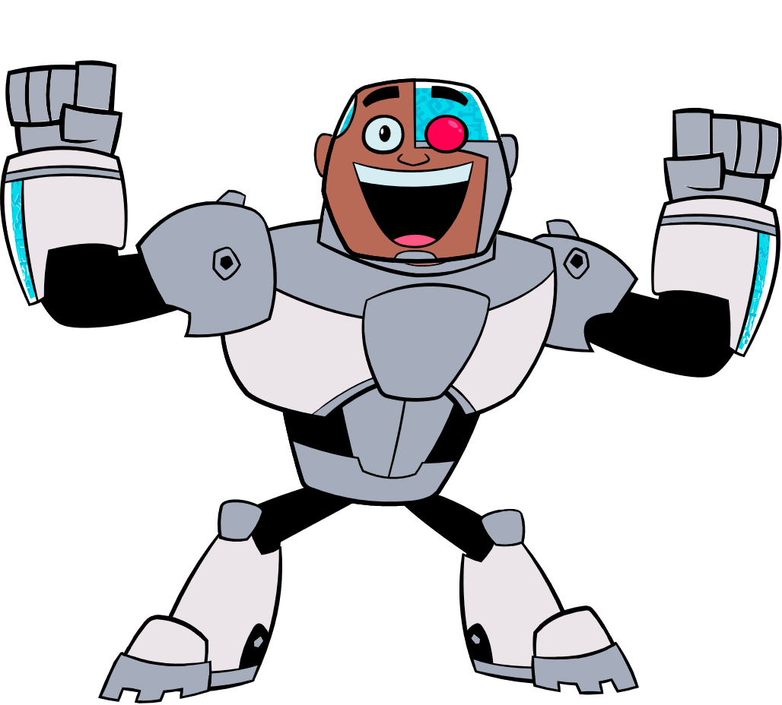
What will the webinar series include?
Each session will be 45 minutes and will feature:
Session welcome and ice breaker
Education
Interaction
At the end of each session, we will stay on the webinar to answer any specific questions you have or topics you want to talk about! This portion will NOT be recorded or shared.

Slide 4
Get To Know You!
1) Did you attend last week’s session?
2) Are you participating as a class / group or by yourself?
3) What state are you joining us from?

Slide 5
Roles Student Play In Bullying
TARGET →
STUDENT WHO →
BULLIES
WITNESS OR → BYSTANDER
Person who is being bullied
Person whose actions cause hurt or harm
Person who sees or knows of the behavior

Slide 6
What You Can Do If You Experience Bullying
If you are being bullied, there’s a lot you can do:
Know that you do not deserve what is happening
Tell someone: your parents, a teacher, a trusted adult
With that adult, develop a plan about how you can respond to the situation or how you can feel safe
With the help of an adult, decide how other students might help
Know your rights, most states have laws against bullying.

Slide 7
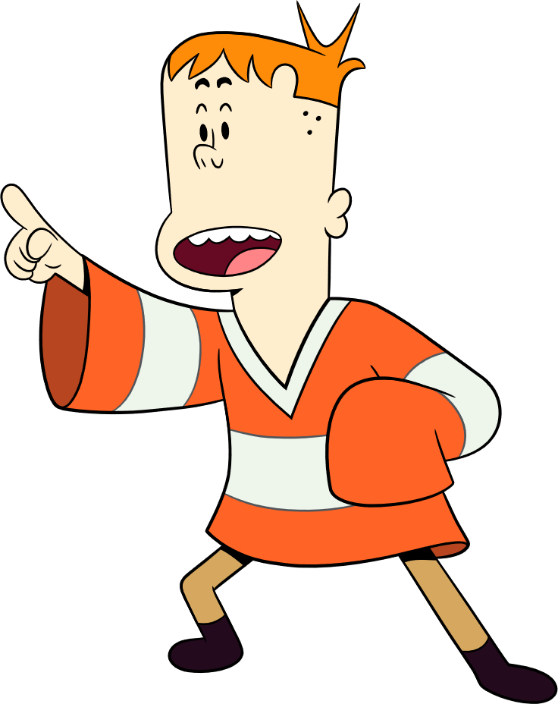
What You Can Do If You Experience Bullying
Problem: I’m being bullied. Should I tell?
How to take action: If you’re being bullied, tell an adult right away! It’s not tattling. When you are being hurt or harmed, it’s a big deal. You need someone you can trust on your side.
Problem: I’m feeling all alone
How to take action: When you are being bullied it might feel like no one cares. But know this, there are people who care. It might not be easy, but know that you can reach out and ask for help. You don’t have to go through this on your own.

Slide 8
What You Can Do If You Experience Bullying
- How To Tell an Adult -
Who Should You Talk To?
What Do You Say?
I think someone might be bullying me or someone I know, will you help?
I want to tell you about something that happened, can we talk more?
Somebody did something that made me feel __________
Sad, hurt, mad, embarrassed, worried, scared.
Know that your feelings are important & what you have to say matters!
Parent
Teacher
Coach
Family member
Counselor
Mentor

Slide 9
What You Can Do If You Experience Bullying
Problem: I don’t feel safe
How to take action: A lot of kids who are bullied don’t want to go to school – or maybe avoid places where the bullying occurs. Talk with your parents or adults at school and ask them “what can we do so that I am safe?” Develop a plan that includes steps that will help you feel like school is a good place to be.
Problem: I feel like nothing will change
How to take action: Sometimes it can be hard to see into the future and know that things can be better. Maybe things won’t change immediately, it might take time, but don’t get discouraged.

Slide 10
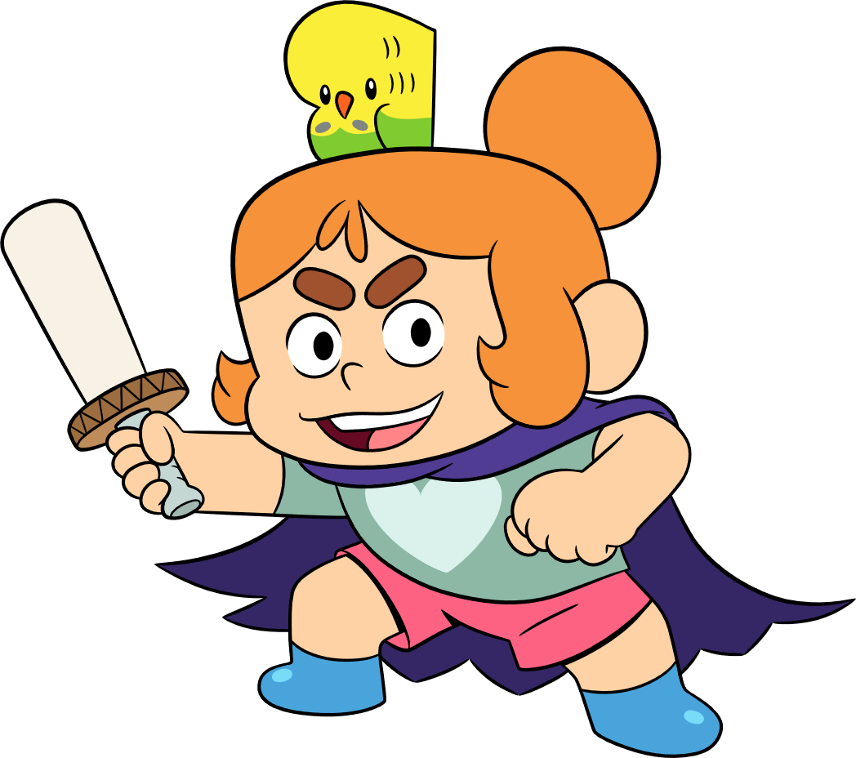
What You Can Do If You Are Bullying
Who Is Involved?
Sometimes kids bully, but that doesn’t mean that they can’t change! That’s because bullying is about behavior, it’s about words and actions—not about who they are. Here’s where to start:
Understand that your actions are hurting someone.
Know that it is NEVER okay to hurt someone.
Realize that everyone deserves respect and that differences are a positive part of our world.
Talk with someone, like your parent or a trusted adult, and ask for their help.
Think through ways to respond positively to others.

Slide 11
What You Can Do If You Are Bullying
Important Things To Remember
Someone might bullying because:
They are frustrated or unhappy with someone else.
Think about it: There are many ways to handle feelings. Talking with someone is one idea—parents, adults at school or a friend—or even the other kid. What are other ways to deal with frustration or being mad?
They are jealous of someone.
Think about it: Jealously is something almost everyone feels. It’s okay to wish that you were as good of soccer player as someone else - it’s not okay to bully someone else to make yourself feel better. How about working on what you are good at — and becoming even better?

Slide 12
What You Can Do If You Are Bullying
Important Things To Remember
Someone might bullying because:
They are looking for attention.
Think about it: Bullying will get you attention—the kind you don’t want. How about seeking positive attention by helping someone?
They have been bullied by someone else.
Think about it: Bullying someone else will NOT make it better. Hurting someone is never the answer. In fact, it will probably make things worse as you will be seen as the problem. It is important to tell someone what is happening, so that they can help make it stop. How about becoming someone who stands against bullying?

Slide 13
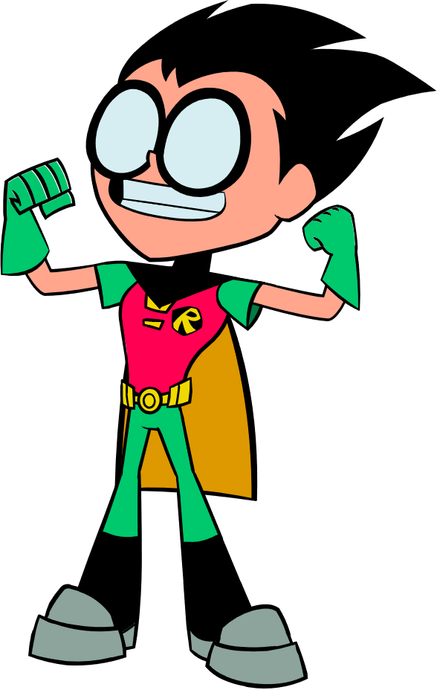
What You Can Do If You See Bullying
Speak up!
When students are willing to say they think something is wrong, they can make a difference. Your words matter, try saying:
I’m here for you & I want to help.
You didn’t deserve to be treated that way.
Can I help you find an adult to talk to?
If you see bullying, tell an adult. Remember, it’s NOT tattling or snitching, it’s okay to tell.

Slide 14
What You Can Do If You See Bullying
Reach out!
Your actions are important!
Say hi if you see them in the hallways
Walk with them to class
Ask them to play a game during recess
Be a friend!
Invite the person who is being bullied to sit with you at lunch.
Give them a compliment about something they do.
Ask questions about their activities or interests

Slide 15
Share Your Opinion!
This week’s polls will allow you to discuss and think more about what bullying looks like at your school, in your community, or in your online world!
By thinking more about the type of bullying we see happening, this can inspire your amazing idea on how to address and prevent it!

Slide 16
Question 1
What are some reasons that kids bully? They:
Want to feel in power and have control
Have been bullied
Feel pressured by peers / want to fit in
Think it’s funny
Don’t realize how much it’s hurting someone
Think it makes them look cool
Like getting a reaction
Other

Slide 17
Question 2
Does bullying happen more often between kids who:
Know each other a lot, such as a friend
Know each other a little bit, such as a classmate
Don’t know each other at all

Slide 18
Question 3
Does bullying happen more often:
In front of adults
When adults aren’t around

Slide 19
Question 4
Do you think bullying is usually more physical or emotional?
Physical: Such as hitting, pushing, destroying someone’s things
Emotional: Such as name calling, leaving people out, gossip, saying mean things (online or in-person)

Slide 20
Question 5
Which places do you think bullying happens most often?
Bus stop or on the bus
Lunchroom
Bathroom
Classroom
During Recess
Hallway
Online gaming
Online, social media
When playing sports or games
Other

Slide 21
Question 6
What is the most common reason kids don’t tell an adult about bullying?
Don’t think it will change anything
Think they will be labeled as a tattletale
Want to handle it on their own
Don’t have an adult they feel they can trust
Other

Slide 22
Question 7
Why is it important to speak up to stop bullying?
Speaking up can help stop bullying before it starts
Bullying at school makes it harder for everyone to learn
If you were being bullied, you’d want someone to speak up for you
Bullying makes kids feel hurt and alone
Other

Slide 23
Question 8
What are the most helpful actions students can take to help stop bullying?
Encourage the person being bullied to get help from a parent or teacher
Let them know they are not alone
Invite them to spend time with you
Tell them that they don’t deserve it
Other

Slide 24
Question 9
When you see bullying, how does it make you feel?
Sad
Scared
Angry
Disappointed
Frustrated
Confused
Other

Slide 25
Question 10
What are the most helpful actions adults can take to help stop bullying?
Talk with kids about what to do if they see bullying or are being bullied
Speak up about bullying to show they care
Encourage kids to watch out for each other
Set bullying prevention rules for everyone
Have consequences for those that bully
Be supportive of anyone who has been or is experiencing bullying

Slide 26
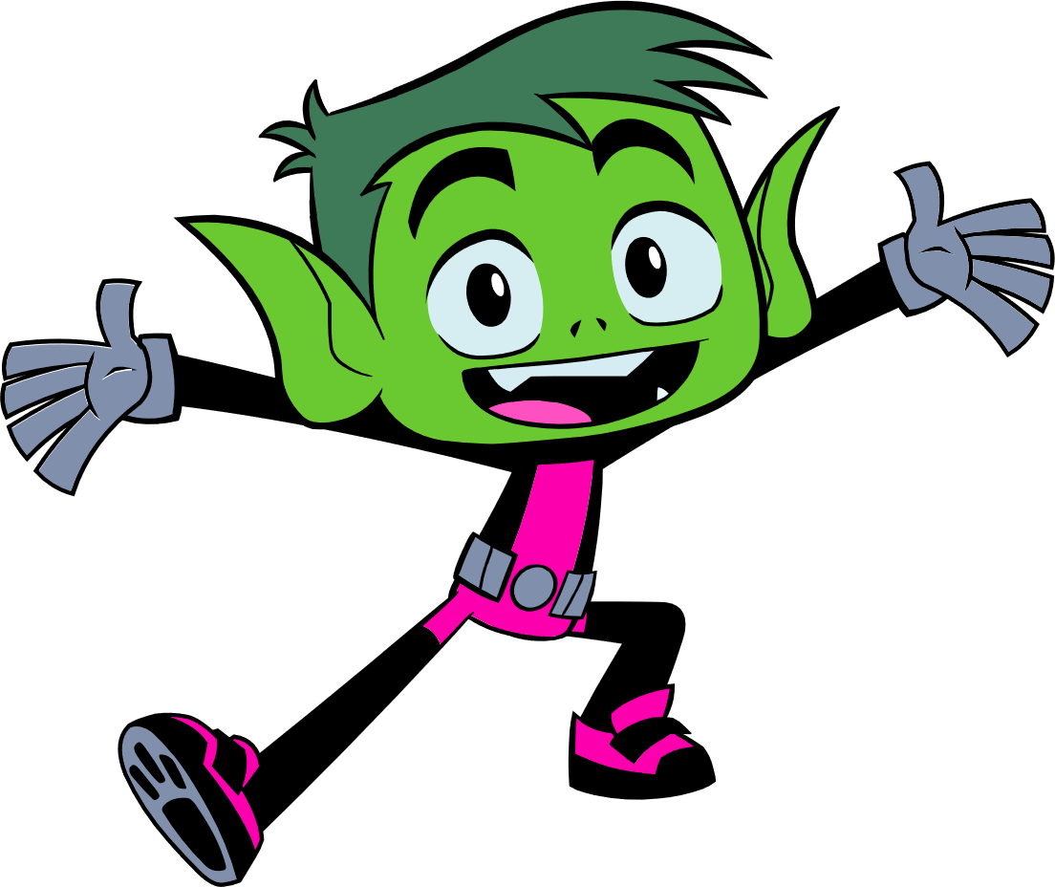
Reflection Questions
Why is it important
for students
to take on bullying?

Slide 27
What To Expect Next Week
NEXT SESSION: Thursday, March 3rd at 2:30 pm CST
WHAT TO EXPECT:
Power of peer support & advocacy
Brainstorming Ideas – Interactive What Would You Do scenarios
REMINDERS:
This webinar will be archived and posted at KidsTakeOnBullying.org
We will be available for the next 15 – 20 minutes if you have any questions!

