Slide 1

Kids Take On Bullying
Webinar Series
Session 3

Slide 2


What will the webinar series include?
We will be meeting for 6 weeks, on Thursdays at 2:30 – 3:15 pm CST. Remaining dates include:
Note: We are skipping the week of March 14 – 18th for Spring Break.
Each session will be recorded & available to watch if you aren’t able to make a session. These will be posted on KidsTakeOnBullying.org the following day.
  March 10
  March 24
  March 31

Slide 3
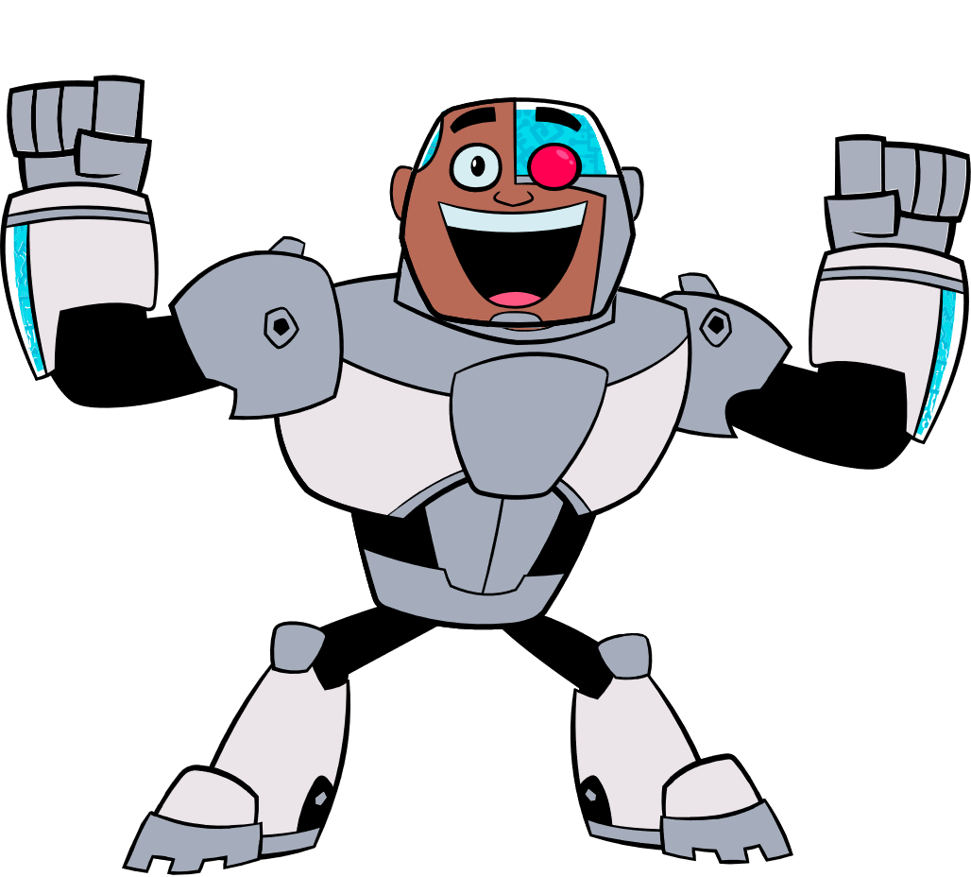
What will the webinar series include?
Each session will be 45 minutes and will feature:
Session welcome and ice breaker
Education
Interaction
At the end of each session, we will stay on the webinar to answer any specific questions you have or topics you want to talk about! This portion will NOT be recorded or shared.

Slide 4
Get To Know You!
1) If you are participating as a school, what is your school mascot?
2) If you’ve attended a session so far, what has been your favorite part?

Slide 5
Being There
Think about what it means to feel all alone, to believe that no one cares, to think that there is no way to change what is happening when you are experiencing bullying.
That's a lonely place to be.
Imagine how all that can be different. Imagine during those times when you feel broken, that someone is there for you.
They talk to you, they tell you that it will be ok, that you matter.
=====================================================================
Your support is meaningful.
It can take someone from feeling hopeless
to feeling valued and respected.
Notes:
Slide: Being There
Objective: Show students why it’s important to be there for a peer experiencing bullying.
Think about what it means to feel all alone, to believe that no one cares, to think that there is no way to change what is happening when you are experiencing bullying.
That's a lonely place to be.
When everyone around you looks the other way, ignores you, and maybe even sides with the person hurting you, it’s hard to believe in yourself.
It's hard to think that life will ever be any different.
Imagine how all that can be different. Imagine during those times when you feel broken, that someone is there for you.
They talk to you, they tell you that it will be ok, that you matter.
They say that you deserve to be treated with respect and kindness.
They tell you that they will be there for you.
Imagine how different that feels. It doesn't take away all the hurt, but hope is a powerful medicine for pain.

Slide 6
Being There
- Ideas -
When you see something, do something!
Don’t focus on fixing the problem; focus on how you be supportive.
Show that you’re listening by allowing them to talk more than you.
Help them think through how they can tell their parents, and what to do if that doesn’t help.
Let them know that they can talk with you anytime.
Never judge or blame them!
Notes:
Objective: This will give students tangible ideas
about how to be there for a peer experiencing
bullying.
Being There - Ideas
When you see something, do something!
Don’t focus on fixing the problem, focus on how you be supportive.
Know that talking with someone will help them.
Think of questions that will lead them to open up more to you.
Show that you’re listening by allowing them to talk more than you.
Being there for someone doesn’t mean solving the problem. It means being an emotional supporter.
Avoid aggression, anger, and confusion.
Be confident and genuine with your suggestions and words.
Help them think through how they can tell their parents, and what to do if that doesn’t help.
Let them know that they can talk with you anytime.
Never judge or blame them!

Slide 7
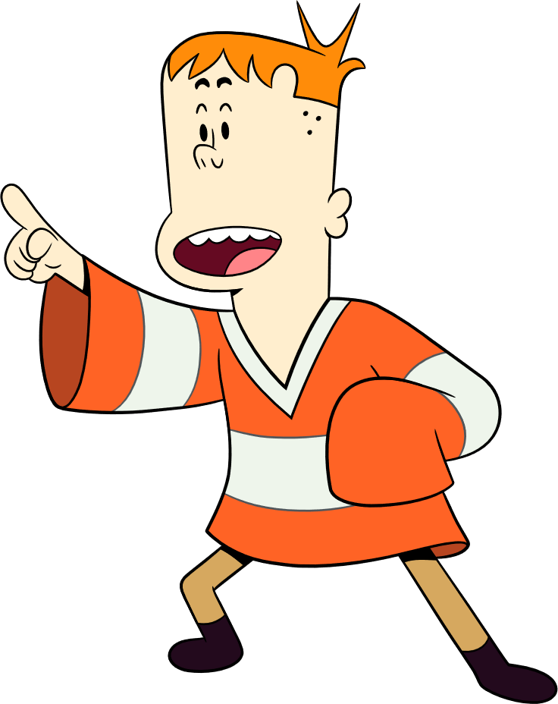
Build Them Up
Bullying so often tears people down, but you can help build them back up.
Building someone up is about:
Letting them know that someone is there to help.
Helping them get back their confidence.
Encouraging them that they are ok just the way they are.
Letting them know that they are important.
==============================================================
Building someone up doesn’t always have to involve compliments, or even words. Letting someone know that they are not alone is one of the most effective interventions, according to those who have been bullied.
Notes:
Slide: Build Them Up
Objective: Give students ideas on way to support someone
experiencing bullying.
When you are being mistreated, it can be hard to feel good about yourself. Being bullied can bring down self-confidence, self-worth, and self-esteem. It can increase anxiety and depression.
Bullying so often tears people down.
When you know that someone has been broken down, help them back up.
Building someone up is about:
letting them know that someone is there to help.
helping them get back their confidence.
encouraging them that they are ok just the way they are.
letting them know that they are important.
Be creative, sincere, and generous in your efforts to support your peers. Building someone up doesn’t always have to involve compliments, or even words. Letting someone know that they are not alone is one of the most effective interventions according to those who have been bullied

Slide 8
Build Them Up
- Ideas -
Invite them into a group activity.
Remind them that they have you as a friend.
Include them in conversations. Even if they don’t want to talk, make sure they know they are a part of the discussion.
Strategize positive ways to react if it happens again.
Tell the person you are there for them, and they didn’t deserve that.
Simply listening and showing that you believe and care about what is going on will do wonders!
Notes:
Slide: Build Them Up - Ideas
Objective: Give students tangible ideas on how
to build up someone who has experienced bullying.
Invite them into a group activity.
Talk with them during class breaks, even if it’s just to say “hi”.
Actively make your non-verbal communication more inclusive, like leaving seats open at your lunch table rather than putting your stuff there.
Include them in conversations. Even if they don’t want to talk, make sure they know they are a part of the discussion.
Recognize the things that they do really well, and compliment them on their talents.
Don’t feel obligated to know the answer to the situation. Sometimes listening is the most genuine way to show support.
Remind them that they have you as a friend.
Offer to do activities together that will guarantee a smile or even a laugh.
Remind them that no one deserves to be disrespected, and that it won’t last forever.
Strategize positive ways to react if it happens again.
Things to say to the person being bullied:
I’m here for you.
You didn’t deserve that.
You are a good person in a bad situation.
That person was wrong to do that.
Let’s tell someone who can help.
Let’s find someone that you can talk to about this.
Simply listening and showing that you believe and care about what is going on will do wonders!

Slide 9

Turn a 180
Helping doesn’t always mean directly confronting the person bullying. You can show your support by diverting the situation in a more positive direction.
Turning a 180 is about:
Redirecting a negative situation
Creating a more supportive school environment
Deescalating bullying situations
===============================================================
It’s not easy to be one person against a wave of negativity, but when one person speaks up, others will follow.
Notes:
Slide: Turn a 180
Objective: Help students learn what it means to
turn a 180 – flipping a negative situation to a positive
Research has shown that students are the most effective people to intervene in a bullying situation. Helping doesn’t always mean directly confronting the person bullying. You can show your support by diverting the situation in a more positive direction.
It’s not easy to be one person against a wave of negativity, but when one person speaks up, others will follow.
The biggest obstacle is believing you are powerless. You CAN make a difference.
Turning a 180 is about:
Redirecting a negative situation
Creating a more supportive school environment
Deescalating bullying situations.
Empowering students to intervene in a bullying situation doesn’t remove responsibility from adults in the school. Adults need to play an active role in bullying prevention, too. Often young people feel like they don’t have control over their own lives – but you CAN make a difference for your peers who are being bullied.

Slide 10
Turn a 180
- Ideas -
Change the subject when your peers start tearing someone down.
Make a point of saying something positive about a person who’s getting picked on.
Reach out to targets of bullying to show them that people do care about them.
Talk to an adult you think would handle the situation in the most effective way.
Anytime you read negativity about someone online, be sure to add something positive about them.
Notes:
Slide: Turn a 180 - Ideas
Objective: Give students ideas on ways they can
turn a 180 when they see a bullying situation.
Ways you can turn a 180:
Change the subject when your peers start tearing someone down.
Make a point of saying something positive about a person who’s getting picked on.
Reach out to targets of bullying to show them that people do care about them.
Be blunt and surprise the person bullying by asking why they did/said it, but only if this is something you feel safe doing.
Let the person being harmed know that you think they are a good person.
Talk to an adult you think would handle the situation in the most effective way.
Talk to the person bullying and educate them on ways to respect others.
Anytime you read negativity about someone online, be sure to add something positive about them.
Report! There are ways to remove postings online that are hurtful.

Slide 11

What Should You Do?
This week’s activity is What Should You Do? Thinking about how you would handle these bullying situations.
Remember – this isn’t about right or wrong answers! It’s all about talking about situations you might see at school and thinking through how to respond!

Slide 12
Scenario 1: The New Kid
Several months into the school year, there is a new student named John in your class. A lot of students have formed friend groups that they hang out with at school.
During a classroom activity one day, you see that the John is being left out of things on purpose. You even hear another student going around to other groups saying, “The new kid John is weird. Don’t let him in your group.” This really bothers you. You want to include John in your group, but you think if you do, others will make fun of you too.
Which option would you choose?
Option 1: Decide that it’s not your problem, John will be okay.
Option 2: Tell other groups to not talk to John because he is weird – even though he think he seems nice.
Option 3: Even though some kids might make fun of you, invite John to be in your group
Option 4: Suggest to your teacher to assign John to a group.
Option 5: Other

Slide 13
Scenario 2: Note Passing Gone Wrong
In science class, you see a student write something on a piece of paper and pass it to another student. When the student gets the note, they read it and write more down on the note. That student then passes it to a different student who reads it, laughs, writes something down, and passes it on again. Finally, someone passes the note to you. When you open the note, you see at the top of the note, “Reasons why Taylor shouldn’t be at this school,” with a list of hurtful comments written about Taylor, who is in science class with you.
Which option would you choose?
Option 1: Write something mean about Taylor and pass it to someone else.
Option 2: Give the note to Taylor so she can read all the comments.
Option 3: Tear up the note and throw it away. After class, say hi to Taylor and give her a compliment about her outfit.
Option 4: After class, anonymously give the note to the teacher so they can address the issue.
Option 5: Other

Slide 14
Scenario 3: The Bus Ride
You and your friends are sitting on the bus home after school one day. One of your friends Jesse is sitting in front of you alone. A younger student named Kris can’t find a seat to sit in and asks if it’s okay to sit next to Jesse. Jesse laughs and says, “This seat is full, why don’t you try sitting somewhere else.” Kris looks upset and walks away. You feel bad about what your friend Jesse said to Kris, but your friendship with Jesse means a lot.
Which option would you choose?
Option 1: Because your friendship with Jesse means a lot, laugh at what happened.
Option 2: Don’t do anything, it probably won’t happen again.
Option 3: Tell Jesse about a time when an older student wouldn’t let you sit with them and there weren’t any other seats open.
Option 4: Tell Kris that they didn’t deserve what happened and it’s not their fault. Invite them to sit with you next time on the bus.
Option 5: Other

Slide 15
Scenario 4: Getting Help From Adults
During recess, you and your friend love to go on the swings. For the past week, whenever you start to swing, two older students come up to the swings and tell you to leave. You told an adult at school about what’s happened, but the adult told you to work it out, but that is really scary as the other kids are older and bigger. You are told to tell an adult, but you did, and nothing has changed.
Which option would you choose?
Option 1: Wait it out to see if the bullying stops. Maybe the older students will find another activity to do at recess.
Option 2: Go back to the same adult, sharing that nothing has changed and ask them if there is something else that can be done
Option 3: Get your entire group of friends to gang up on the students pushing you off the swings.
Option 4: Reach out to another trusted adult for help.
Option 5: Other

Slide 16
Scenario 5: Being Cyberbullied
You are playing your favorite computer game and receive a message from someone you go to school with, but who is not your friend. The message says, “Seriously, what makes you think you should be on this game, why do you even bother playing?” You’re not sure if the person is joking or sent the message to the wrong person, so you don’t say anything back and sign off. While you’re playing the game the next day, the same person sends you another message saying, “You’re the worst player. You should delete your account.”
Which option would you choose?
Option 1: Ignore the messages and hope that it stops
Option 2: Respond to the message by saying, “You’re the one no one wants to play with. You’d better back off or else.”
Option 3: Try to avoid the person at school
Option 4: Block the person. Talk with your parents or a trusted adult to get their advice about how to
handle the situation.
Option 5: Other

Slide 17

Reflection Questions
If you were being bullied, what would you want your peers to do to help out?

Slide 18
What To Expect Next Week
NEXT SESSION: Thursday, March 10th at 2:30 pm CST
WHAT TO EXPECT:
Share stories from other kids & teens involved in bullying prevention
Brainstorming Ideas – Thinking more about what we can do
REMINDERS:
This webinar will be archived and posted at KidsTakeOnBullying.org
We will be available for the next 15 – 20 minutes if you have any questions!

