Slide 1
Kids Take On Bullying
Webinar Series
Session 4

Slide 2
What will the webinar series include?
We will be meeting for 6 weeks, on Thursdays at 2:30 – 3:15 pm CST. Remaining dates include:
Note: We are skipping the week of March 14 – 18th for Spring Break.
Each session will be recorded & available to watch if you aren’t able to make a session. These will be posted on KidsTakeOnBullying.org the following day.
March 24
March 31

Slide 3
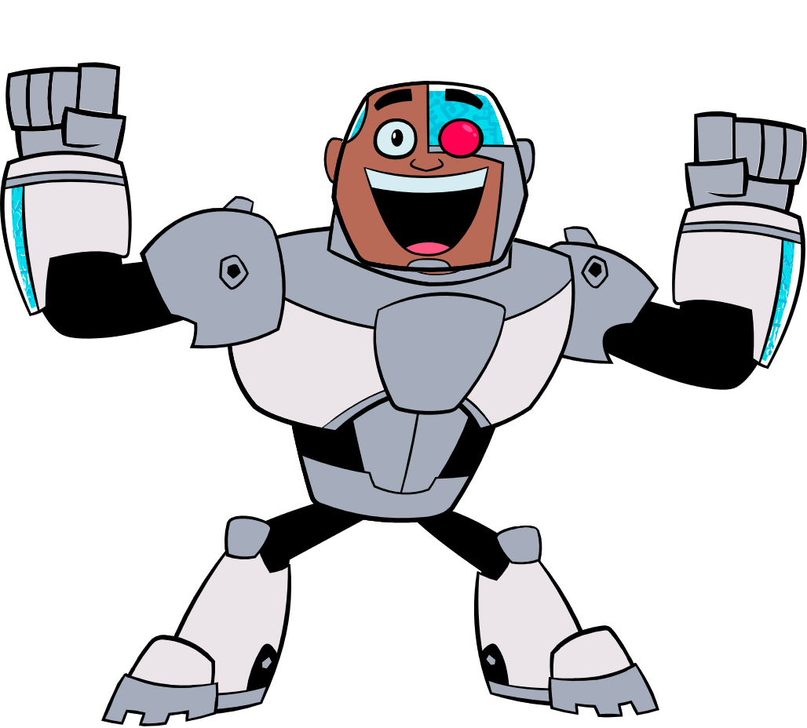
What will the webinar series include?
Each session will be 45 minutes and will feature:
Session welcome and ice breaker
Education
Interaction
At the end of each session, we will stay on the webinar to answer any specific questions you have or topics you want to talk about! This portion will NOT be recorded or shared.

Slide 4
Get To Know You!
What is one thing your school currently does for bullying prevention?

Slide 5
Upstander’s Club
The Upstander's Club (4-6th grade students) choose projects to create and promote.
Last year, they created the kindness pledge, an accompanying animation video + participated in PACER’s Run, Walk, and Roll Against Bullying.
They also created a fundraiser to help homeless youth and families at Fairview Elementary.
They created flyers, videos, spoke at our staff meeting, and strategized to raise funds for over a month! In less than a month, they surpassed their goal and raised $1,445 to help support multiple homeless families!
Notes:
The Upstander's Club are student leaders in grades 4 – 6 who exemplify standing up for what's right, reporting bullying and spreading kindness while assisting with creating a positive school climate. The Upstander's Club choose projects to create and promote. Last year, they created the kindness pledge and an accompanying animation video. This year, they participated in PACER’s Run, Walk, and Roll Against Bullying as the Fairview Upstanders to help promote bullying prevention. Their next initiative was to create a fundraiser to help homeless youth and families at Fairview Elementary. They extended this philanthropic work to include a local homeless shelter and nonprofit organization that also supports homeless youth and families. The Upstanders set out to raise $1,000 for this fundraiser. In their words: "There are many people on the streets and in shelters, and we hope to reduce that number to a minimum with your donations. Their goal is to raise funds so homeless individuals can eventually secure permanent housing and nutritious food." They created flyers, videos, spoke at our staff meeting, and strategized to raise funds for over a month! In less than a month, they surpassed their goal and raised $1,445 to help support multiple homeless families! As a result, their fundraiser gained recognition from district administrators and district board members and will be presented as one possible solution to supporting homeless youth and families in our school district. These students created this fundraiser out of the kindness of their humongous, selfless hearts! As one student exclaimed, “Upstanders are superheroes!”

Slide 6
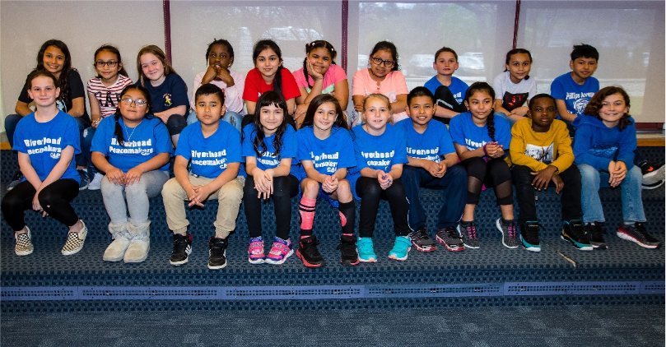
Riverhead Peacemakers
Every year this group of dedicated fourth graders acts as role models in their schools.
They read every class a book about not bullying and have them sign a pledge not to bully and to be kind.
They have every school in our district participate in an event called the Great Kindness Challenge where they complete as many kind deeds as they can.
Since its inception, the Peacemakers have grown and have become an integral part of our school community spreading their message of inclusion and kindness.

Slide 7
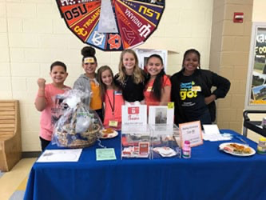
Marley Middle School Kindness Club
The club started with a little over 20 students in grade 6 – 8 and have grown to 95 members and counting.
They started the year by designing a monthly Kindness tracker with different "look fors” (to look for compliments, look for kindness, look for inclusion, etc.). Teachers stamp the card for every time they see a student complete a kind act.
Once the student fills the card, they turn it into the Kindness Club members at the table outside the cafeteria for a caught being kind sticker and an entry into the monthly raffle.
During the kindness challenge, they reached over 1,000 acts of kindness at their school!

Slide 8
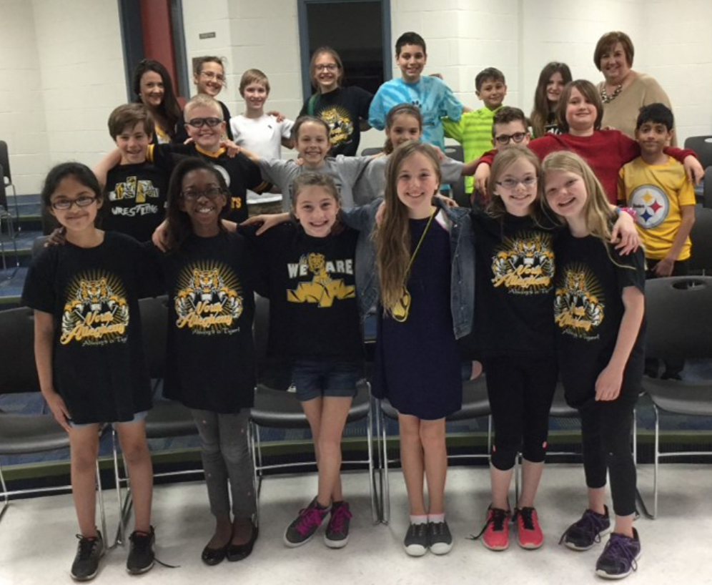
Marshall Elementary School Bullying Prevention Club
This group is made up of dedicated fourth-graders who want to make a difference in our school. They work together to make sure our school remains bully free. They have addressed the definition of bullying and taught our school the rules we are to follow if they feel they are being bullied.
Each month they have created a schoolwide theme, like Friendship or Respect. They display the theme on a poster and hang quotes around the school that relate to the theme.
This month they are creating lessons to teach to the younger students about being a good friend. They will read a story to other students about how to help your friends if you are the bystander + an activity the group created!
For their theme next month, they are going to have students create a poster to fit the schoolwide theme + the school winner will have their poster made into a banner which will be hung outside our school next year.

Slide 9
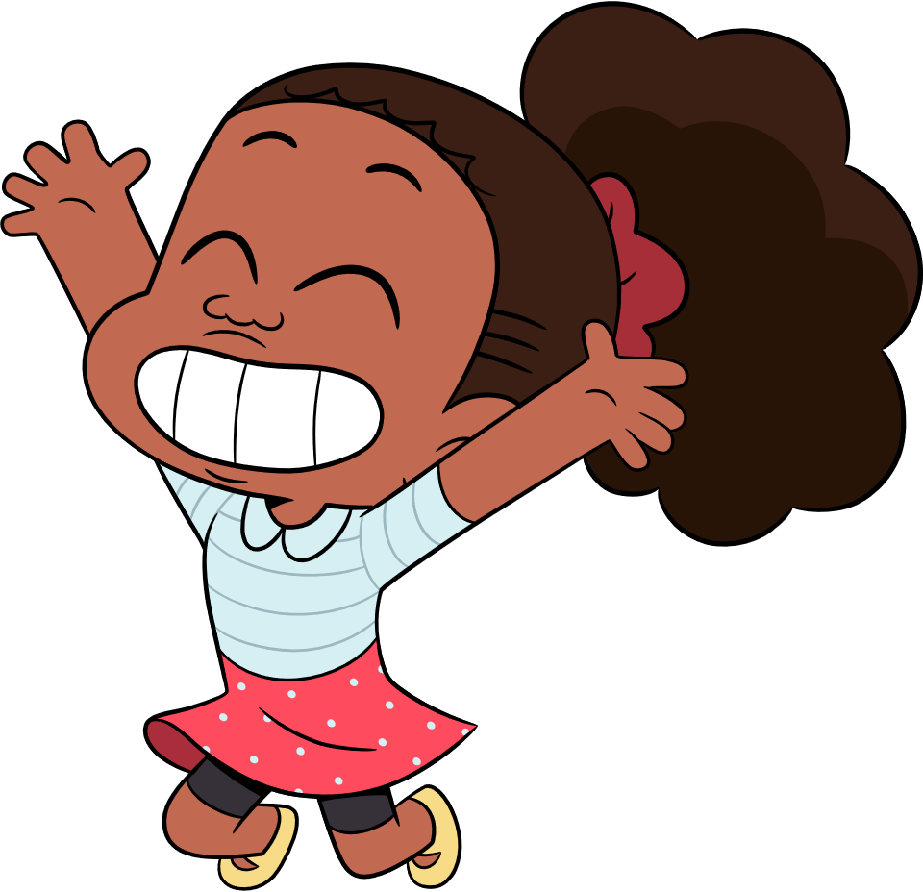
Let’s Brainstorm!
In this week’s activity, we are going to talk through different ideas that you could implement at your school or in your community!
For each idea, think about:
Do you think this idea would help prevent bullying?
Is this an idea you are interested in starting at your school?

Slide 10
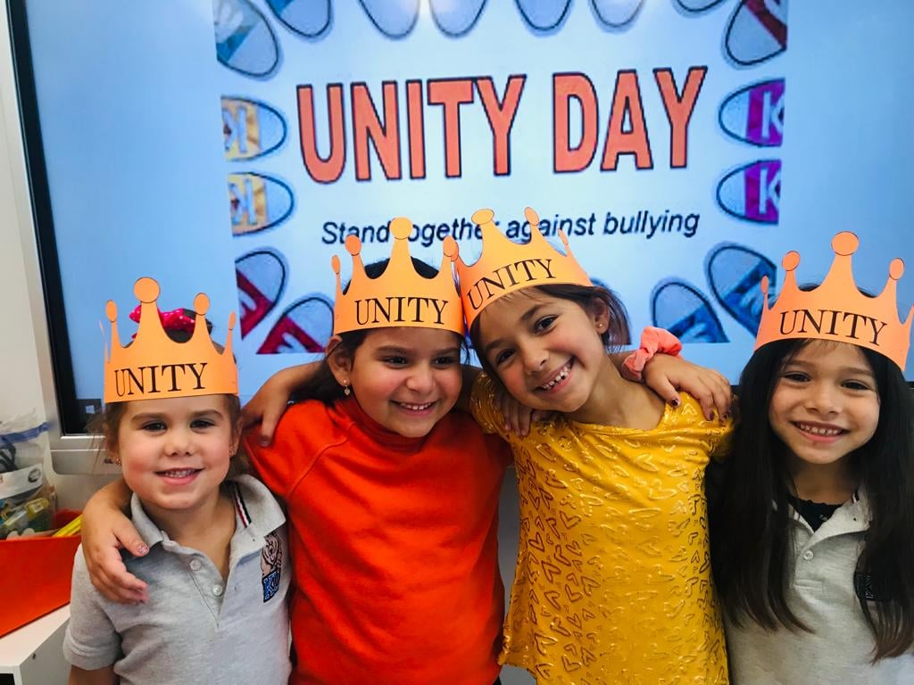
Unity Day!

Slide 11
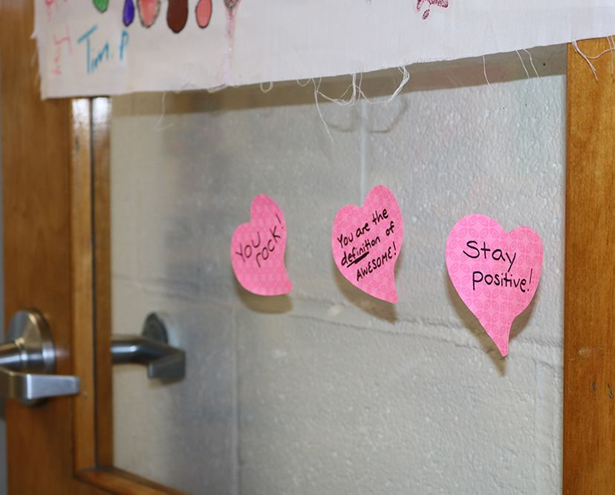
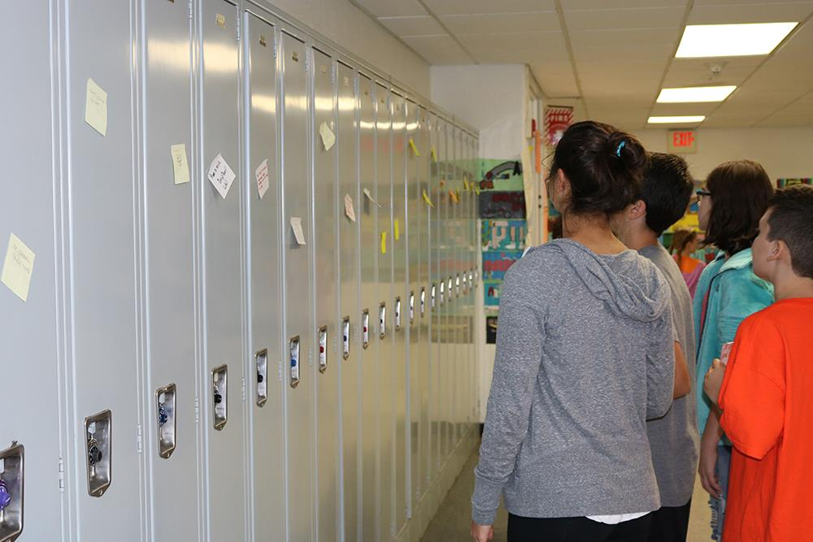
School Kindness Notes

Slide 12
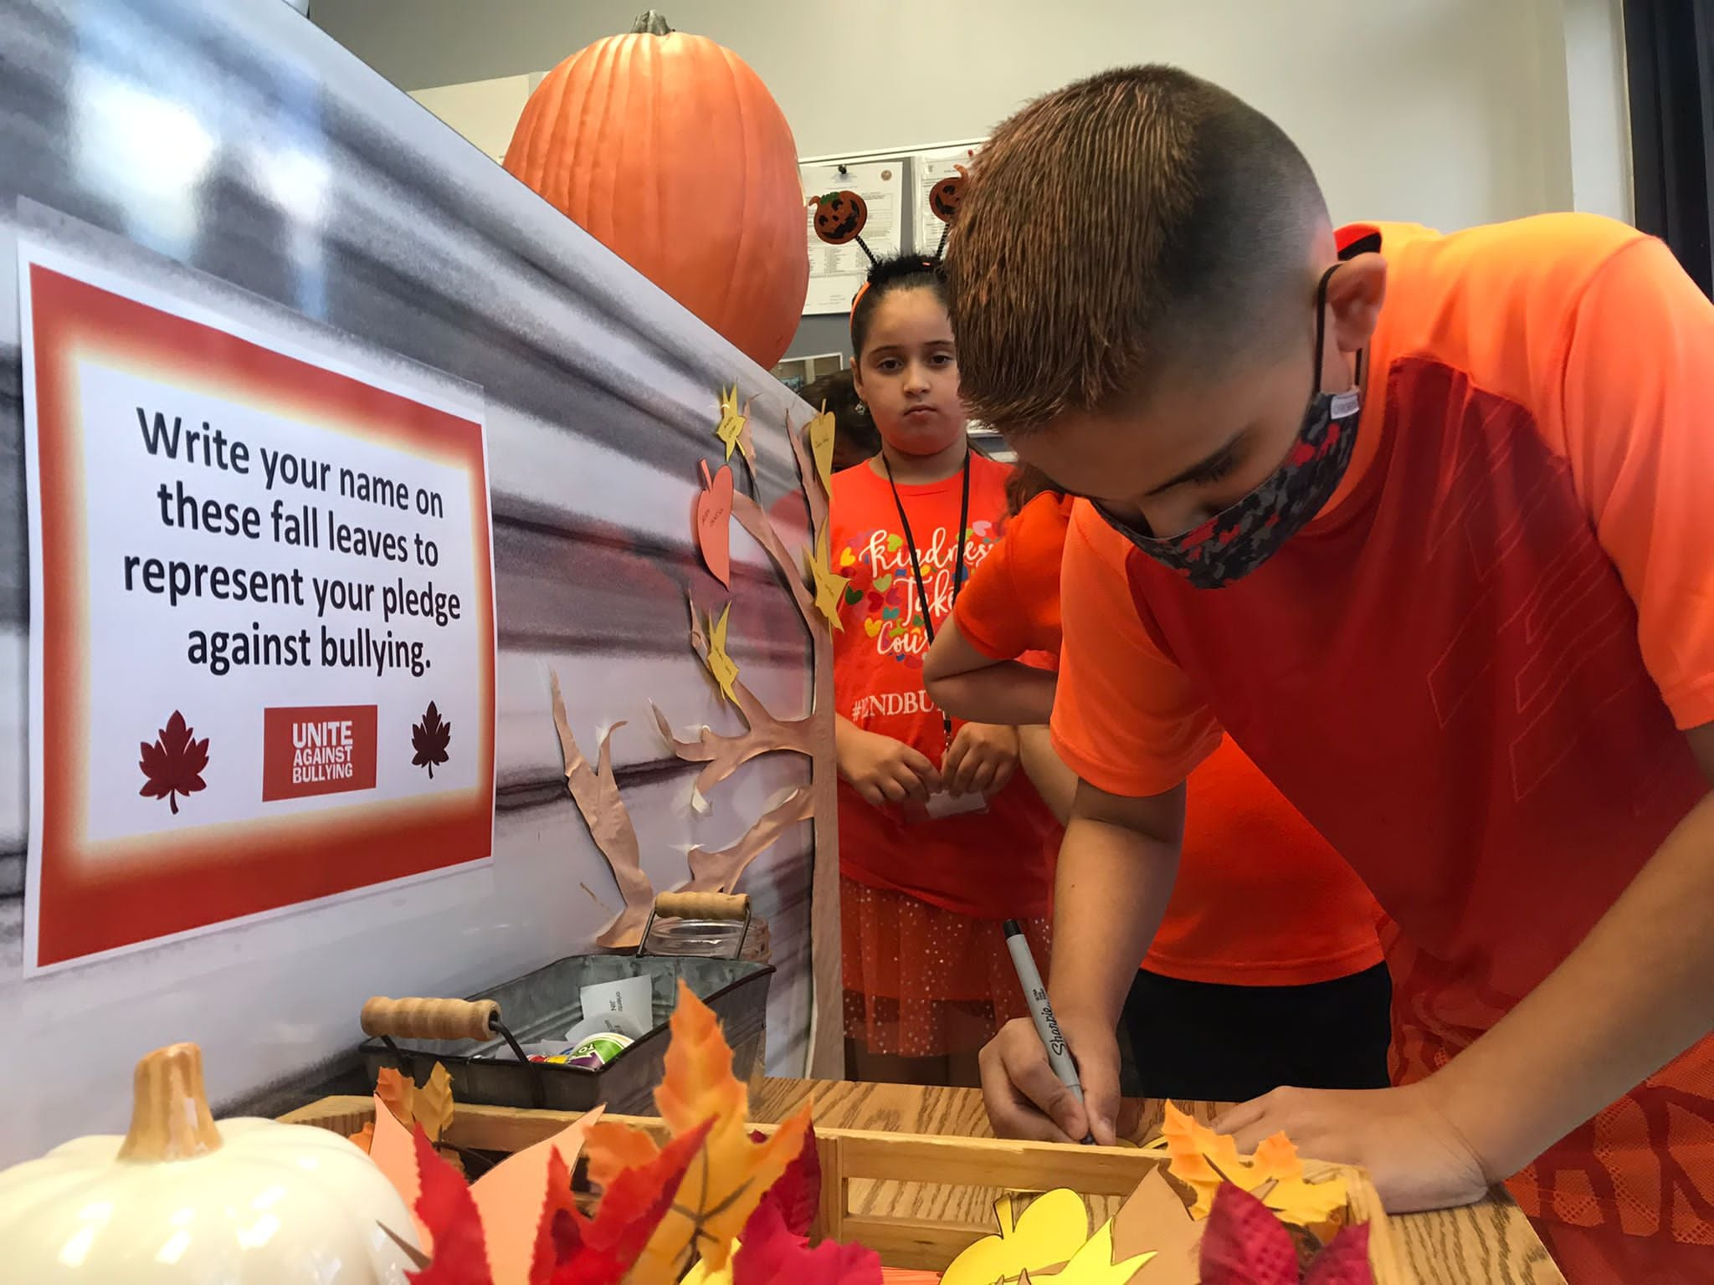
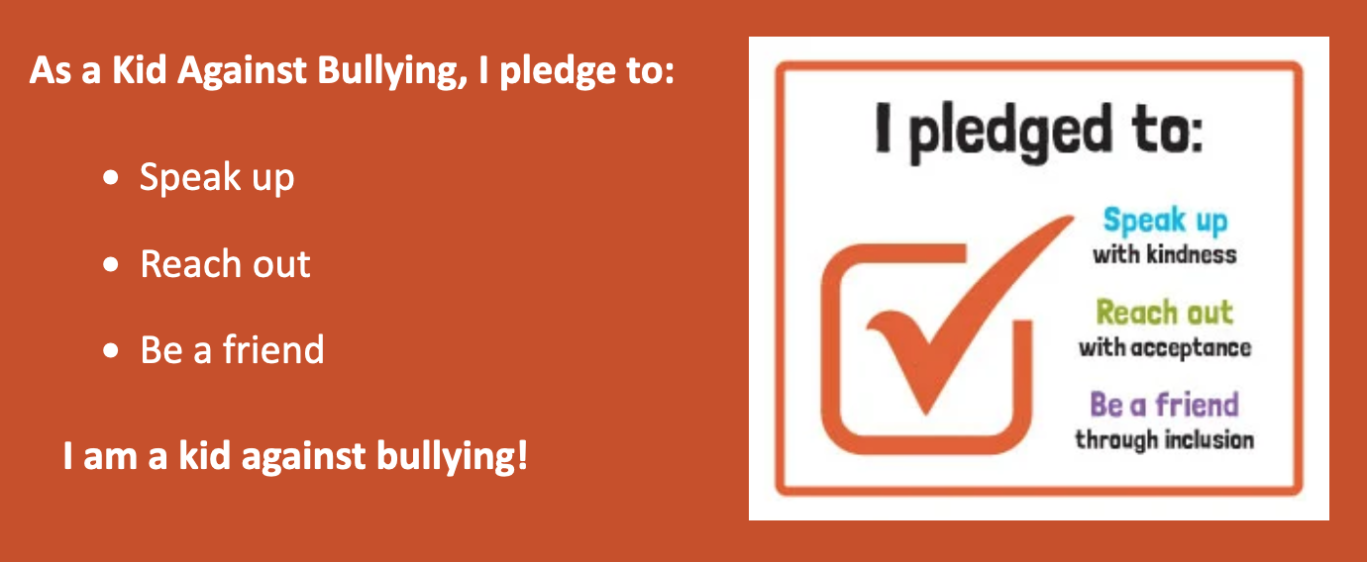
Pledge Signing

Slide 13
Students With Solutions
Notes:
Every video submission will be entered in a random drawing for FREE PRIZES including t-shirts, resource kits, poster series + include someone kits from Cartoon Netowrk

Slide 14
Celebrate
National Bullying Prevention Month

Slide 15
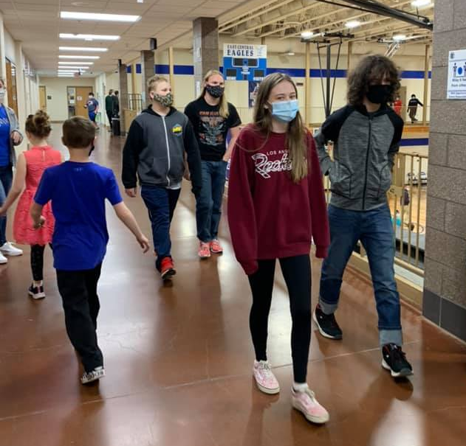
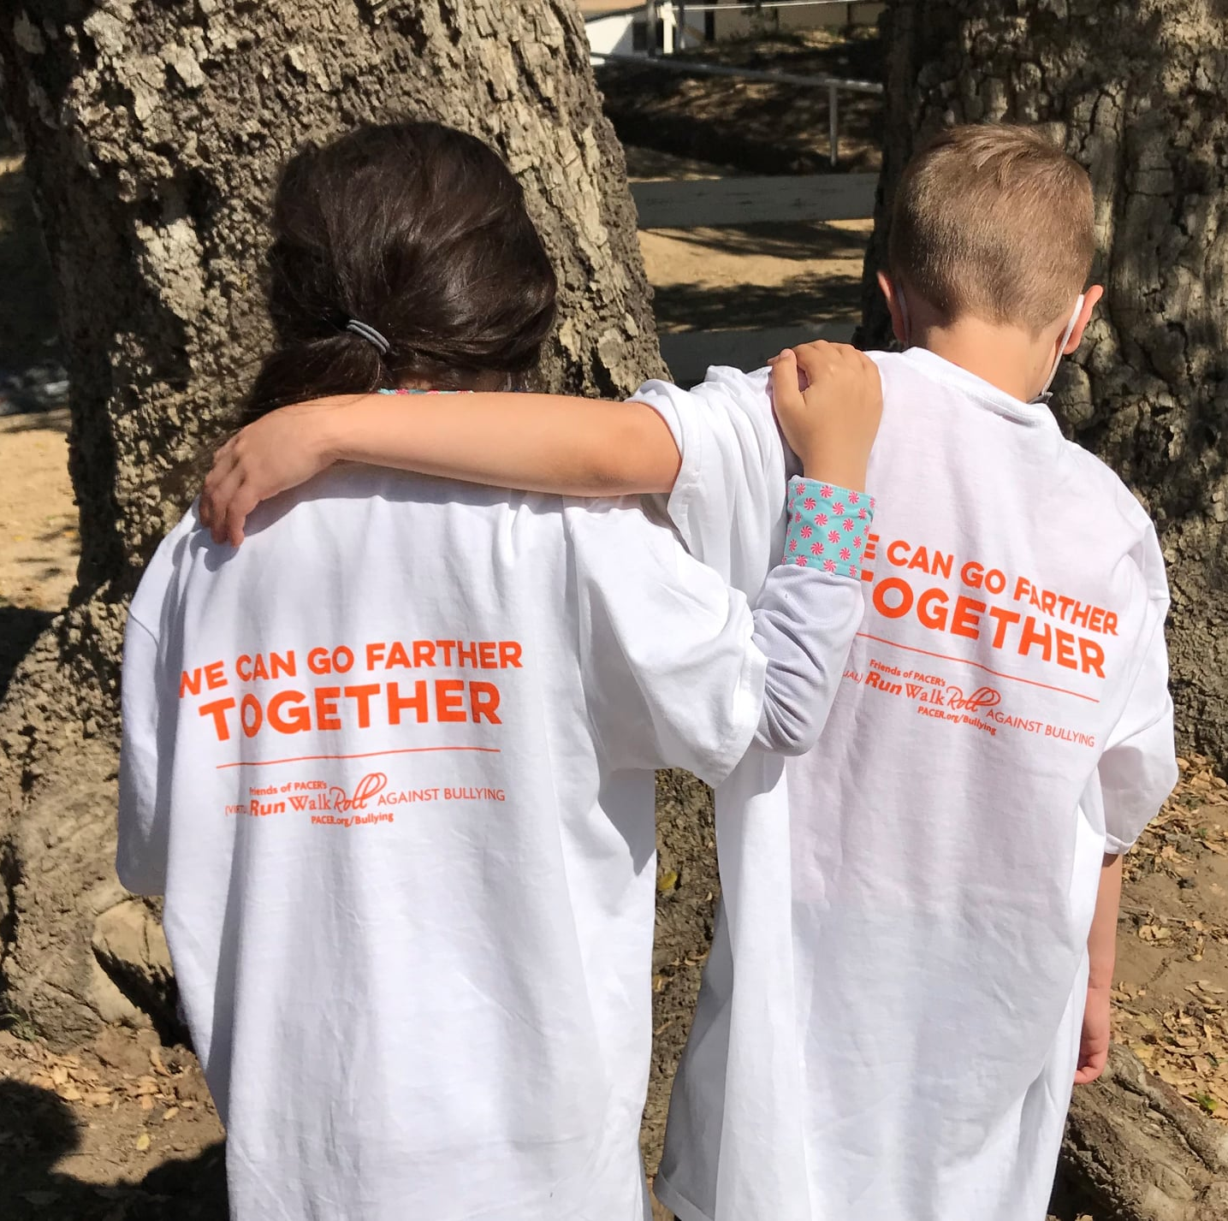
Run Walk Roll

Slide 16
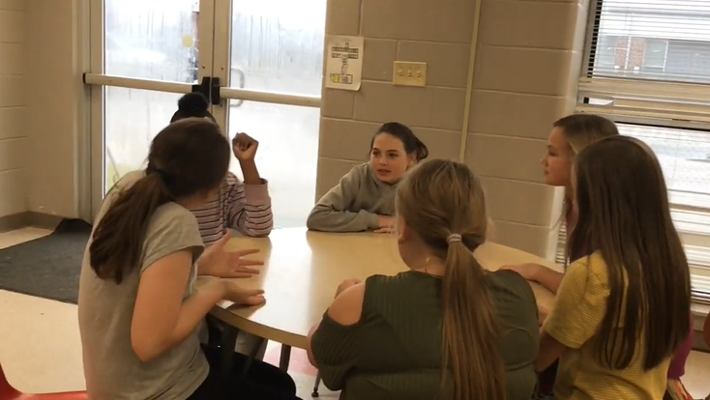
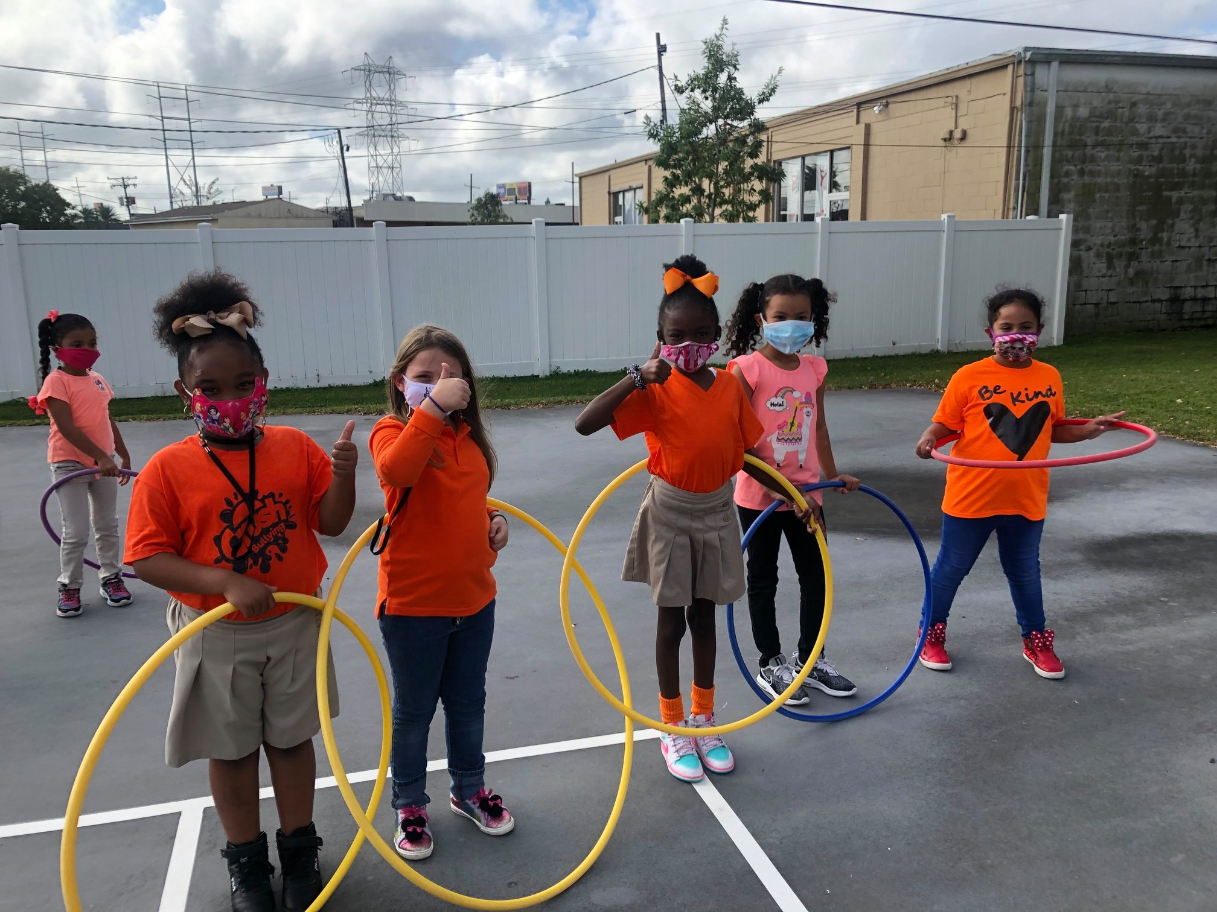
Mix It Up Days

Slide 17
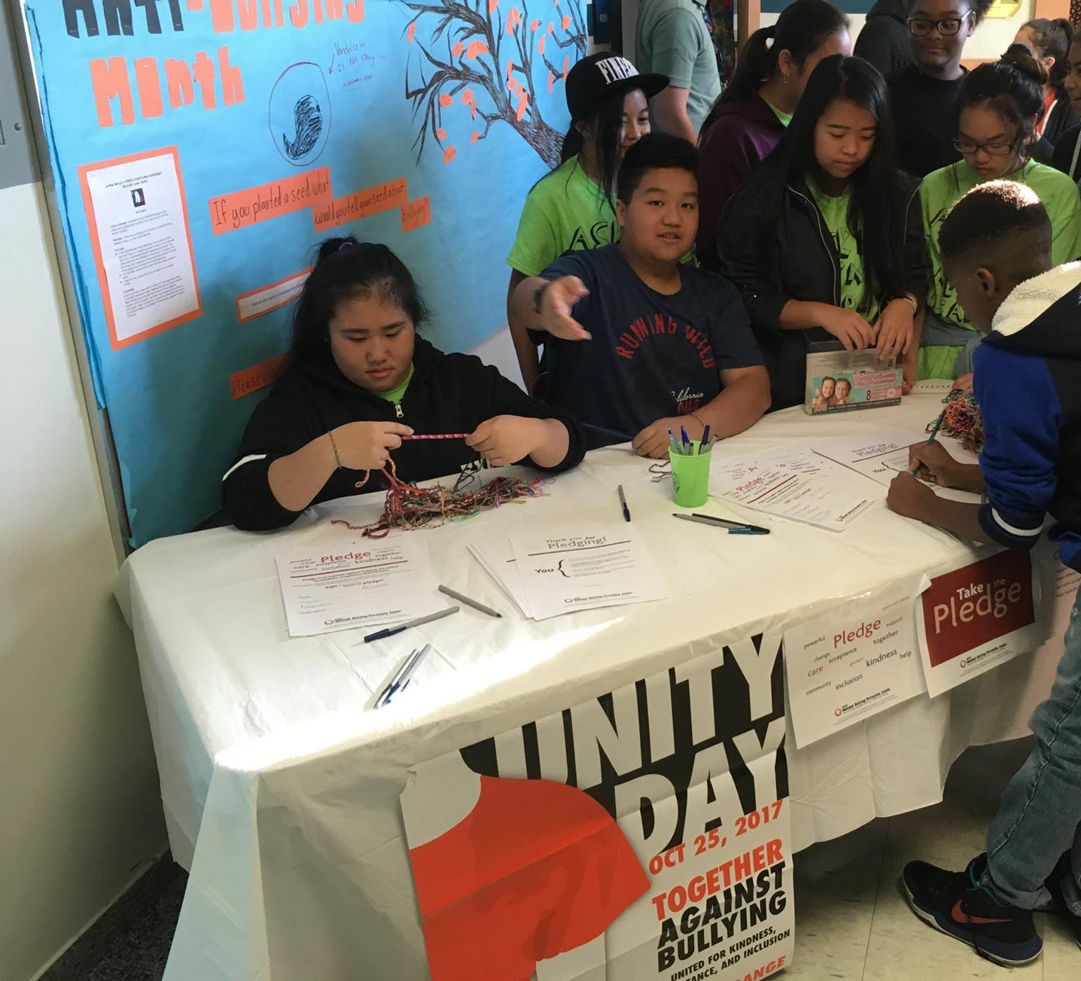
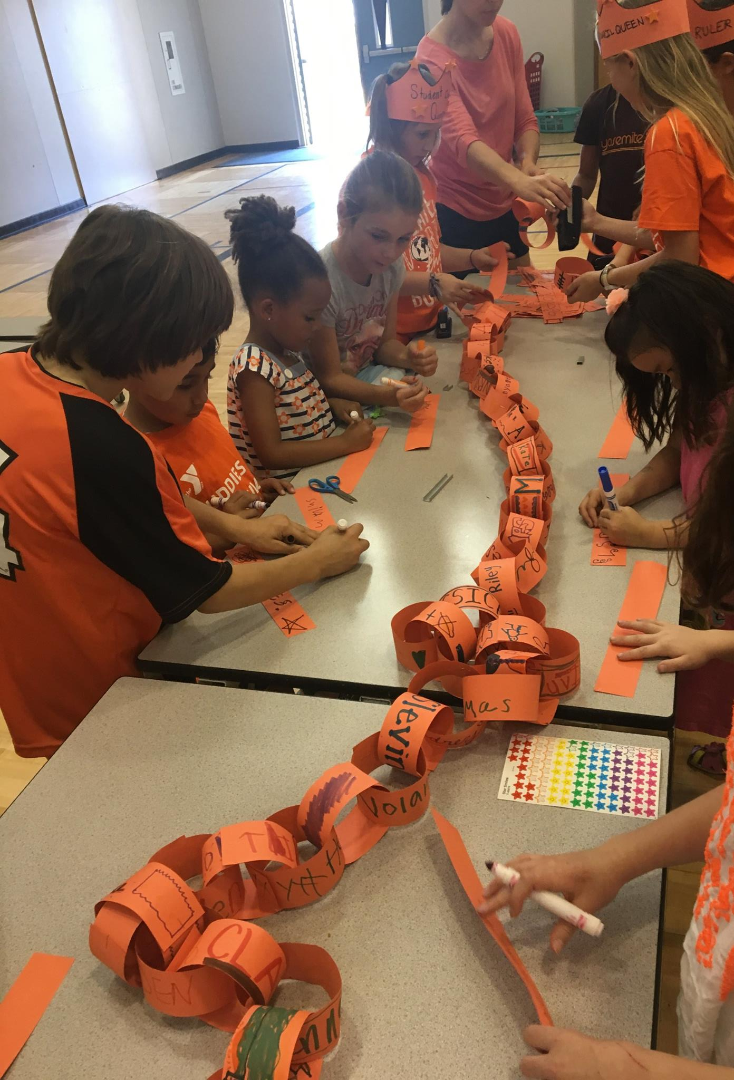
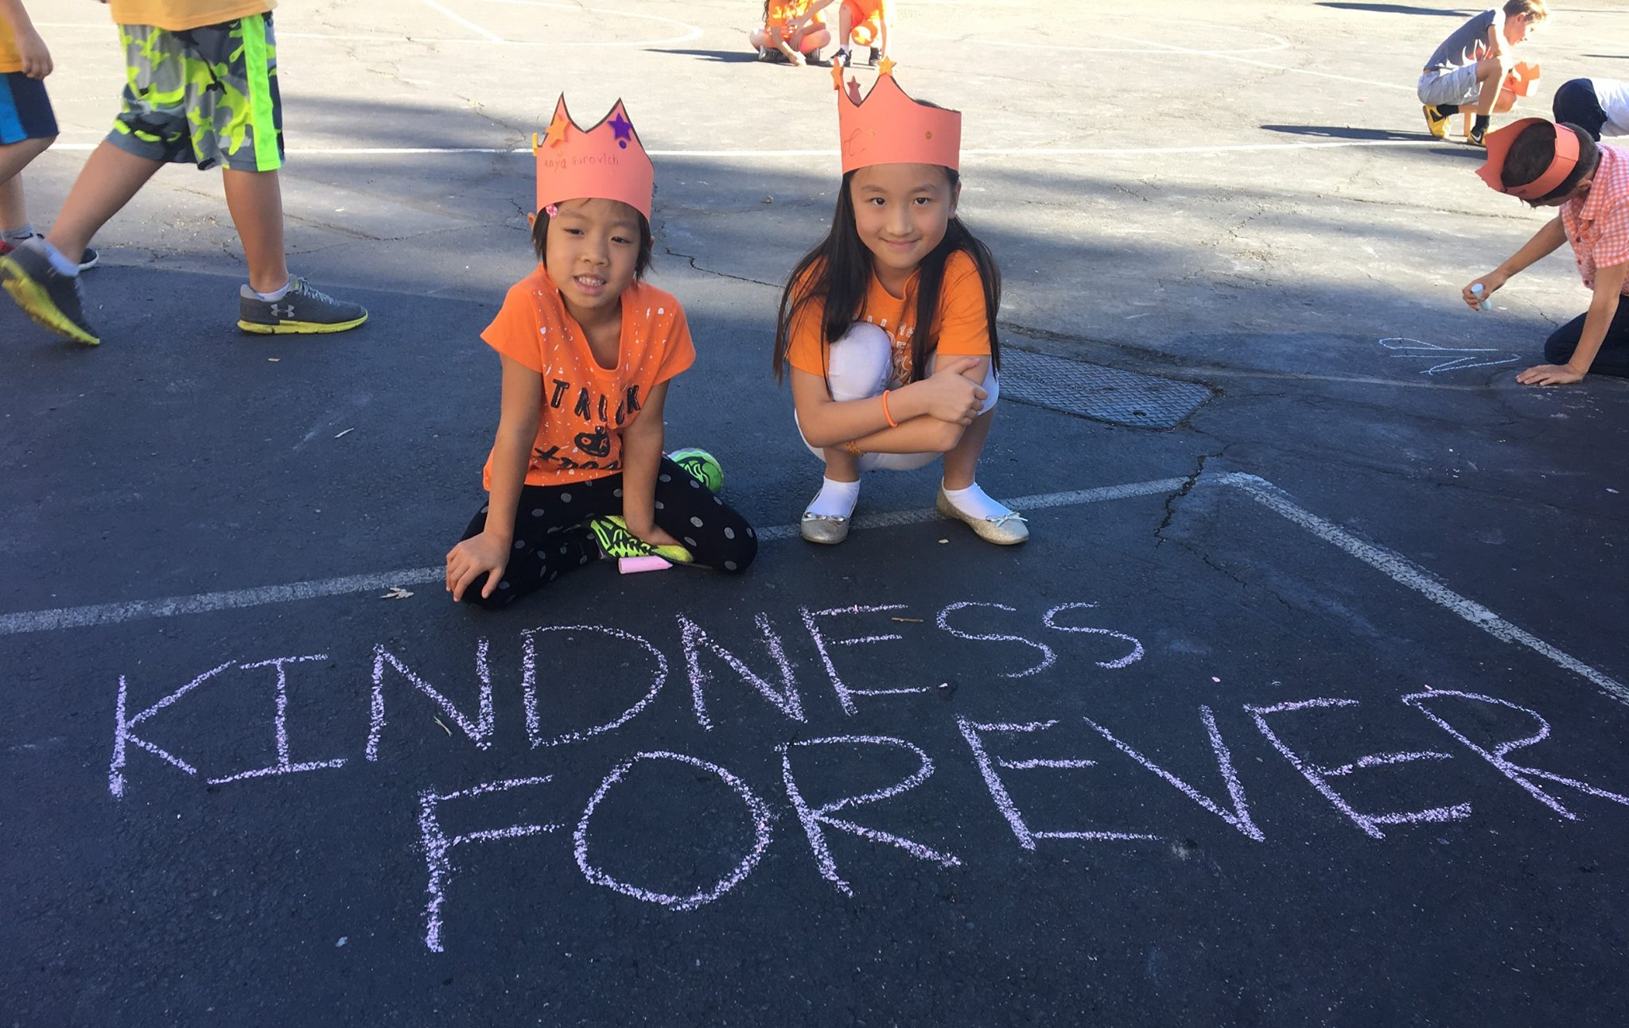
School Kindness Club

Slide 18
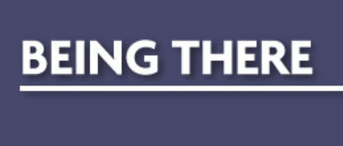
Themed Months

Slide 19
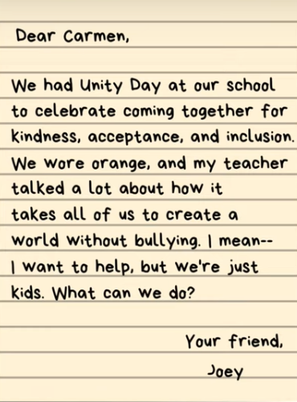
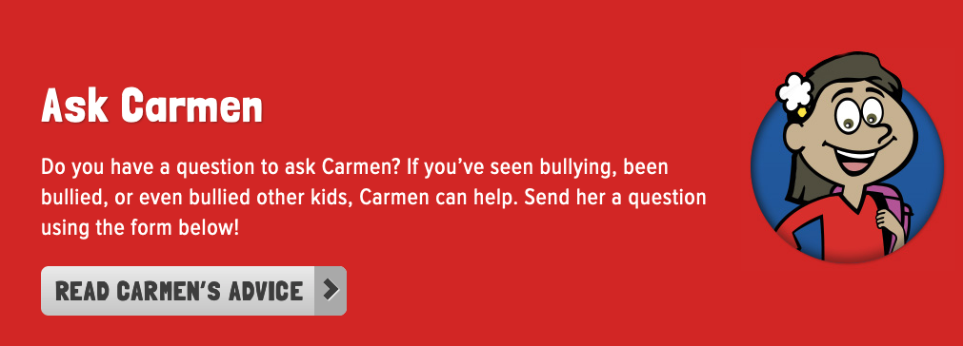
Student Advice Column

Slide 20
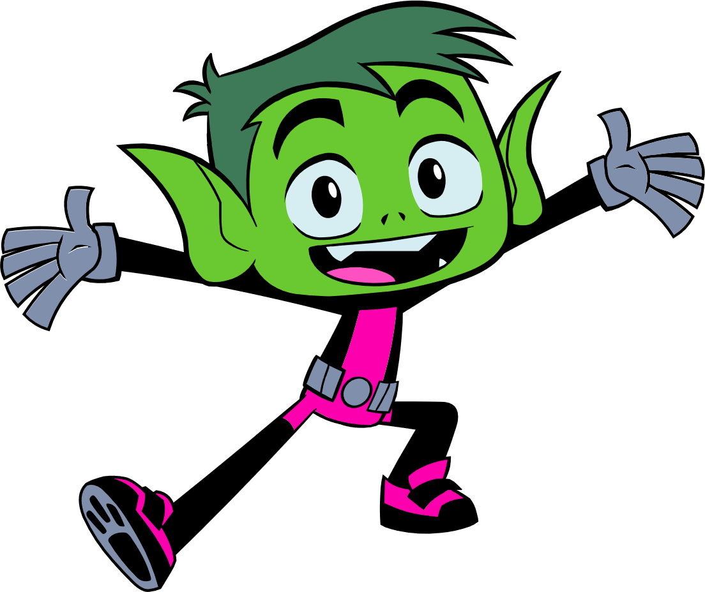
Reflection Questions
What other ideas do you have to prevent bullying at your school?

Slide 21
What To Expect Next Week
NEXT SESSION: Thursday, March 24th at 2:30 pm CST
REMINDERS:
We will be skipping next week for Spring Break
This webinar will be archived and posted at KidsTakeOnBullying.org + the PowerPoints!
We will be available for the next 15 – 20 minutes if you have any questions!

