Slide 1

Kids Take On Bullying
Webinar Series
Session 6

Slide 2


What will the webinar series include?
This is our final session! Thanks so much to everyone who has participated the last 6 weeks!
We will stay on for the last 15 minutes after the session to answer any questions!
Every session will still be available to watch, along with the PowerPoints at KidsTakeOnBullying.org

Slide 3
What will the webinar series include?
Share your thoughts
We’d love your feedback on this webinar series!
https://www.surveymonkey.com/r/KTOB_Eval
Link was also sent in email with this week’s zoom link + will send reminder out on Monday with the link again

Slide 4
Ice Breaker
What is one thing you learned during this webinar series?

Slide 5
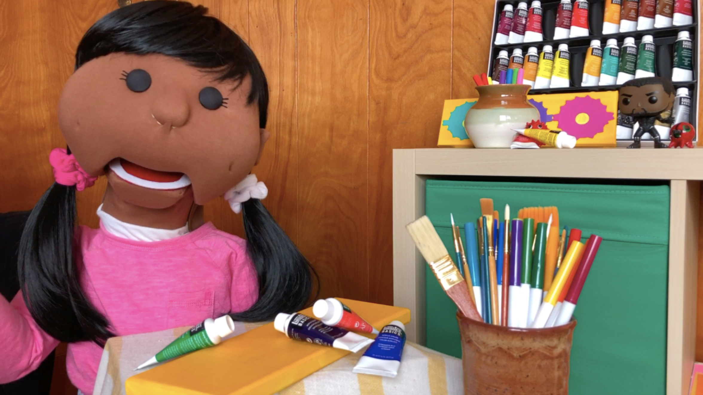
Exciting Guest This Week!
Please welcome Carmen!

Slide 6
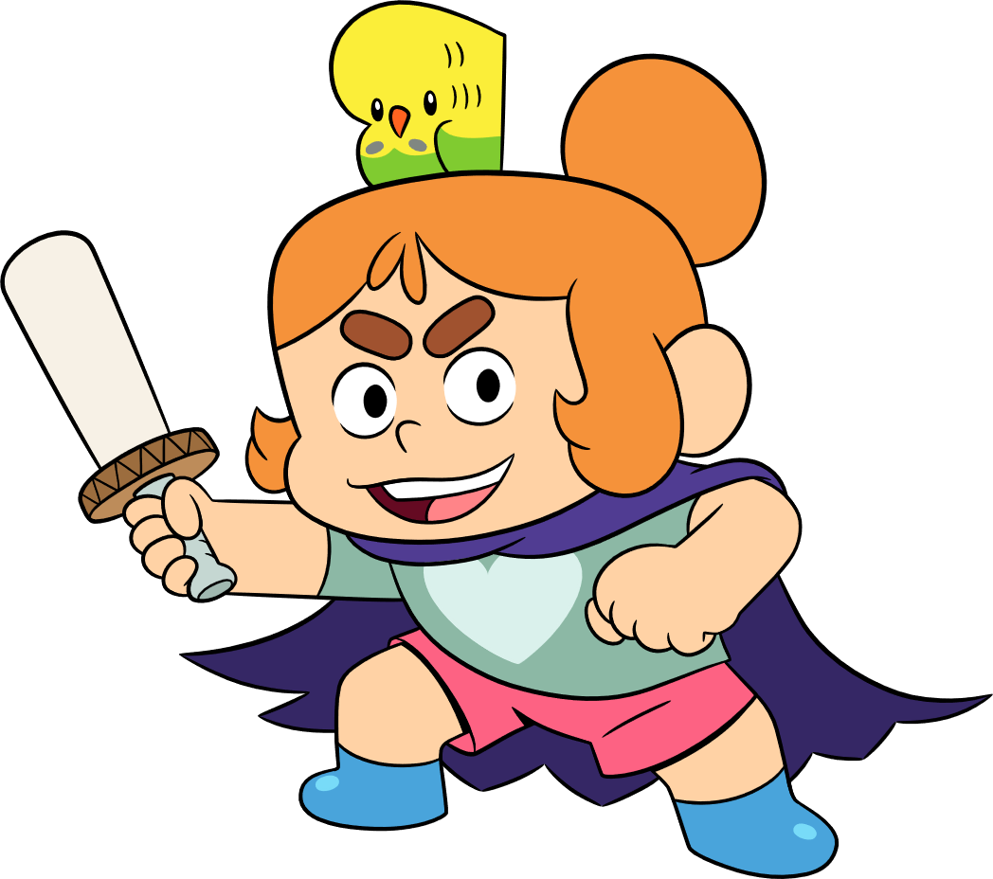
Final Polls!
What was your favorite thing about the webinar series?

Slide 7
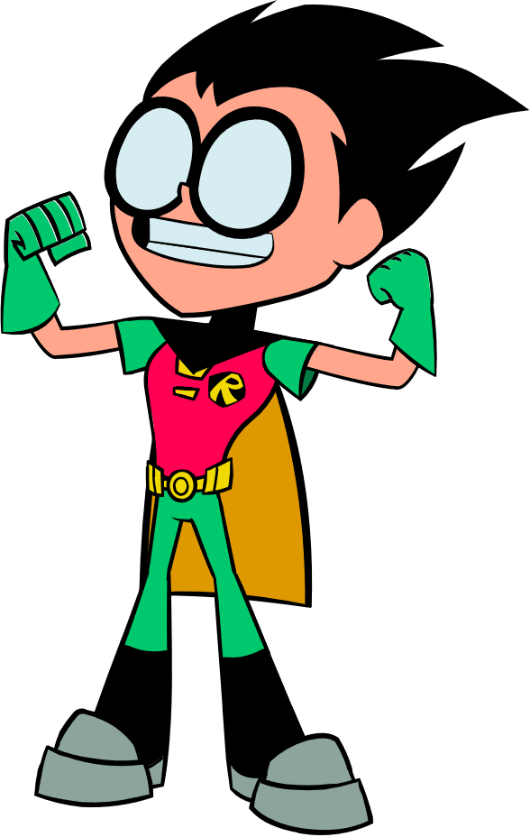
Final Polls!
Do you think kids can make a difference to prevent bullying?

Slide 8
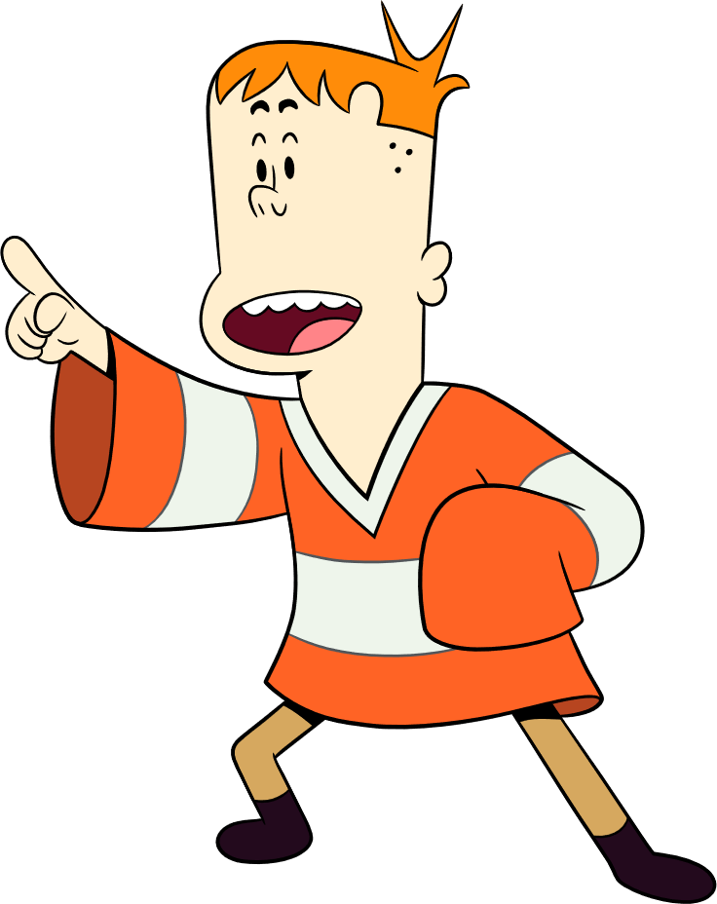
Final Polls!
Do
What is one way you want to take on bullying?

Slide 9
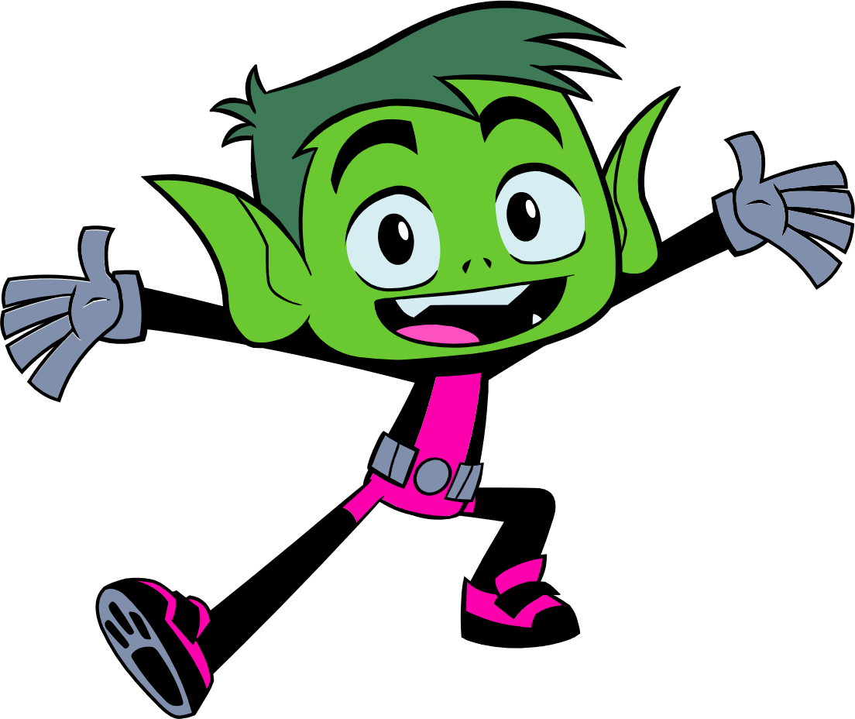
Reflection Questions
What is your amazing bullying prevention idea you’d like to try?

Slide 10
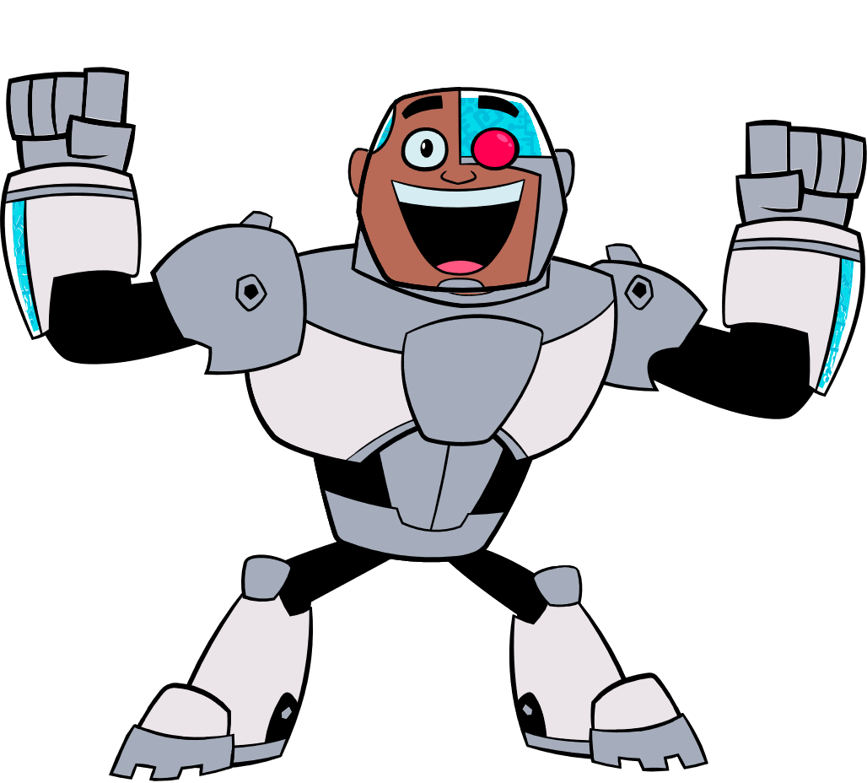
Thank you!!
Any questions? We are here to help with all your bullying prevention efforts!
Bailey.Huston@PACER.org

