Slide 1
Introduction to Assistive Technology (AT) for Young Learners
Training materials created by the Technology to Improve Kids’ Educational Success (TIKES) Project, a project of PACER Center: www.pacer.org/stc/tikes
Notes:
Slide 1: Title Page
Title slide

Slide 2
Intro to Assistive Technology (AT) for Young Learners Training materials created by PACER Center for Technology to Improve Kids’ Educational Success (TIKES) Project
Paula Goldberg, PACER Center Executive Director
Bridget Gilormini, Director Simon Technology Center
Notes:
Slide 2: Workshop Information
Presenter Notes:
Workshop presenters may wish to insert location, date, and name of presenters on this slide.

Slide 3
Federally Funded Early Childhood and Assistive Technology Grants
Education priority based on research that shows assistive technology is underutilized with children with disabilities ages birth to 5
One of three awarded in the country by Office of Special Education Programs OSEP U.S. Department of Education
You play an important role in equipping not only yourselves but future early intervention and early childhood providers and teachers across the U.S.
Notes:
Slide 3: About TIKES
Presenter Notes:
TIKES or Technology to Improve Kids’ Educational Success is one of three early childhood and assistive technology model demonstration grants awarded nationally. This education grant is based on a priority to improve outcomes for children with disabilities ages birth to 5 by leveraging the use of assistive technology to bridge developmental and achievement gaps. Research shows that assistive technology is underutilized and under documented for children with disabilities ages birth to 5. The majority of families do not learn about assistive technology from their teachers or providers but from other families. This grant is about developing a model of training materials to equip and support educators and families by increasing their knowledge and awareness of assistive technology and helping them identify appropriate technology solutions for their children or students.

Slide 4
PACER Center
An established parent center providing important information to parents and educators for more than 35 years
Over 30 different programs available
www.pacer.org
952-838-9000
Notes:
Slide 4: About PACER Center
Presenter Notes:
PACER Center is a parent center built on the premise of parents helping parents. For more than 35 years PACER Center has been helping families advocate for the educational rights of their children. PACER Center also works closely with schools and school districts, educators and providers to help them understand the parent perspective, provide valuable staff training resources and offer resources from over 30 different programs that include transition, bullying, juvenile justice, early childhood, state personal development grants, and many more.

Slide 5
Simon Technology Center
Celebrating over 27 years of assistive technology services and projects
Dedicated to making the benefits of technology more accessible
www.pacer.org/stc
952-838-9000
Notes:
Slide 5: About the Simon Technology Center
Presenter Notes:
For over 27 years, the knowledgeable staff of the Simon Technology Center have been making the benefits of assistive technology accessible to families, educators, and consumers. The STC does this through a variety of core services and assistive technology projects that include free assistive technology explorations with families and their children, information and referral services, workshops, and a vast AT lending library to support the exploration of assistive technology.

Slide 6
Session Agenda
What is assistive technology?
Continuum and categories of assistive technology
Hands-on with assistive technology
Notes:
Slide 6: Session Agenda
Presenter Notes:
“An Introduction to Assistive Technology for Young Learners” is a workshop designed to help educators and families learn about and use assistive technology to help young children develop, learn and grow.
Assistive technology is a broad category of specialized technology that helps learners of all ages do something that without this technology they could not do. For young learners, introducing assistive technology can be very powerful in helping them to participate in their daily routines and activities at home, at school, and in the community. Today we will be giving you an overview of assistive technology. We will talk about the continuum and categories of assistive technology. We’ll spend some time trying a variety of technology as we introduce each category. It is also important to know what the research says about assistive technology. We will share some articles you may be interested in reading and summarize some of the findings.

Slide 7
Session Agenda
What the research says about assistive technology
Closing thoughts, questions, and evaluations
Notes:
Slide 7: Session Agenda - continued
Presenter Notes: (Duplicate from Slide 6)
“An Introduction to Assistive Technology for Young Learners” is a workshop designed to help educators and families learn about and use assistive technology to help young children develop, learn and grow.
Assistive technology is a broad category of specialized technology that helps learners of all ages do something that without this technology they could not do. For young learners, introducing assistive technology can be very powerful in helping them to participate in their daily routines and activities at home, at school, and in the community. Today we will be giving you an overview of assistive technology. We will talk about the continuum and categories of assistive technology. We’ll spend some time trying a variety of technology as we introduce each category. It is also important to know what the research says about assistive technology. We will share some articles you may be interested in reading and summarize some of the findings.

Slide 8
What is Assistive Technology (AT)?
Any item, piece of equipment, or product system, whether acquired commercially off the shelf, modified, or customized, that is used to increase, maintain, or improve functional capabilities of a child with a disability.
–IDEA 2004
Notes:
Slide 8: What is Assistive Technology (AT)?
Presenter Notes:
Assistive technology devices and services were first defined in federal law in the Individuals with Disabilities Education Act of 1990. These definitions remained unchanged until 2004 with the passage of the Individuals with Disabilities Education Improvement Act when the definition of an assistive technology device was added to clarify what a school system’s responsibility is regarding surgically implanted technology such as cochlear implants.
Related Activity or Questions:
How does this definition challenge or confirm participants’ ideas about assistive technology?
Based on this definition, do participants’ feel that they are active users of assistive technology?

Slide 9
OSEP Part C Clarification Letter
“AT must serve a developmental purpose” by supporting the child’s ability to participate in everyday activities.”
Notes:
Slide 9: OSEP Part C Clarification Letter
Presenter Notes:
All children develop within the context of everyday activities which are the primary source of learning opportunities for a child. There are five developmental domains to consider: Physical, social-emotional, language, cognitive, and adaptive. These developmental areas are inter-related, overlapping, predictable, uneven, and unique for every child. Participation is critical to a child’s development and in the context of routines provides both planned and unplanned learning opportunities, and allows for a child to practice functional skills. Everyday routines have many contexts and occur in the home or community, at mealtime or outside play, and at birthday parties and dance class.

Slide 10
Keep in Mind That…
AT for infants and toddlers looks different than AT for students and adults
AT for infants and toddlers is used to support a child’s development
Many changes occur as young children grow which requires dynamic use of AT
Notes:
Slide 10: Keep in Mind That…
Presenter Notes:
AT for infants and toddlers looks different than AT for students and adults; AT for infants and toddlers is used to support a child’s development.
There are many changes as young children grow which requires dynamic use of AT

Slide 11
Why Use AT?
Assistive technology helps children ages birth to 5 with disabilities participate in everyday activities in order to grow and learn
Notes:
Slide 11: Why Use AT?
Presenter Notes:
The purpose of assistive technology is to create opportunities for children. All children need interactions that will allow them to grow and change. Assistive technology needs to be built into the daily routines and activities of the child. It is only through these interactions that children may reach their full potential with the help of assistive technology.
Related Activity or Questions:
Ask each participant to think of their own child or a particular student with a disability. Have them write down three opportunities they would like this child to have. Ask them to keep this child and the opportunities in mind throughout the workshop.

Slide 12
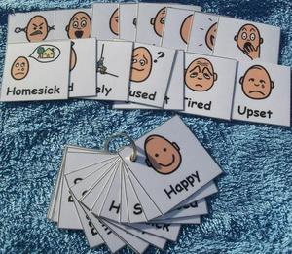
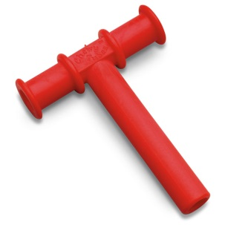
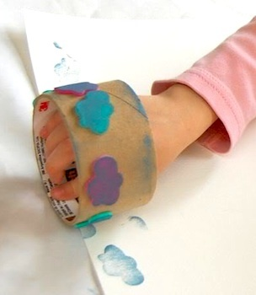
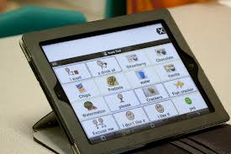
What Are the Benefits of AT?
Enhance communication
Increase independence
Broaden life opportunities
Notes:
Slide 12: What are the benefits of AT?
Presenter Notes:
AT creates opportunities for children to communicate and participate in a way that would not be possible without the use of assistive technology. It increases their ability to do it themselves and empowers children to experience all of life’s opportunities.

Slide 13
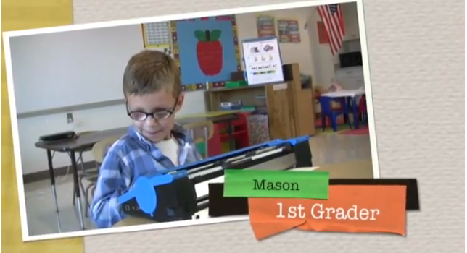
What Are the Benefits of AT?
Increase participation
Promote development
Enhance learning
Boost self-esteem
Meet Mason
Notes:
Slide 13: What are the benefits of AT? (cont.)
Presenter Notes:
Assistive technology helps children build new skills or use the ones they already have. It also allows children to be an active part of their family, classroom, and community. It can increase their participation in activities, promote their development, enhance their learning, and boost their self-esteem.
Related Activity or Question:
Let’s look at one example of AT in Action. Meet Mason, a young learner who has and continues to use assistive technology to help him learn, grow, and develop.
Meet Mason YouTube Video Link: http://www.youtube.com/watch?v=IcUNnnwFm4g

Slide 14
True or False?
There are prerequisite skills that a child must have before using AT, including the understanding of cause and effect.
☐ True
☐ False
Notes:
Slide 14: True or False
Presenter Notes:
True or False? Do you think that children must have a set of prerequisites before introducing assistive technology?
False. It is a myth that children must already possess certain skills before they can use or benefit from assistive technology. The truth is that all children can use and benefit from assistive technology.
Related Activity or Questions:
Ask the participants to think about a child again. Discuss what skills this child has and what skills they believe the child might need before using AT.

Slide 15
No Prerequisites
There are no prerequisites for using AT.
(Dugan, et al., 2006; Wilcox, et al., 2006; Wilcox, et al., 2006)
Notes:
Slide 15: No Prerequisites
Presenter Notes:
Because it is important lets say it again. There are NO prerequisites for using AT. Even infants can grow, learn, and increase family and community participation with the use of AT.

Slide 16
True or False?
Assistive technology can hinder development.
☐ True
☐ False
Notes:
Slide 16: True or False
Presenter Notes:
True or False? Can assistive technology hinder the development of children?
False. It is a myth that AT will inhibit development in children. The research actually shows the opposite.

Slide 17
Research
Research supports that in even a short amount of time, the introduction of assistive technology can make a large difference.
Notes:
Slide 17: Research
Presenter Notes:
Research supports that even in a short amount of time the introduction of assistive technology can make a big difference.

Slide 18
Research
Data suggests that the use of AT can significantly improve outcomes for infants and toddlers and improve both socio-emotional and pre-academic skills.
(Campbell, et al., 2006; Dugan, et al., 2006; Moody, 2012; Wilcox, et al., 2006)
Notes:
Slide 18: Research
Presenter Notes:
With the use of AT, children can build new academic, social, and emotional skills, often at a rate that is much faster and more effective than building those skills without the use of AT.
Related Activity or Questions:
Ask participants to think about and discuss a tool they have used in the past to help them master a task or skill.
How does this experience relate to a child using AT?

Slide 19
The Assistive Technology Continuum
Without Any Medium Technology
Technology Relatively Complicated
Simple Modifications Mechanical Devices
Low Technology High Technology
Less Sophisticated Very Advanced
Affordable Tools Incorporate Computers
Notes:
Slide 19: The Assistive Technology Continuum
Presenter Notes:
When individuals talk about AT, devices and systems are put on a continuum ranging from no technology to high technology. On one end of the continuum there are simple non-electronic devices. Looking higher up on the continuum, things become more complicated, have more moving parts, have batteries and wires, and generally can be more costly. It is also important to remember that low tech is not better than high tech and high tech is not better than low tech. It is about matching the right technology with the needs of the child. It is also likely that a child will benefit from an array of technology across the continuum depending on what their needs are.
Related Activity or Questions:
Give each table or group of participants a bag with four to eight assistive technology items and give them 10 minutes to explore and discuss their items within the smaller group. Give each group a different selection of assistive technology tools.

Slide 20
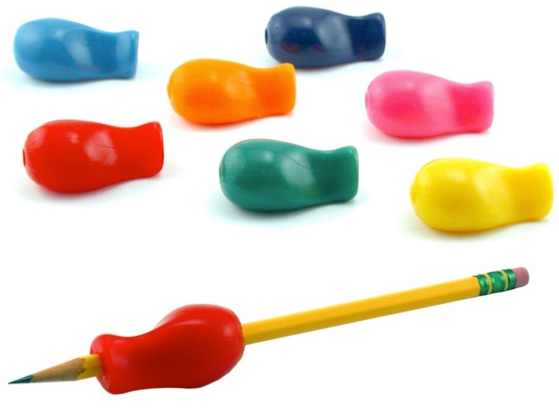
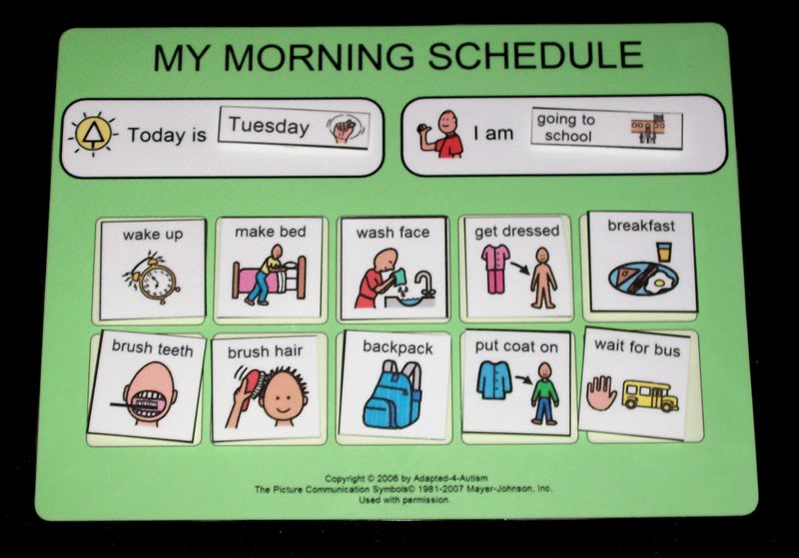
The Assistive Technology Continuum
Without Any Technology
Simple Modifications
Notes:
Slide 20: The Assistive Technology Continuum – Without Any Technology
Presenter Notes:
AT Items without any technology components are very simple adaptations that have no working parts. They include things like pencil grips or visual supports. Pencil grips come in an array of materials, shapes, and weights and are meant to help the child improve their grasp of the writing tool such as a pencil or a crayon. Visual supports are used to support learning and understanding. They consist of objects, pictures, gestures, etc. Some recognizable examples include morning schedule, social stories, reward charts, behavior charts, and much more.
Related Activity or Questions:
Ask the small groups to identify their items without any technology components. Have them report to the group about what the item is (or what they guess it is) and how it might be helpful to a young child.

Slide 21
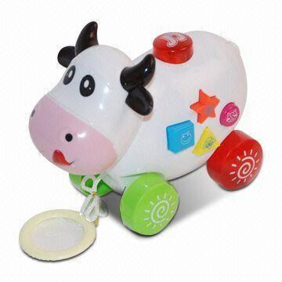
The Assistive Technology Continuum
Low Technology
Less Sophisticated
Affordable Tools
Notes:
Slide 21: The Assistive Technology Continuum – Low Technology
Presenter Notes:
Low tech items are items that have simple parts and batteries. Components are simple and easy to operate. They include things like toys with lights, vibrations, and textures that you can purchase at a toy store.
Related Activity or Questions:
Ask the small groups to identify their low technology item(s). Have them report to the group about what the item is (or what they guess it is) and how it might be helpful to young a child.

Slide 22
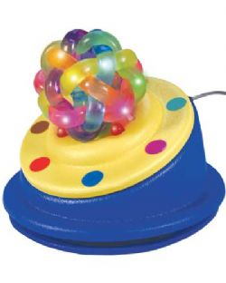
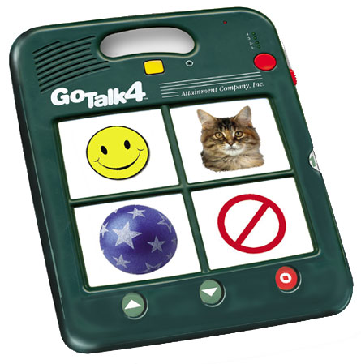
The Assistive Technology Continuum
Medium Technology
Relatively Complicated
Mechanical Devices
Notes:
Slide 22: The Assistive Technology Continuum – Medium Technology
Presenter Notes:
Medium technology items are becoming more sophisticated. They have more moving parts and may take some time to learn and implement. They include things like switches used to activate a toy and communication devices programmed by an adult to provide a voice to a child who has limited or no speech.
Related Activity or Questions:
Ask the small groups to identify their medium technology item(s). Have them report to the group about what the item is (or what they guess it is) and how it might be helpful to a young child.

Slide 23
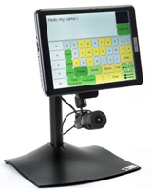
The Assistive Technology Continuum
High Technology
Very Advanced
Incorporate Computers
Notes:
Slide 23: The Assistive Technology Continuum – High Technology
Presenter Notes:
High tech AT consists of devices that have complex electronic components and moving parts. They include things like computers and high tech communication devices with a feature called dynamic display.
Related Activity or Questions:
Ask the small groups to identify their high technology item(s). Have them report to the group about what the item is (or what they guess it is) and how it might be helpful to a young child.

Slide 24
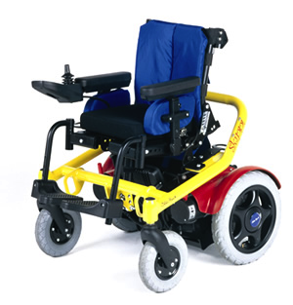
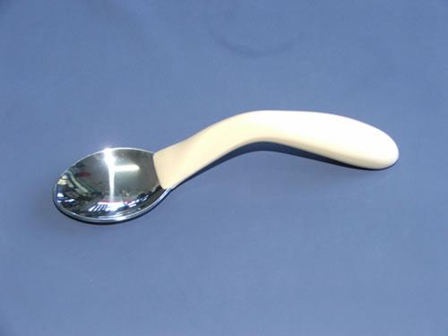
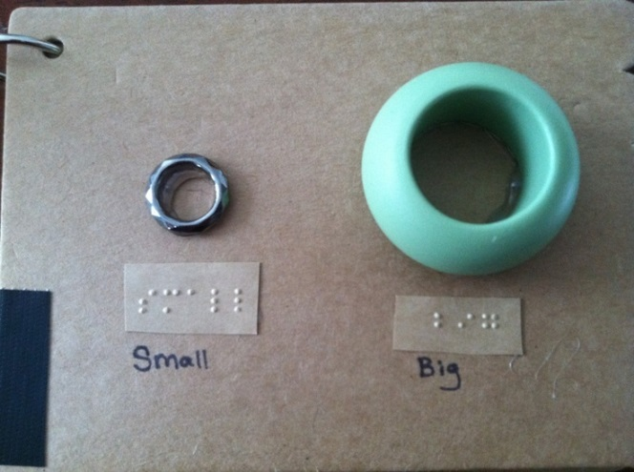
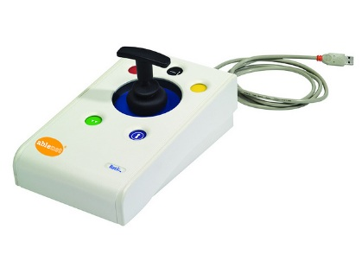
Categories of Assistive Technology
Aids to daily living
Mobility and positioning
Vision and hearing
Computer access
Notes:
Slide 24: Categories of Assistive Technology
Presenter Notes:
We also put AT into broad categories to make it easier to talk about. The next two slides list all of the categories traditionally used to talk about assistive technology. In the upcoming slides, each category will be defined and examples of items that fall into each category provided. There is some crossover between categories, but you will find that most AT devices fit well within these areas.
Aids to daily living provide support in daily routines and activities such as eating, bathing, sleeping, etc. Pictured here is a spoon designed with a handle that makes it easier to grip.
Mobility and positioning is a category that is designed to help people with physical disabilities get around and be in the proper position to participate in daily routines and activities. Pictured here is a power mobility device.
The category of vision and hearing addresses tools that help people with the range of vision and hearing disabilities, including blindness and deafness. Pictured here is an example of braille labeling.
The category of computer access consists of tools that help someone overcome the barrier that having a disability presents and provides access to a computer or tablet device. Pictured here is a joystick mouse which allows the user to access the pointer on the computer, move it across the screen, and make selections as someone else might use a traditional computer mouse.
The above descriptions talk about the pictures layered and embedded within the PowerPoint that will be shown during the electronic presentation of this slide.

Slide 25
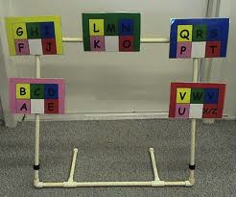
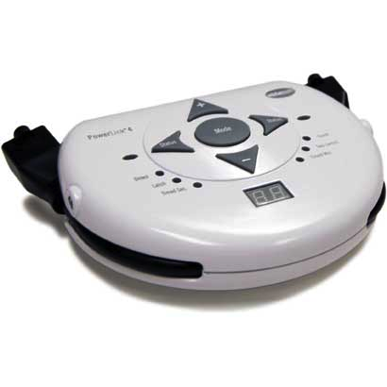
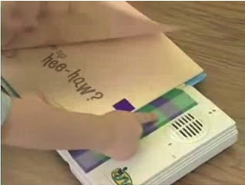
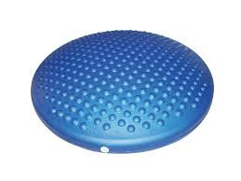
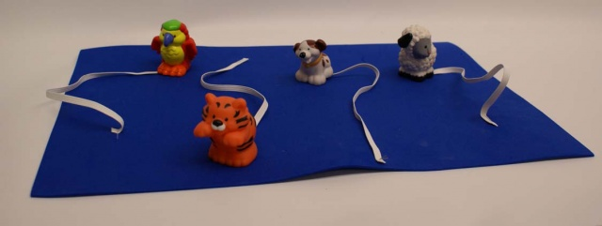
Categories of Assistive Technology
Education
Communication
Recreation
Sensory aids
Environmental control
Notes:
Slide 25: Categories of Assistive Technology (cont.)
Presenter Notes:
Assistive technology for education helps children with educational goals such as reading and writing. Pictured here is the Bookworm a device by AbleNet designed to help give a child independent access to reading, shared reading, etc. Individual pages of the book can be recorded and then accessed by the child with the push of a button or switch.
Assistive technology for communication helps children find and use their “voice.” It is appropriate for children with little or no speech or unintelligible speech. Pictured here is an eye gaze system where letters are used to form words.
Recreation is an important part of life so we have assistive technology that helps us access recreation activities. This includes games, toys, sports, etc. Pictured here are small manipulatives tethered to a piece of felt.
Assistive technology for sensory aids provides children either with needed sensory input or a calming effect when there has been too much sensory input. Pictured here is a disco sit. The bumps on this round disc provide sensory input to a child who is sitting in a chair or on the floor which may help them focus and pay attention during a routine or activity.
Environmental controls help give children access to a wide variety of home and school tools such as a blender, radio, TV, etc. Pictured here is the Power Link which allows the user to control things that plug in.
The above descriptions talk about the pictures layered and embedded within the PowerPoint that will be shown during the electronic presentation of this slide.

Slide 26
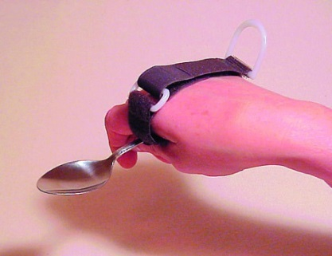
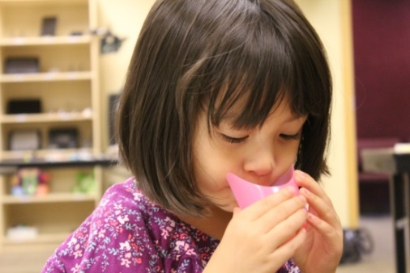
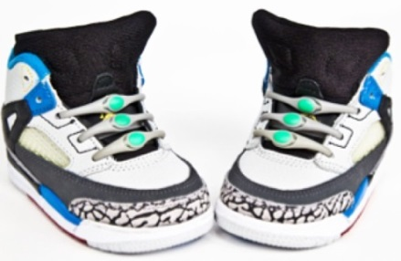
Aids for Daily Living
Feeding and eating aids
Dressing and grooming aids
Bathing and toileting aids
Executive function aids
Sleeping aids
Fine motor development aids
Notes:
Slide 26: Aids for Daily Living
Presenter Notes:
First we will talk about assistive technology for daily living. This category includes items that assist in self-care and daily living. Items such as dressing aids, adapted feeding tools, and AT for personal hygiene fall into this area.
Pictured here is a utensil cuff designed to be used by a child with limited functionality of the hands to improve their ability to grasp and use forks and spoons. It can be used with handles of many sizes and shapes.
Next we have a nosey cup which is a standard type cup with a cut out for the nose to allow drinking without bending the neck or tilting the head. Some nosey cups also come with handles.
For our last example we have elastic shoelaces. The elastic shoelaces allow a child to put on their shoe and get a snug fit without having to be able to tie their shoes.
The above descriptions talk about the pictures that will be shown during the electronic presentation of this slide.

Slide 27
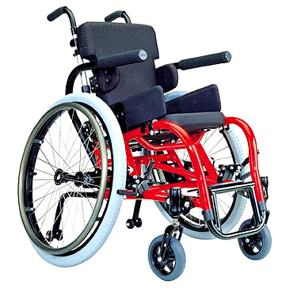
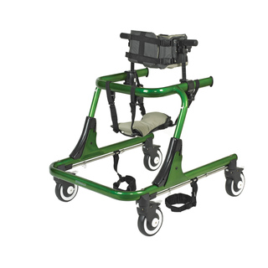
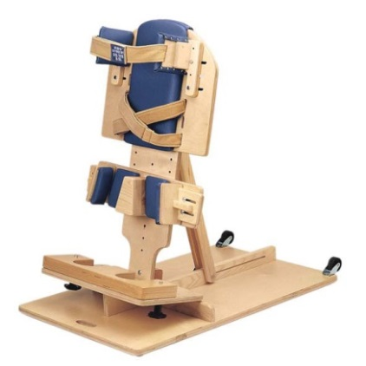
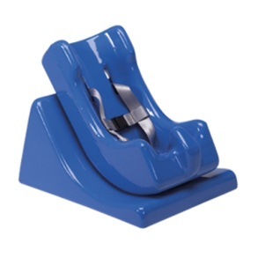
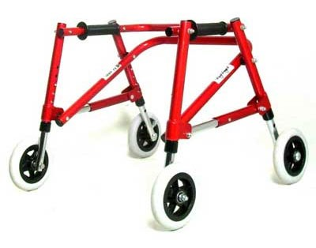
Mobility and Positioning
Wheelchair
Gait trainer
Walker
Positioning aids
Stander
Notes:
Slide 27: Mobility and Positioning
Presenter Notes:
Mobility and positioning is a category that people are most familiar with today. This category includes devices that vary a great deal in complexity. There are very low tech items like a bean bag chair and devices as complex as a power wheelchair.
Wheelchairs come in many sizes and with a variety of technology capabilities. Wheelchairs are designed to improve mobility.
Gait trainers are designed for use by people of all ages who have a physical disability. It is a wheeled device that helps a person who is unable to walk independently to learn or relearn to walk safely and efficiently as part of gait training.
A walker is also designed to help with independent mobility and provide support.
Positioning forms are designed to help provide support for babies and toddlers who have low tone or difficulty maintaining a position.
Standers provide partial weight bearing support to help strengthen critical motor skills so a child can progress toward independent standing. They also provide alternate body positions for children with physical disabilities.
The above descriptions talk about the pictures layered and embedded within the PowerPoint that will be shown during the electronic presentation of this slide.

Slide 28
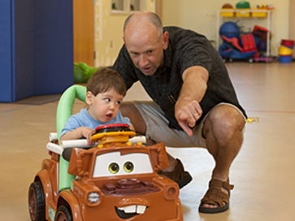
Go Baby Go: Video
Notes:
Slide 28: Go Baby Go
Presenter Notes:
For very young children there are few choices when it comes to mobility devices. Cole Galloway from the University of Delaware and a team of people are trying to change this by adapting readily available motorized cars designed for young children and modifying them for children with disabilities. Let’s look at this video about the possibilities of powered mobility for young children.
Link to YouTube Video: How One Man's Trip to Toys 'R' Us Brought Mobility to Hundreds of Kids With Disabilities - https://www.youtube.com/watch?v=U-NE7B0RTdA (4:48).

Slide 29
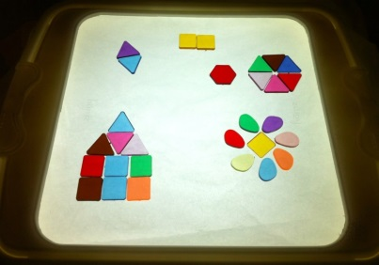
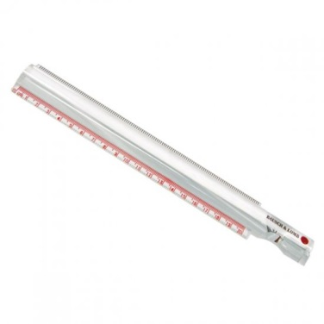
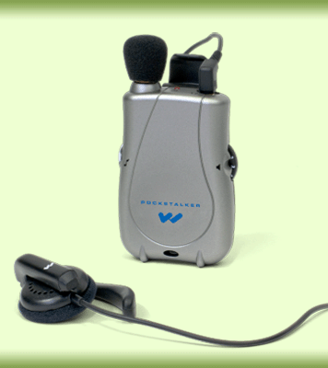
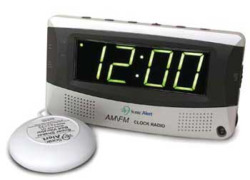
Vision and Hearing
Lighted visual display
Magnifiers
Braille display
Screen reader
Talking products
Digital book players
Alerting devices
Assisted listening devices
Notes:
Slide 29: Vision and Hearing
Presenter Notes:
Assistive technology for vision and hearing is also a category that people are familiar with today. However, it is a much bigger category than many realize. Audio books use technology to provide live or electronic narration of a book and are in this category, as well as large print text and vibrating phone alerts.
A light box is designed to help teach basic visual skills as well as more complex visual-motor and visual-perceptual skills. The high contrast background created by the light box’s illuminated surface makes a variety of visual tasks easier to perform. The goal is that using brightly colored items will motivate students to use their vision. There are many devices that help magnify what someone is looking at.
Pictured here is a magnifying bar designed to help magnify words and lines in printed material such as in a book or worksheet.
Screen readers (not pictured) are computer software that use a computer voice to read a variety of text or help someone with a visual impairment navigate the computer screen.
The personal sound amplifier helps someone with a hearing impairment hear important noise such as the teacher talking while minimizing potentially distracting background noise. The amplification of the teacher is better than the amplification of the noise.
The vibrating alarm clock provides an alternate alerting system to someone who cannot hear the clock’s auditory alarm.
The above descriptions talk about the pictures layered and embedded within the PowerPoint that will be shown during the electronic presentation of this slide.

Slide 30
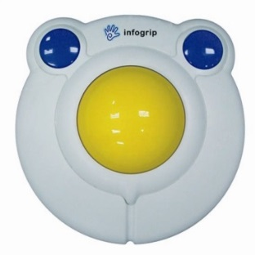
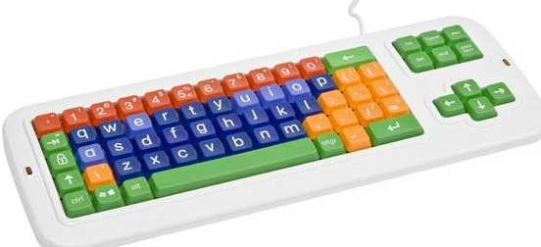
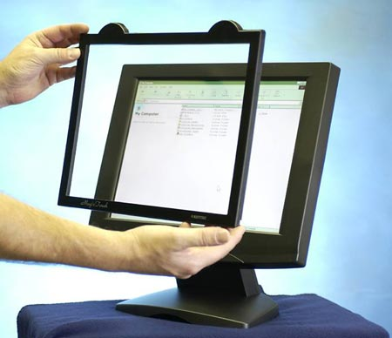
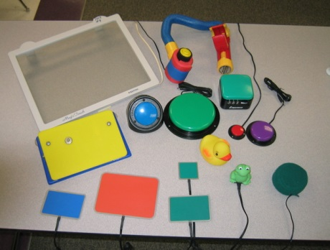
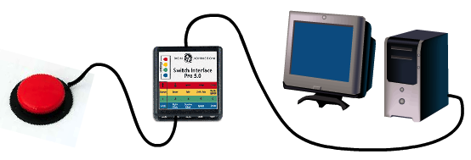
Computer Access
Alternative keyboards
Adapted mice
Guided computer interface and safety controls
Computer accessibility
Switches
Switch interface
Notes:
Slide 30: Computer Access
Presenter Notes:
Computer access is a category of technology that helps children use traditional technology like a computer. There are a wide range of access methods including a smaller size mouse, a joystick, or rollerball mouse. There are also more complicated scanning and switch systems that make computing accessible to a wide variety of users.
Alternative keyboards come in a variety of shapes, sizes, and configurations, including a plug and play keyboard that plugs in and works instantly, a programmable keyboard which gives more flexibility in creating layouts, and an onscreen keyboard pictured here is a small colorful QWERTY layout.
Trackballs and joysticks provide alternative ways of moving the mouse and interacting by clicking, selecting, and moving things.
The touch screen allows users to interact with the content on the computer by touching the screen. The finger essentially becomes the mouse, allowing you to select things, move things and much more.
When other options do not work, then we might look at a switch. Switches come in a wide range of sizes, touch sensitivity, and function.
Along with a switch, we need a switch interface which is a device that helps the computer understand what the switch is telling it to do.
The above descriptions talk about the pictures layered and embedded within the PowerPoint that will be shown during the electronic presentation of this slide.

Slide 31
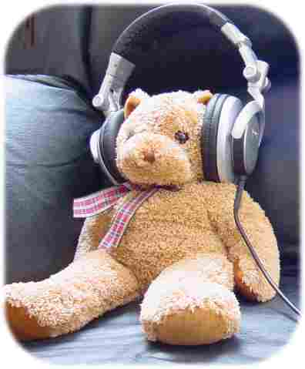
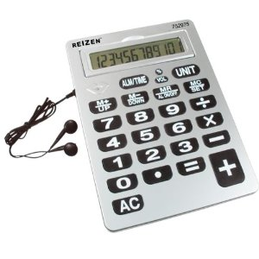
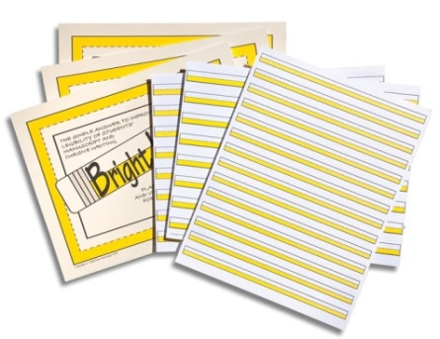
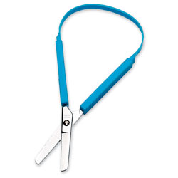
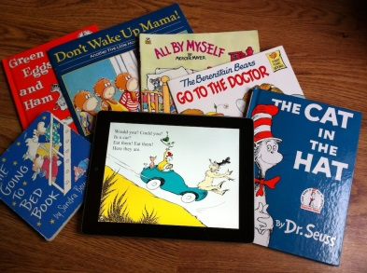
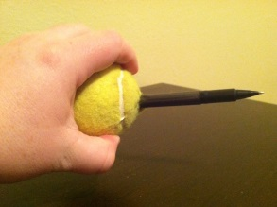
Education
Adapted books
Accessible books
Adapted paper
Adapted writing tools and grips
Writing positioning aids
Math manipulatives
Alternative calculators
Notes:
Slide 31: Education
Presenter Notes:
The education category is particularly important for young children and assists them in participating in classroom activities. It allows them to access instructional and play materials in novel ways and helps them build those priceless early skills that will be the base for their future learning success.
Electronic digital books often combine elements of print with audio, making them very interactive and engaging.
A talking calculator provides audio support for numbers and calculations. This one is also large for someone with vision or motor difficulty.
Adapted paper consists of tools such as raised line paper, different weights or thickness of paper, and more. Raised line paper provides a visual and tactile boundary of where writing should occur.
Audio books are live narrated books or books read with a computer voice.
Adapted writing grips help the user interact with a writing tool to write, color, and draw.
Adapted scissors provide support when cutting is difficult with traditional scissors.
The above descriptions talk about the pictures layered and embedded within the PowerPoint that will be shown during the electronic presentation of this slide.

Slide 32
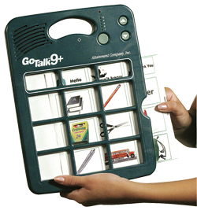
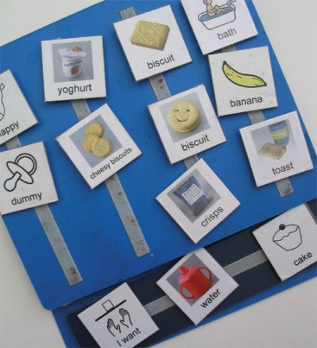
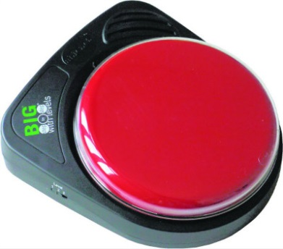
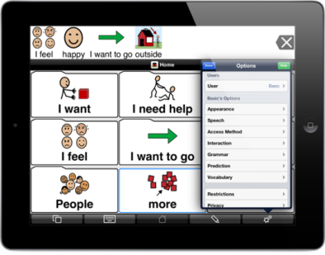
Communication
Picture symbols
Single message device
Mid-tech voice output device
High-tech voice output device
Notes:
Slide 32: Communication
Presenter Notes:
Communication is also a crucial category. Children who are able to communicate effectively are able to have their needs met, express thoughts and emotions, and build relationships with those around them. Assistive technology for communication can be as simple as a picture symbol and as complex as a dynamic display device. As previously mentioned, there are no prerequisites for introducing a tool to help increase speech and language skills. The pictures selected here represent the continuum of communication.
Picture communication uses symbols or picture representations to communicate a single concept. Here you see what might be called a PECS (Picture Exchange Communication System) book with a variety of symbols that the users search through to communicate their intent. The picture symbols include items commonly found in a user’s book (e.g., food, activities, rewards, etc.).
Moving up the continuum we have a single message device. This particular one is called a Big Mac. Typically a single message is programed on the device and placed near an activity or the user to support communication. A common first message might be, “I want more juice.”
Next we have a mid-tech device. There are approximately 32 “cells” containing a variety of words. A voice recording is made for each word or selection. The user directly selects them with a finger. If that is not possible, the user can activate a switch or get help from a communication partner which is often a parent, a sibling, or a teacher.
Highest on the continuum are sophisticated devices with many features. Pictured here is an iPad with the communication app Proloquo2Go. These more sophisticated, complex devices often come pre-loaded with a wide range of vocabulary and function and can be customized by the parent or teacher for the individual user.
It is important to understand the language system of the many devices available when choosing a device for a user.
The above descriptions talk about the pictures layered and embedded within the PowerPoint that will be shown during the electronic presentation of this slide.

Slide 33
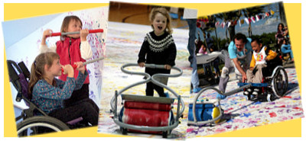
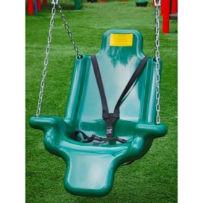
Recreation
Adapted arts and crafts
Adapted sports equipment
Adapted toys
Adapted play
Notes:
Slide 33: Recreation
Presenter Notes:
Play is essential to early childhood development. It is through play that children learn to interact with their physical and social worlds. Assistive technology can improve a child’s ability to learn through both structured play and free play, and helps build peer relationships.
Adapted art tools like these special paint brushes provide a different kind of grip that makes it easier to use and manipulate to create art.
Adapted bikes give children the opportunity to pedal and participate in an activity common to many children.
Adapted toys allow children to control something with a switch, with sound, and engage in an activity that brings them learning and socialization opportunities. It also brings them joy!
Adapted swings provide a safe, supportive environment to give children the opportunity to engage in another common play activity.
Adapted games give players of all abilities access to the same games and play opportunities.
The above descriptions talk about the pictures layered and embedded within the PowerPoint that will be shown during the electronic presentation of this slide.

Slide 34
Sensory Aids
Tactile toys and fidgets
Auditory stimulation
Deep pressure and weighted items
Choice board with calming choices
Notes:
Slide 34: Sensory Aids
Presenter Notes:
Many people are surprised by the category of sensory aids. Yet this category is truly as important as all of the others. Children who are receiving too much or too little sensory input are not able to focus on pre-academic or social skills. Sensory AT helps children focus on these skills by giving them extra sensory input. It can also be a way of providing a calming strategy in response to an overload of sensory input.
Tactile toys and fidgets provide little fingers and hands something to do. They can help the user pay attention and fidget in an appropriate manner.
Noise cancelling headphones help block out sound when noise is too much sensory input for the child. It helps children participate in activities that they may not have been able to because of the noise.
Weighted vests provide sensory input at the vestibular system, helping to calm and regulate the sensory nervous system.
Calming choice boards help the child learn about and understand their bodies and how they operate, and how to make choices to regulate their sensory system.
The above descriptions talk about the pictures layered and embedded within the PowerPoint that will be shown during the electronic presentation of this slide.

Slide 35
Environmental Controls
Control access:
Direct, voice, switch, remote, and eye gaze
Wired and wireless
Automated controls
Mobile device controls
Notes:
Slide 35: Environmental Controls
Presenter Notes:
Environmental controls allow the user to participate in and impact their environment. It can include using a remote control to turn a bedroom light on and a switch to turn a television on and off.
Pictured here we have a switch and switch interface being used to control music on an iPod or iPhone. The device is being held by a suction cup table mount.
Next we have a device called the Wemo which uses an app to interface with the device and control things that you plug into the device such as a lamp.
The above descriptions talk about the pictures that will be shown during the electronic presentation of this slide.
Related Activity or Questions:
Ask participants to categorize the items from their bag of assistive technology. Discuss as a large group any item that does not fit neatly into one category. Discuss how many assistive technology tools can achieve multiple goals in multiple categories.
Have the participants seen or discussed any familiar objects or devices during this conversation that they did not previously view as assistive technology?
Do the categories expand their view of assistive technology or how assistive technology is used?

Slide 36
Hands-on with Assistive Technology
Notes:
Slide 36: Hands-on with Assistive Technology
Presenter Notes:
Now let’s take a look at some of the items we’ve been talking about. We have set up four stations with a variety of assistive technology for you to see, touch, and try.
(Gather a variety of assistive technology for participants to explore. Check with a local lending library such as the Simon Technology Center to get items you may not have)

Slide 37
Research
Strong research-based evidence demonstrates the positive effects of many types of assistive technology to use with children ages birth to 5
Particularly strong evidence supports the use of switches and visual supports
Notes:
Slide 37: Research
Presenter Notes:
New studies are being done and published in increasing numbers. The research that exists shows strong support for the use of assistive technology for all children, including infants and toddlers. Items ranging from low-tech to high-tech have all been found to be effective. The use of switches and visual supports have been studied a great deal and research suggests both of these are extremely effective.

Slide 38
Research
In a review of a number of studies done by Carl Dunst and others, a wide variety of assistive technology makes a noticeable difference in just a few sessions of use with children.
Systematic Review of Studies Promoting the Use of Assistive Technology Devices by Young Children with Disabilities. (Research Brief Volume 8, Number 1 2013)
Notes:
Slide 38: Research
Presenter Notes:
This slide references a synthesis of research done by Carl Dunst, Carol Trivette, Deborah Hamby, and Andrew Simkus called Systematic Review of Studies Promoting the Use of Assistive Technology Devices by Young Children with Disabilities. (Research Brief Volume 8, Number 1 2013)
Related Activity or Questions:
Ask participants to share anecdotal stories about the positive effects of AT in the life of a child they know.
Are there particular items that you have seen great success with?
Are there items you or the children you work with have struggled with using?
If you have struggled with using items, what was the problem?
Was the problem with the assistive technology or the way it was used?

Slide 39
Effective Use of Assistive Technology
AT needs to be:
Used on a consistent basis
Integrated into daily life
A part of daily activities and routines
Used as a tool to interact with others
Notes:
Slide 39: Effective Use of AT
To be effective, AT needs to become a part of the child’s daily routine and be consistent across all environments. AT use should also increase and even allow children to initiate participation.
We know AT makes a difference because of the stories the educators and families share with us. In one case, a young child came to the Simon Technology Center for an exploration of assistive technology. She was physically impaired but the specialist noticed she could move her toe. The team quickly set up a switch activated toy, which was a bear that sang, and she used her toe to operate it. Her mother shared that this was the first time her daughter had controlled anything in her life.
How precious are the words, “I love you” from a child to a parent – especially when a child who cannot verbalize those words finds a way to communicate them through technology? One child we know had difficulty with their communication skills and unlike other parents, this mom had yet to hear her child say those magical words. With the introduction of a simple 9-message communication device, the child activated a message telling her mom, “I love you.” It was a joyous moment for the mother.

Slide 40
Closing Thoughts
Remember the child is the focus; assistive technology is a tool to help the child.
Notes:
Slide 40: Closing Thoughts
Assistive technology devices can be powerful tools, but we need to be aware that they are tools. The child and the child’s needs are the most important part of the equation. Teachers and parents play a critical role in identifying those needs and identifying technology that might help.
Related Activity or Questions:
Ask participants to think back to the child they thought about in the first part of the presentation.
Did they see a piece of AT that might be appropriate for that child?
What about that child makes that piece of AT an appropriate choice?

Slide 41
Closing Thoughts
AT is a powerful tool that will improve learning and positive outcomes for children.
Notes:
Slide 41: Closing Thoughts
With the right device, assistive technology can be a powerful tool to improve outcomes for children and increase their opportunities for learning.
Related Activity or Questions:
Encourage participants to think first about the child then about the desired outcome. Remind them that this is an introduction and that as they move forward in the workshop series, they will learn more about AT devices, how to implement the use of AT in the home and classroom, and most importantly, how to keep the child in mind when exploring AT.

Slide 42
Questions?
Notes:
Slide 42: Questions
Thank you for letting us share this very important topic with you. Please take a minute to complete the TIKES workshop evaluation. We appreciate your feedback and comments very much.

Slide 43
Additional References
Brennan, L. (2009). The impact of visual supports on the basic counting skills of students with Autism and typically developing preschool students. (Doctoral Dissertation). Retrieved from http://search.proquest.com/docview/304869540?accountid=26879. (304869540)
Campbell, P. H., Milbourne, S., Dugan, L. M., & Wilcox, M. J. (2006). A review of evidence on practices for teaching young children to use assistive technology devices. Topics in Early Childhood Special Education, 26(1), 3-13. doi: 10.1177/02711214060260010101
Notes:
Slide 43: Additional References

Slide 44
Contact Information
Technology Improves Kids Educational Success (TIKES) Project:
Pacer.org/stc/tikes
952-838-9000
The TIKES Project is funded by the Office of Special Education (OSEP)
TIKES is a project of
PACER Center
PACER.org | 952-838-9000 | 888-248-0822
Notes:
Slide 44: Contact Information
Presenter Notes:
For information about this or other training materials available through the TIKES project please contact them using the above contact information.

